Slide 1
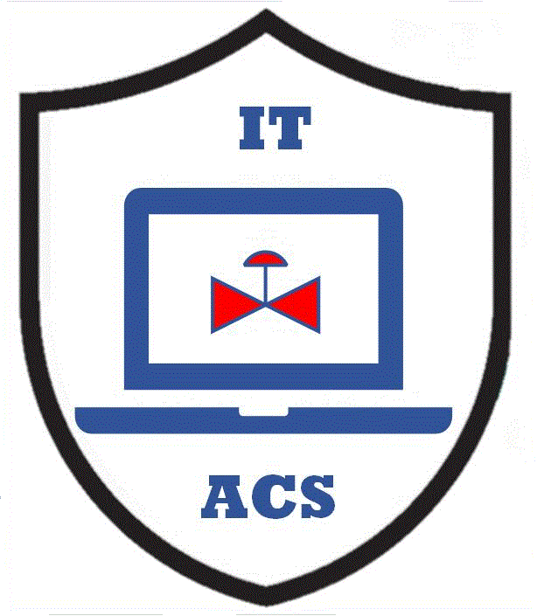


Structure of Information on PERA Website
MLM-002-A
Industry – All
Principal Role – All
Professional Role – All
Enterprise Phase – All
Turn on your audio and click start to begin video
Notes:
This MLM describes the structure of information on the PERA website, beginning with the basic PERA Master Planning Handbook and the Purdue reference Model For CIM.
The concepts described in these documents are then developed in more detail using User Guides for each industry
These User Guides are divided by Principal Role (e.g., Owner, Vendor, EPC, Service Provider, etc.).
Each User Guide (for that Industry and Principal Role) provides links to other PERA resources such as MLMs, Learning Maps and discussion papers.

Slide 2
Purdue Master Planning & Reference Model
PERA is designed to address Control and Information systems for all Enterprises, and ‘architecture Levels” from field sensors to the corporate board room.
It is based on two main documents that are used to produce “Deliverables” as below.
Handbook of Master Planning
- 330 Pages + Appendices
Reference Model for CIM
( Computer Integrated Manufacturing )
- 220 pages with Appendices
Enterprise
Master Plan
Physical
Facilities Architecture
Human
Org. & Architecture
Control & Info Systems Architecture
Program
Master Plan
Facilities Designs & Operating Practices
Org. Charts, Professional Roles & Training
Control & Info Systems & Network Designs
Project
Master Plan
Project
Master Plan
Notes:
PERA is a GERAM (General Enterprise Reference Architecture and Methodology). It is designed to address Control and Information systems for:
All Enterprises
During all of its lifecycle phases, and
All “architecture Levels” from field sensors to the corporate board room.
PERA is based on two main documents that are used to produce “Deliverables” (shown in white). The Handbook of Master Planning is used to prepare Master Plans for Enterprises, Programs, or Projects, and the Reference Model for CIM produces Facility Designs, Org. Charts, and System Designs.
.
PERA provides a classification system for industrial facilities based on common characteristics of Enterprise production facilities.

Slide 3
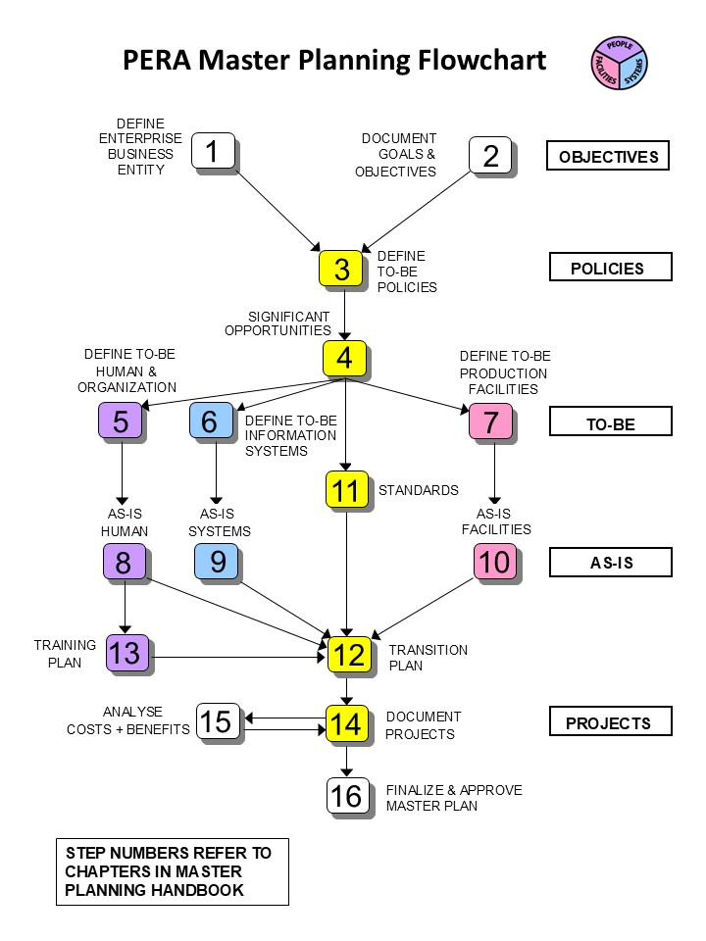
PERA Handbook of Master Planning
MAY BE USED TO PRODUCE
ENTERPRISE, PROGRAM, OR PROJECT PLANS
USING
STEP-BY-STEP MASTER PLANNING PROCESS
Handbook of Master Planning
- 330 Pages + Appendices
Enterprise
Master Plan
Program
Master Plan
Project
Master Plan
Project
Master Plan
Notes:
PERA Handbook of Master Planning may be used to create:
Enterprise Master Plans (for example for a new corporation)
Program Master Plans (such as a Cybersecurity Master Plan for a company), or
Project Master Plans (such as a major new facility or upgrade)
The PERA master planning procedure is summarized in the diagram on the right. Note the use of PERA colors to indicate People, Systems and Facilities.

Slide 4
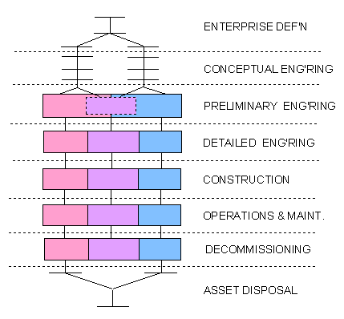
PURDUE REFERENCE MODEL FOR CIM
The Purdue Reference Model for CIM:
Is used during all Phases of the enterprise life cycle
Separately addresses Facilities, People and Systems at each Phase
PERA Master Planning may replace or supplement the Enterprise Definition and Conceptual Engineering Phases.
Notes:
The Purdue Reference Model for Computer Integrated Manufacturing (CIM):
Is used during all Phases of the enterprise life cycle
Separately addresses Facilities, Human and Organization, and Systems at each Phase
PERA Master Planning may be used to replace or supplement the Enterprise Definition and Conceptual Engineering Phases.

Slide 5
PERA Website Information Hierarchy
Purdue Handbook of Master Planning
Purdue Reference Model for Computer Integrated Manufacturing
PERA Industry Classification System
User Guide
for Industry & Principal Role
(e.g. Owner)
User Guide
for Industry & Principal Role
(e.g. Vendor)
User Guide
for Industry & Principal Role
(e.g. EPC)
Professional Roles
(for each Industry and Principal Role)
Learning Maps
(by Professional Role)
MLM
MLM
MLM
MLM
MLM
Notes:
Because PERA is designed to address all Enterprises, an industry classification system (shown in pink) is necessary. This classification recognizes similarities and differences in facilities, people and systems.
The PERA Master Planning Handbook, the Model for CIM and the Industry Classification System are common across all Enterprises, however, because physical facilities, organizations, and systems vary widely across Enterprises, an industry-specific set of User Guides may be created for Principal Roles (such as Owner, Vendor and EPC).
Each User Guide includes a set of Professional Roles for that Principal Role.
Each User Guide also provides links to MLMs and procedures that use terminology and concepts commonly used by that Principal Role in that Industry. Some of these are common across all Industries, and some are industry-specific.
Finally, MLMs and procedures may be combined in Learning Maps for a particular Professional Role.
Click on any “box” in this diagram to see more information on each of the above.

Slide 6
Key “Take-away” Messages
PERA is a GERAM (General Enterprise Reference Architecture and Methodology). It is designed to address all Enterprises at all architectural levels for Facilities, People and Systems.
A PERA Industry Classification System is based on characteristics of Enterprise production facilities, terminology and concepts.
User Guides for Owners, Vendors, and EPCs are used to incorporate generic PERA Master Planning and the PERA Model for CIM, with Industry-specific requirements, Professional Roles, Learning Materials and Procedures.
Learning Maps may be used to combine MLMs and Procedures for a Professional Role.
Notes:
PERA is a GERAM (General Enterprise Reference Architecture and Methodology). It is designed to address all Enterprises at all architectural levels for Facilities, People and Systems.
A PERA Industry Classification System is based on common characteristics of Enterprise production facilities, terminology and concepts.
User Guides for Owners, Vendors, and EPCs are used to incorporate generic PERA Master Planning and the PERA Model for CIM, with Industry-specific requirements, Professional Roles, Learning Materials and Procedures.

Slide 7

Author
Gary has more than 40 years of experience with enterprise integration and optimization projects, including PERA master planning and project management.
As one of the initial authors of the PERA Handbook of Master Planning, he has used PERA Enterprise Architecture and Master Planning methodologies throughout his career including control and information systems for oil production, pipelines, refining and marine loading, petrochemicals, coal, gas, and oil-fired power plants, polyethylene, ammonia, explosives, paint, pulp and paper, food and beverage, and pharmaceuticals. LNG facilities included world-scale arctic, European, and US Gulf coast complexes.
infrastructure facilities included Fire, Police, and Emergency Response systems for major US cities, as well as emissions reporting and trading systems for more than 100 US Power Plants,
https://creativecommons.org/licenses/by-sa/4.0/
Please click here to provide feedback on this MLM.
Notes:
Gary has more than 40 years of experience with enterprise integration and optimization projects, including PERA master planning and project management.
As one of the initial authors of the PERA Handbook of Master Planning, he has used PERA Enterprise Architecture and Master Planning methodologies throughout his career including control and information systems for oil production, pipelines, refining and marine loading, petrochemicals, coal, gas, and oil-fired power plants, polyethylene, ammonia, explosives, paint, pulp and paper, food and beverage, and pharmaceuticals. LNG facilities included world-scale Arctic, European, and US Gulf coast complexes.
infrastructure facilities included Fire, Police, and Emergency Response systems for major US cities, as well as emissions reporting and trading systems for more than 100 US Power Plants.

