Slide 1
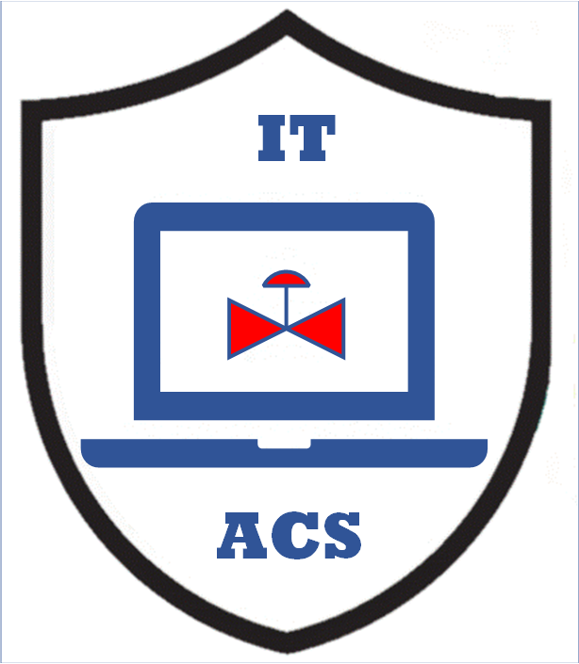


PERA Information Structure
MLM-005-A
Industry – All
Principal Role – All
Professional Role – All
Enterprise Phase – All
Turn on your audio and click start to begin video
Notes:
PRINT VERSION OF NARRATIVE
The purpose of this Micro Learning Module is to describe the structure of information as it is being implemented on the PERA Website, Micro Learning Modules (MLMs), and User Guides.
Click the NEXT button when you are ready to advance to the next slide.

Slide 2
What are PERA Information Classes?
Information stored on the PERA Website is indexed by:
Industry Class
Principal Role
Enterprise Phase
Each of these classes has subclasses.
Industry Class
Industry Subclass
Architecture Level
Principal Role
Professional Role
Org. Chart Position
Enterprise Phase
Facility Lifecycle
Subphase or Milestone
Notes:
PRINT VERSION OF NARRATIVE
What are PERA Information Classes?
Information stored on the PERA Website is indexed by:
Industry Class
Principal Role
Enterprise Phases
Each of these classes has subclasses.
- Industry Class
- Industry Subclass (e.g., Oil Refining)
- Architecture level (e.g., Level 1 sensors)
- Principal Role
- Professional Role (e.g., Control Engineer)
- Organization Chart Position (e.g., Maintenance Manager)
- Enterprise Phase
- Facility Lifecycle (e.g., Cybersecurity Master Planning, or Plant Operations)
- Subphase or milestone (e.g., Acceptance Testing)
2

Slide 3
Industry Classes and Subclasses
Industries
Industry Classes
Process Type
Architecture
Levels
Industry Classes are divided into Process Types.
(see MLM-004-A for an explanation and listing of Industry and Process Classes).
Process Types have Control and Information System Architecture Levels. Similar Process Types have similar Control and Information System Architectures.
Notes:
PRINT VERSION OF NARRATIVE
Industry Classes and Subclasses:
Industry Classes are divided into Process Types. (see MLM-004-A for an explanation and listing of Industry and Process Classes).
Process Types have Control and Information System Architecture Levels. Similar Process Types have similar Control and Information System Architectures.
Those of you who are familiar with PERA will recognize the People (Purple), Systems (blue), and Facilities (pink) color-coding pattern.

Slide 4
Principal Roles and Sub-roles
Roles
Requirements (e.g., from ISA 62443) may be assigned to a Principal Role or a Professional Role.
Requirements for a Principal Role are typically shown as deliverables between swim lanes for each Role.
Principal Roles
Professional Roles
Org. Chart
Positions
Requirements for a Professional Role may be shown as deliverables after work processes.
Organization Chart Positions are established by the Principal Role (company) and are assigned Professional Roles.
Notes:
PRINT VERSION OF NARRATIVE
Principal Roles are assigned to organizations, such as Owner-Operator or Vendor.
Professional Roles exist within a Principal Role (such as a control engineer or maintenance technician at an Owner-Operator’s Plant), and these Professional Roles are assigned to
Organization Chart Positions (such as Plant Maintenance Manager). Note: one or more professional roles may be assigned to an org chart position.
Requirements (from a standard or best practice) may be assigned to a Professional Role
Requirements for a Professional Role are typically shown as Deliverables transferred between Work Processes.

Slide 5
Lifecycle Phases and Sub-phases
Phases
Many different lifecycles can be defined, including those of Enterprise Facilities that are designed, built, and operated, or of Automation and Control System Products that are prototyped, manufactured, and eventually become obsolete.
Some lifecycles exist within a single Enterprise Phase, while others may span several Enterprise Phases (like a Product Lifecycle).
Enterprise Phases
Facility Phases
Subphases &
Milestones
Notes:
PRINT VERSION OF NARRATIVE
Phases include:
Enterprise phases (e.g. design or operations phase)
Lifecycle Phases (e.g. cybersecurity program lifecycles)
Subphases & Milestones (e.g. Project Phases or “sign-off milestones”
Many different life cycles may be defined, including IACS product lifecycles and facility lifecycles.
Some lifecycles exist within a single Enterprise Phase, while others may span several Enterprise Phases.

Slide 6
PERA Information Structure is Hierarchical
Industries
Industry Classes
Process Type
Architecture
Levels
Roles
Principal Roles
Professional Roles
Org. Chart
Positions
Phases
Enterprise Phases
Facility Phases
Subphases &
Milestones
Notes:
PRINT VERSION OF NARRATIVE
The PERA website information structure is Hierarchical:
Industry Classes have Process Types, and these each have Architecture Levels
Principal Roles have Professional Roles that are assigned to Organization Chart Positions
Enterprises have Lifecycles. Each Enterprise may have multiple Facilities and these Facilities have Phases and Sub-phases

Slide 7
Information Search
In addition to specifying the Industry, Role, Phase, and associated subclasses, PERA Website users can “filter” for content such as:
White Papers, News, and FAQ’s
Micro Learning Modules (MLMs)
Learning Maps (containing MLMs)
User Guides (by Industry and Professional Role)
Text search using the PERA Chatbot
Products form another fundamental information type
They are structured under the Industry, Role, and Phase Classifications described above.
Product functionality of the PERA website has been suspended while the underlying data is restructured from DB /PHP to XML/AI
Notes:
PRINT VERSION OF NARRATIVE
In addition to specifying the Industry Role, Phase, PERA Website users can search for content such as:
White Papers, News, and FAQ’s
Micro Learning Modules (MLMs)
Learning Maps (containing MLMs)
User Guides (by Industry and Professional Role)
Text search using the PERA Chatbot
Products form another fundamental information class
They are structured under the Industry, Role, and Phase Classifications described above.
Product functionality of the PERA website has been suspended while the underlying data is restructured from DB /PHP to XML/AI

Slide 8
More Reading
Related MLMs:
MLM-004-A PERA Enterprise Classes
MLM-007-B Automation and Control System Architecture Levels
MLM-001-A Principal Roles in ACS Cybersecurity
MLM-001-B Professional Roles in ACS Cybersecurity
  Please click here to provide feedback on this MLM.
https://creativecommons.org/licenses/by-sa/4.0/
Notes:
:

Slide 9

Author
Gary has more than 40 years of experience with enterprise integration and optimization projects, including PERA master planning and project management.
As one of the initial authors of the PERA Handbook of Master Planning, he has used PERA Enterprise Architecture and Master Planning methodologies throughout his career including control and information systems for oil production, pipelines, refining and marine loading, petrochemicals, coal, gas, and oil-fired power plants, polyethylene, ammonia, explosives, paint, pulp and paper, food and beverage, and pharmaceuticals. LNG facilities included world-scale arctic, European, and US Gulf coast complexes.
infrastructure facilities included Fire, Police, and Emergency Response systems for major US cities, as well as emissions reporting and trading systems for more than 100 US Power Plants,

