Slide 1

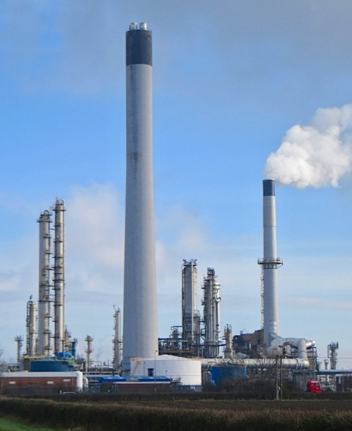
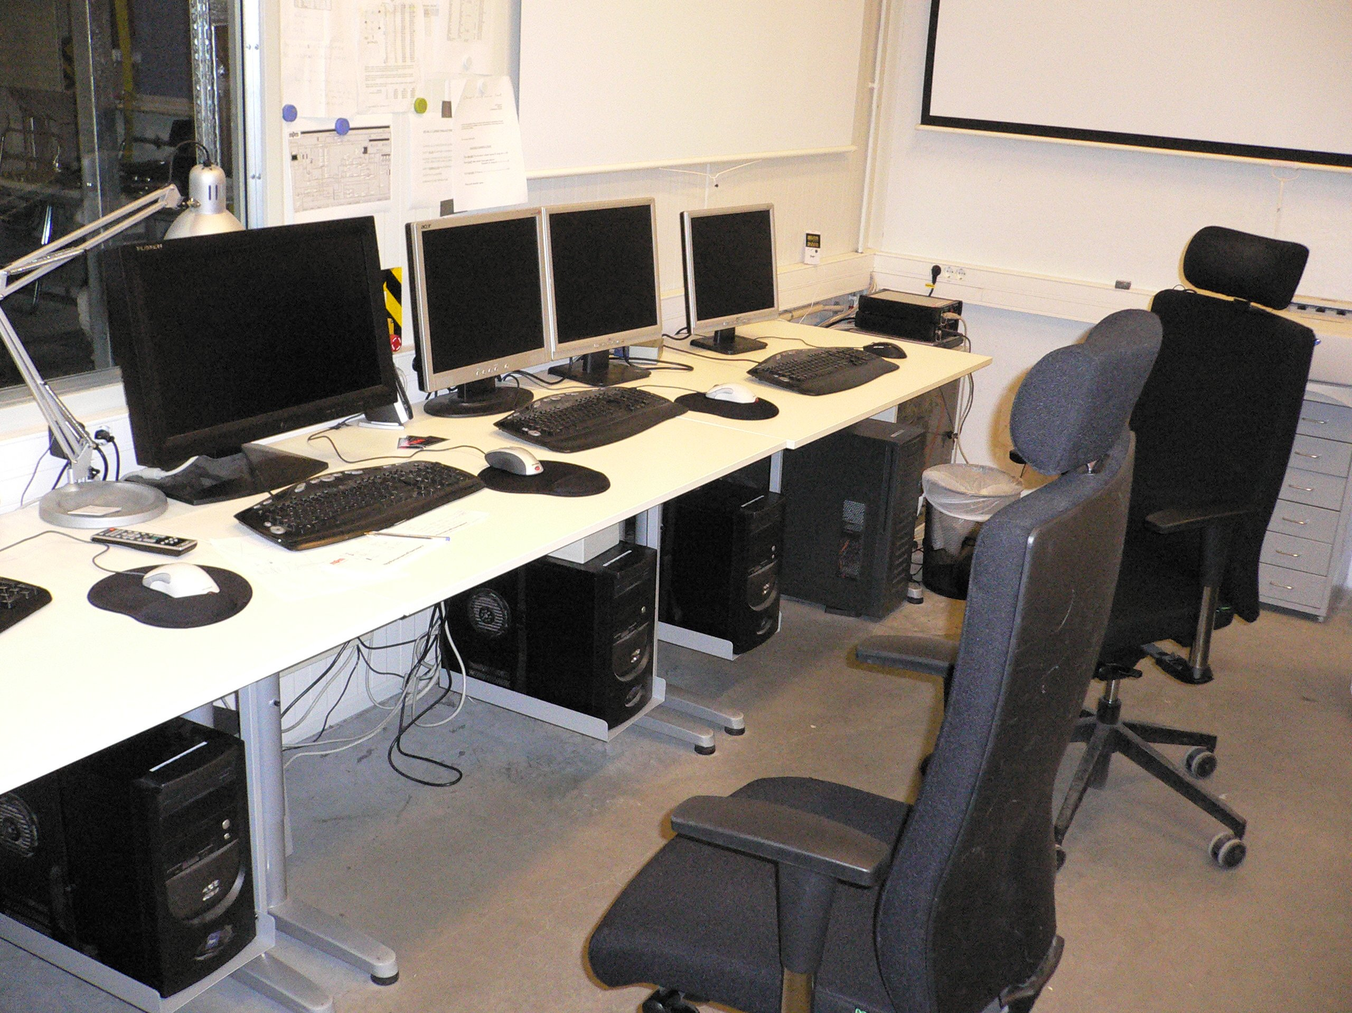


Cybersecurity Table-Top Exercise (TTX) for Power Plants
MLM-020-C
Industry – Process Industry
Principal Role – All
Professional Role – Control Engineer + IT Specialists
Enterprise Phase – All
Turn on your audio and click start to begin video
Notes:
This MLM provides an introduction to the use of Table-Top Exercises for Process Industry plants. It is intended for design engineers and plant engineers who will use Table-top studies to investigate cybersecurity issues in Power Plants and other Process industry facilities.
Click the NEXT button when you are ready to advance to the next slide.

Slide 2
The Cyber Attack Surface - 3 Main Vectors
Internally Generated Cyber Attacks
Start with breaching the physical perimeter
The attacker can be an employee, visitor, or hacker
Externally Generated Cyberattacks
May start through external networks or the internet with Social Engineering
May operate for months prior to being detected
Supply Chain Cyber Attacks
Vendors of products and supply services
Expert service personnel (in the country or abroad)
Increased frequency of Remote support access > Higher Risk
Peoples
Readiness & Knowledge
Existing
Vulnera-
bilities
Physical
Perimeter Protection
Creating Risky Condition
Notes:
Internally Generated Cyber Attacks
Start with breaching the physical perimeter
The attacker can be an employee, visitor, or hacker
Externally Generated Cyberattacks
May start through external networks or the internet with Social Engineering
May operate for months prior to being detected
Supply Chain Cyber Attacks
Vendors of products and supply services
Expert service personnel (in the country or abroad)
Increased frequency of Remote support access > Higher Risk

Slide 3
Cyber Defense Triad
Business Continuity Preparedness
Preparing alternative operation
Using backup data and services
Incident Response
Minimizing the damage caused by the attack
Involving preassigned trained team
Obtaining assistance according to plan
Disaster Recovery Planning
Acting quickly and efficiently
Restoring the plant operation
BCP
IR
DRP
Notes:
The time base of Business Continuity Preparedness (BCP) is years,
Incident Response is minutes, and
Disaster Recovery Planning (DRP) is weeks.

Slide 4
TTX is Part of Cybersecurity Program 1/2
Allow the organization to test its preparedness for an incident
Test the readiness of your BCP-DRP-IR team
Help to detect weaknesses related to knowledge of the team
May lead to specific training programs as required
What type of TTX drills may be considered
An overall action involving all teams (including the management)
A specific action just for designated teams (as refereed here)
Who shall supervise the TTX process
Internal team including members who are not implementation participants
External consultants who can detect gaps
Notes:
The Table Top Exercise is part of the Cybersecurity Program which has the following objectives:
Allow the organization to test its preparedness for an incident
Test the readiness of your BCP-DRP-IR team
Help to detect weaknesses related to the knowledge of the team
May lead to specific training programs as required
What type of TTX drills may be considered
An overall action involving all teams (including the management)
A specific action just for designated teams (as refereed here)
Who shall supervise the TTX process
Internal team including members who are not implementation participants
External consultants who can detect gaps

Slide 5
TTX is Part of Cybersecurity Program 2/2
Assessment & Preparedness
Detecting vulnerabilities
Training and Familiarization
Boosting the expertise
Testing Plans and Procedures
Constantly improving
Coordination/ Communication
Enhanced teamwork
Crisis Response Improvement
Correct handling of incident
Leadership Development
Cyber-risk aware organization
Resource Management
Optimizing the resources
Compliance Requirements
International and local regulation
Improved Effectiveness
Enhanced Internal capabilities
Insurance requirements
Goal is to reduce the cost of damages
Notes:
Other TTX objectives include:
Assessment & Preparedness -Detecting vulnerabilities
Training and Familiarization - Boosting the expertise
Testing Plans and Procedures - Constantly improving
Coordination/ Communication - Enhanced teamwork
Crisis Response Improvement - Correct handling of the incident
Leadership Development - Cyber-risk aware organization Resource Management - Optimizing the resources
Compliance Requirements - International and local regulations Improved Effectiveness - Enhanced Internal Capabilities Insurance requirements - Goal is to reduce the cost of damages

Slide 6
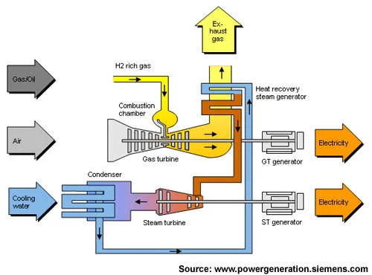
Combined Cycle Power Plant Example
Combined Cycle Power Plant (CCPP) Main Components
Supply& Storage of Gas
Gas Turbine operation
Heat transfer to boiler
Steam Boiler function
Steam Turbine operation
Power generator
Step-up transformer.
Protected HV feeders
Onsite control room
Process Areas
Gas Supply
Gas Turbine
Steam Boiler
Electric Power
Gas Supply
Air Entry
Water Supply

Slide 7

Typical scenarios examined in TTX
Typical Incident Scenarios examples
The HMI Screen is not getting field updates
The Power Plant stopped producing energy
Alert on severe vibration of the gas turbine
The mouse on the HMI screen is moving
CCTV shows people near the generator
The operator sees high boiler pressure
https://stock.adobe.com/images/cyber-security-risk-management-abstract-concept-vector-illustration/448780870
Notes:
Typical Incident Scenarios Examined in the Table Top Exercise:
The HMI Screen is not getting field updates
The Power Plant stopped producing energy
Alert on severe vibration of the gas turbine
The mouse on the HMI screen is moving
CCTV shows people near the generator
The operator sees high boiler pressure

Slide 8
Typical Incident Response Actions
Incident response actions
How to detect accurately?
Who must participate?
How to Respond quickly?
Conduct Emergency Shut Down (ESD)
Conduct Controlled Shut Down
How to Investigate the incident?
Documenting the event?
Public Relations Handling
Notes:
Incident response actions include:
How to detect an incident accurately?
Who must participate?
How to respond quickly?
Conduct Emergency Shut Down (ESD)
Conduct Controlled Shutdown
How to Investigate the incident?
Documenting the event?
Public Relations Handling

Slide 9
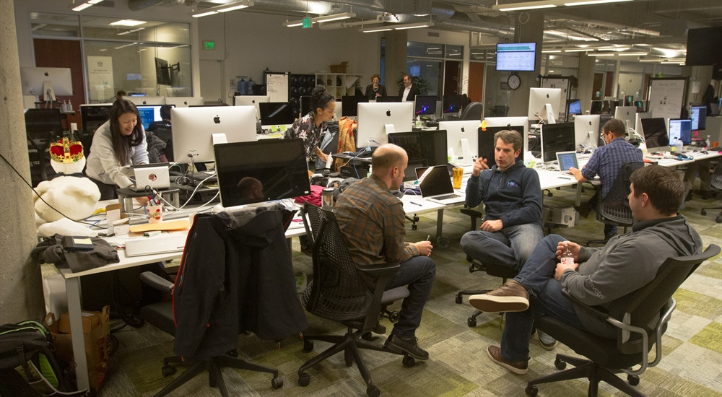
TTX Example for a Combined Cycle Power Plant
Initial action
Test
Yes
Next Action
Inspection Phase 1
Critical action
Next Action
Remediation
Probably Yes
No change
Detection action
Next Action
Completion action
Yes
START point of the Incident
No
Next Action
No
Not sure
Did you detect anomaly ICS behavior ?
Yes
Next Action
Yes
Next Action
Final
Action
Yes
No
No
Did they
All is works
No
Final
Action
END point of the Incident
Notes:
Typical Work Process used in response to an incident in a Combined Cycle Power Plant

Slide 10
Team selection for this TTX
Acting as a Plant Operation Manager
Responsible for Safety
Fill the role of the Plant CISO
Supporting ICS with IT Cybersecurity
On-site ICS Cyber security experts
P
C
M
I
S
Notes:
The TTX team should be include individuals who will:
Act as a Plant Operations Manager - Dealing with IR and the preparedness of the organization
Responsible for Physical Security and Safety - 1-2 people dealing with physical security and safety assurance
Fill the role of the Plant CISO - Ensures the technical/regulatory compliance requirements
Supporting ICS with IT Cybersecurity - 2-4 Dealing with all aspects related to network connectivity
On-site ICS Cyber security experts - 2-4 people capable of dealing with the on-site process and appliances

Slide 11
Incident - The HMI is not getting updates 1/4
Assessing the seriousness of the Incident
Concerns and Risks | Fin. Losses | Bus. Cont. | Damage | Safety | Risk to Lives
?- Unknown/ H-High/ M-Medium/ L-Low | L | L | M | L | L
no immediate risk of severe damage to equipment
no immediate risk to people
The decision is to start an investigation of the incident
Notes:
The team decided that there is no immediate risk of severe damage to equipment and no immediate risk to people.
The decision is to start an investigation of the incident by calling several specialists to the control room

Slide 12
Incident - The HMI is not getting updates 2/4
Whom to dispatch to help?
P?
M?
S?
I?
C?
Whom to dispatch to help?
IT Cybersecurity Experts (I)
ICS Cyber security experts (S)
Concerns and Risks | Fin. Losses | Bus. Cont. | Damage | Safety | Risk to Lives
?- Unknown/ H-High/ M-Medium/ L-Low | L | L | M | L | L
P
Responsible for Physical & Perimeter Security
C
M
The CCPP Manager responsible for operations?
On-site Industrial Cyber Security Expert
I
S
Onsite Information technology cyber security expert?
The onsite person filling the role of a CISO

Slide 13
Incident - The HMI is not getting updates 3/4
Recommended Actions
Control room manager to activate the secondary HMI
In parallel to onsite inspections, take actions to restart the HMI.
Inspect the ICS Zone networks: Switches, firewalls, routers, etc.)
If the fault continues, perform a controlled plant shutdown.
Concerns and Risks | Fin. Losses | Bus. Cont. | Damage | Safety | Risk to Lives
?- Unknown/ H-High/ M-Medium/ L-Low | L | L | M | L | L
Selected actions to be decided by the team

Slide 14
Incident - The HMI is not getting updates 4/4
Incident Response Flowchart
Series of step-by-step actions
The team must make decision at each step
IT Related Incident
Does it risk the plant’s Normal Operation?
Conducting an inspection of the system in operator room
Did they request to shut down the plant?
Perform careful Shut down of the ICS
Next Action
Yes
START point of the Incident
Yes
Not sure
Next Action
No
Conduct IT and/or ICS maintenance for the plant
Did you detect anomaly ICS behavior ?
Does it risk the plant’s Operation Safety?
Next
Further inspection for the ICS Network Operation and completion of Repair Actions
Yes
Final
Action
The inspection detected a disconnected data cable
Document the incident. Report to stakeholders
END point of the Incident

Slide 15
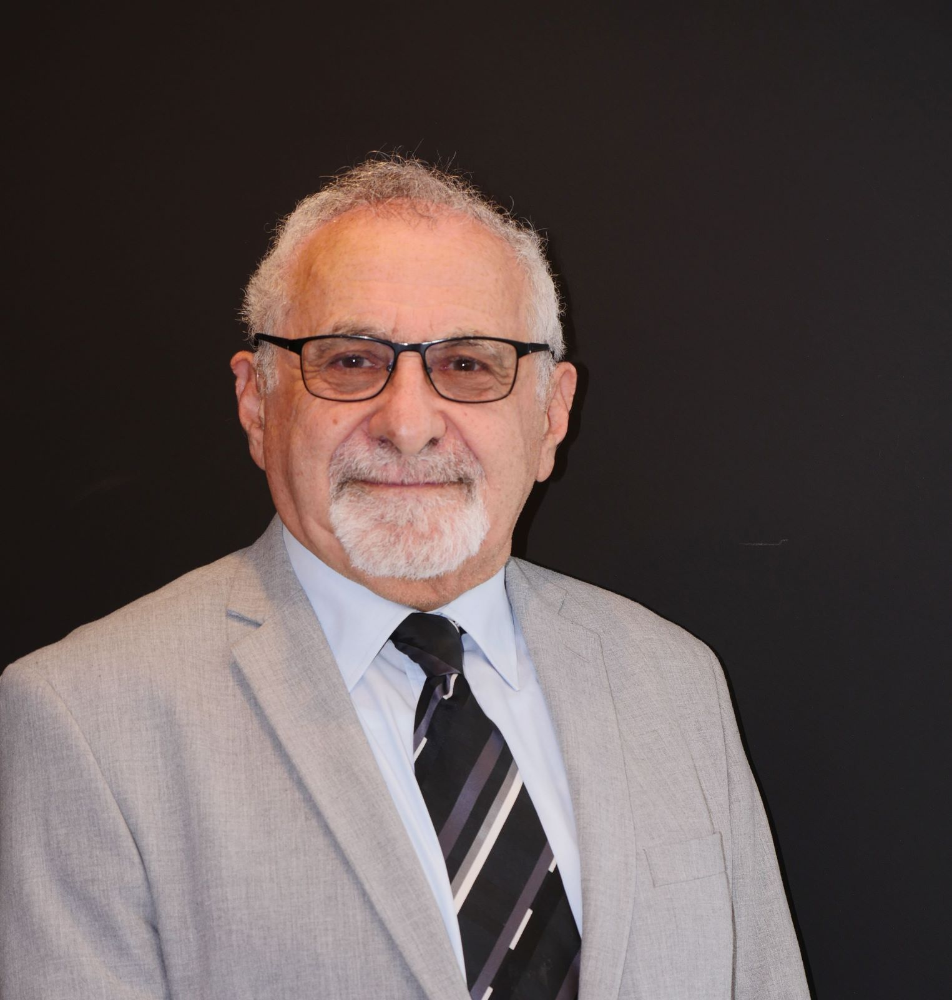
About the Author
Daniel Ehrenreich
Consultant, workshop lecturer, and Secure Communications and Control Expert. Daniel has over 32 years of experience with control solutions of industrial operations and integration with Cyber security
Acting as an expert and volunteer contributor to multiple ISA 62443 workgroups.

