Slide 1
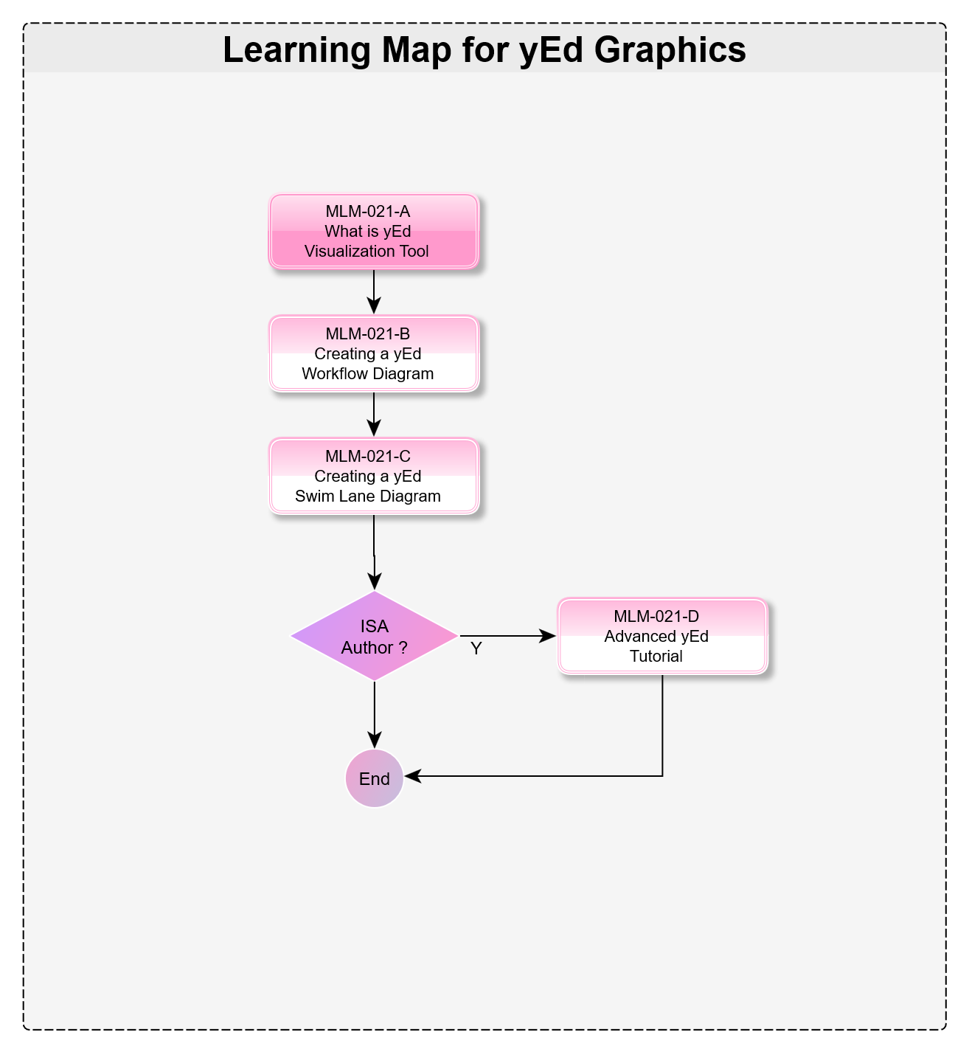


What is yEd Graphics?
Micro Learning Module
MLM-021-A
Industry – All
Principal Role – All
Professional Role – All
Enterprise Phase – All
Turn on your audio and click start to begin video
Notes:
This Micro-Learning Module describes the yEd graphic application, which can be used to produce various diagrams for PERA .
It is intended for authors of ISA MLMs, course materials, and standards.
Click the NEXT button when you are ready to advance to the next slide.

Slide 2
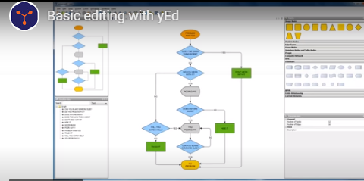
What is yEd ?
A multi-purpose diagramming program developed at Stanford University.
yEd is based on the open GraphML standard
It is a free Java application that runs on Windows, iOS, and Linux.
Notes:
PRINT VERSION OF NARRATIVE
yEd is a multi-purpose diagramming program that was Developed at Stanford University.
It uses the open GraphML standard that is based on XML. GraphML can describe, import, and export the structure and data for virtually any graph..
yEd is a free Java application that runs on Windows, iOS, and Linux.
It is distributed by yWorks, a company that offers a very complete library of diagramming software components that can be added to user software applications.

Slide 3
Why Use yEd for PERA Diagrams ?
yEd creates diagrams either:
manually using “Drag & Drop” from a Palette, or
from Tabular Data (Excel & many other formats).
Notes:
PRINT VERSION OF NARRATIVE
Once entered, the data can be presented in multiple different “structures” as shown in the following menu.

Slide 4
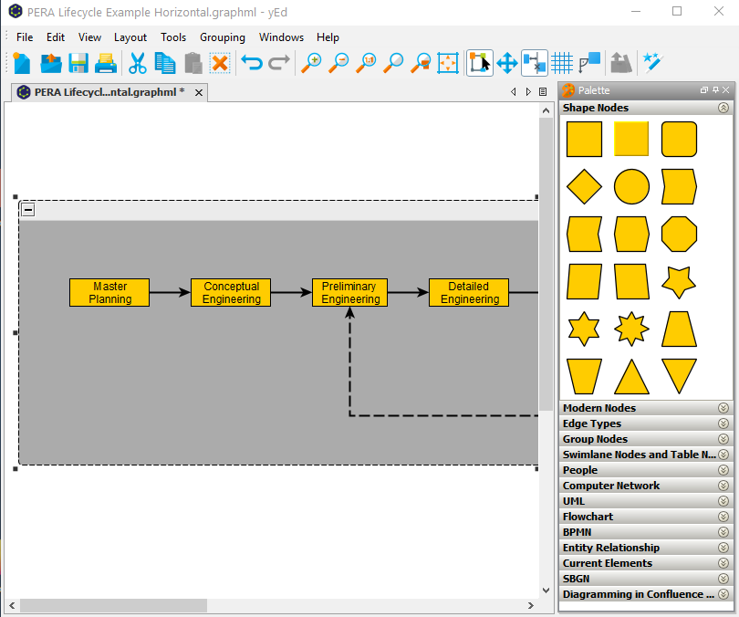
How to Create Diagrams
1) yEd quickly generates diagrams from a Palette.
Notes:
PRINT VERSION OF NARRATIVE
yEd quickly generates Visualizations using “Drag & Drop” of “nodes” from a Palette shown on the right.
Once created, these “shape nodes” may be rearranged by simply selecting them with a mouse click, and then dragging them to a new location.
All connections, (called “edges”) will automatically move with the node.

Slide 5
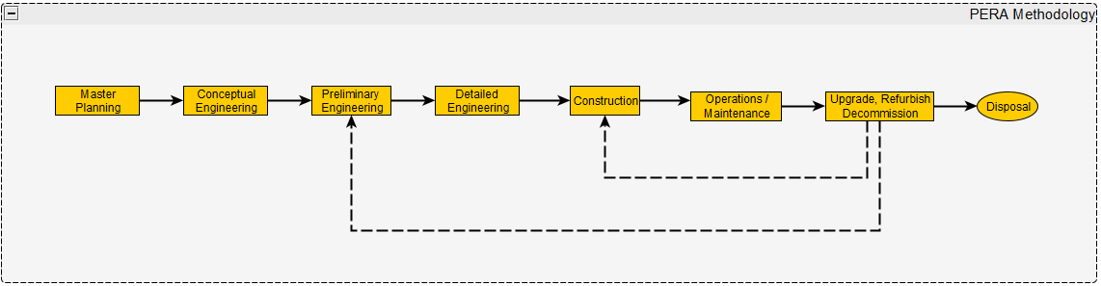
How to Create Diagrams
2) yEd also generates diagrams from Tabular Data (e.g. an Excel spreadsheet)
Node | Node Group | Node Name, EN
PERA |  | PERA Methodology
PERA-Phase 1 | PERA | PERA-Master Planning
PERA-Phase 2 | PERA | PERA-Conceptual Engineering
PERA-Phase 3 | PERA | PERA-Preliminary Engineering
PERA-Phase 4 | PERA | PERA-Detailed Engineering
PERA-Phase 5 | PERA | PERA-Construction
PERA-Phase 6 | PERA | PERA-Operations / Maintenance
PERA-Phase 7 | PERA | PERA-Upgrade, Renewal, Decommission
PERA-Phase 7 Decommission | PERA | PERA-Decommission
Notes:
PRINT VERSION OF NARRATIVE
yEd also generates Diagrams from Tabular Data (for example from an Excel file)
The kind of graph “structure” that will be produced, is selected from a menu (in this case a “Horizontal” structure).
Again, nodes can be rearranged with a simple “drag & Drop”.

Slide 6
Why Use yEd for PERA Diagrams ?
yEd creates diagrams either:
manually using “Drag & Drop” from a Palette, or
from Tabular Data (Excel & many other formats).
Once entered, the same data can be displayed in multiple different “visualizations” or “structures”
Notes:
PRINT VERSION OF NARRATIVE
Once entered, the data can be presented in multiple different “structures” as shown in the following menu.

Slide 7
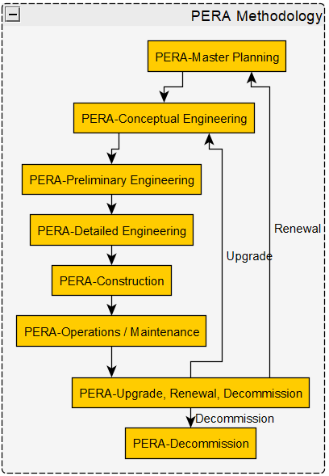
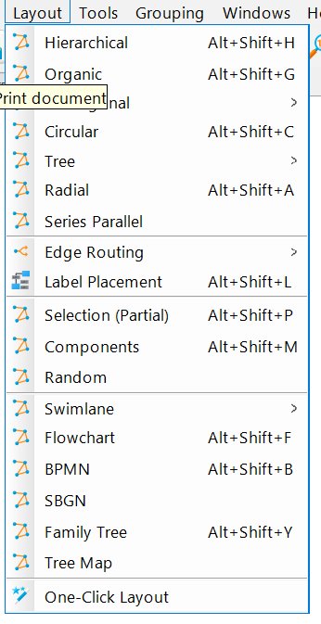
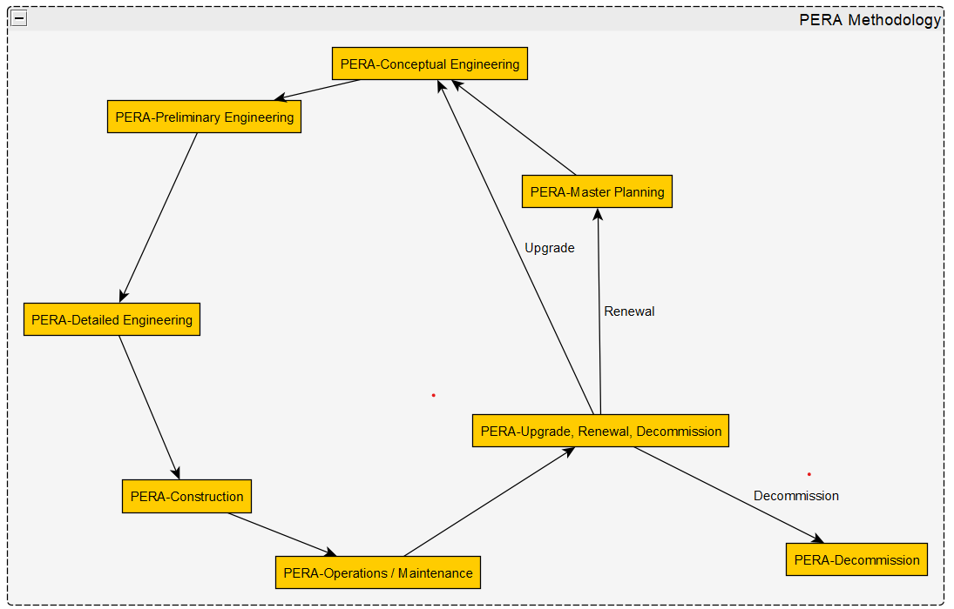
Same Data May Be Shown in Different Visualizations
Top-Down
Hierarchical
Visualization
Options (Layout)
Circular
(One Click to change from
Hierarchical to Circular)
Drag objects to rearrange.
All connections will remain attached.
Notes:
PRINT VERSION OF NARRATIVE
The same data that was used to produce the “Horizontal” diagram shown earlier, can be displayed in a “Top Down Hierarchical” structure or a “Circlular” structure by just selecting the desired layout structure from the menu, as shown in red.

Slide 8
Why Use yEd for Diagrams ?
yEd quickly generates Visualizations either:
from Tabular Data (Excel and many other formats), or
manually using “Drag & Drop” from a Palette
Once entered, the same data can be displayed in multiple different visualizations.
Many standard graphic “templates” are provided in yEd and custom templates may be stored and reused.
Notes:
PRINT VERSION OF NARRATIVE
Many standard graphic “templates” are provided in yEd.
In addition, custom graphic “templates” may be stored and reused

Slide 9
Many Standard Templates
Logic Flowchart Diagrams
Swim Lane Diagrams
BPMN Workflow Diagrams
UML Class Diagrams
Fishbone Diagrams
Entity Relationship Diagrams
Network Topology Diagrams
Failure Mode and Effects Analysis
Mind Mapping
Custom Diagrams can also be saved
A Library of >50 User-defined Diagrams is available.
Notes:
PRINT VERSION OF NARRATIVE
Many custom templates are available that can be useful for IACS including:
Flowcharts
Swim Lane
BPMN
UML
Fishbone
E/R
Network
FMEA
Mind Maps and many others
In addition, users can create and store custom templates and draw on a library of more than 50 User-defined Diagrams.

Slide 10
Why Use yEd for PERA Diagrams ?
yEd quickly generates Visualizations either:
from Tabular Data (Excel and many other formats), or
manually using “Drag and Drop” from a Palette
Once entered, the same data can be displayed in multiple different “structures”
Once created, Graphic objects may be rearranged with all connections retained
Many standard graphic “templates” are provided in yEd and custom templates may be stored and reused.
yEd imports and exports data in multiple formats
Notes:
PRINT VERSION OF NARRATIVE
yEd imports and exports data in multiple formats, saving time when creating diagrams and turning graphics into actionable data.

Slide 11
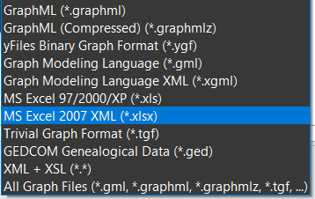
yEd Import Options
yEd quickly generates Visualizations from Tabular data input including:
Importing and exporting from Excel is very useful, particularly for simple diagrams.
Notes:
PRINT VERSION OF NARRATIVE
yEd quickly generates Visualizations from Tabular data input in more than a dozen formats including XML and Excel.
Data may also be exported in 6 different formats.

Slide 12
Excel Import Benefits
A key reason to use yEd is to ensure consistency between your data and your visualization, which you achieve using Excel
The Import from Excel to yEd is very flexible and:
Groups your nodes together
Automatically arranges your objects and your notes together
Facilitates creation of the same diagram in other languages
A second reason is to be able to add lots of descriptive text inside your Nodes and on the “Edges”

Slide 13
Key “Take-away” Messages
Why Use yEd ?
Saves time and improves quality and consistency of diagrams
Diagrams may be configured from a “Drag & Drop Menu, or auto-generated directly from data
Many standard and custom templates are available
Download yEd for free at https://www.yworks.com/products/yed
Key Definitions:
GraphML - Standardized format for exchanging graphical data and structure.
13
Notes:
PRINT VERSION OF NARRATIVE
Saves time to produce diagrams, while improving quality and consistency
Diagrams may be configured from a “Drag & Drop” menu, or auto-generated directly from data
Many standard and custom diagram templates are available
yEd may be downloaded for free, including for commercial use.

Slide 14
More Reading
Related MLMs
See MLM-021-B How yEd is used in PERA
See MLM-021-C Creating yEd Swimlane Diagrams
References:
Watch yEd Video Introduction in 90 seconds
See “Basic Editing with yEd” on YouTube
Please click here to rate this learning module.
Notes:
PRINT VERSION OF NARRATIVE
Thank you for taking the time to view this Micro Learning Module.
Select the Resources tab (at the top of the screen) to view and/or print a PDF of this MLM, including speaker notes.
You may wish to follow these next links to see a video introduction to yEd and how to use its editor.
We have also provided a short course on the interface for this MLM.
The last link requests your feedback about this MLM.

Slide 15

Author
Bill Bosler, P.E., is an Oil & Gas Business Development leader and enterprise -integration SME with 40+ years across upstream, pipelines, refining, petrochemicals, and major capital projects. He combines PERA master planning with ISA-95/IEC-62264 data models to help operators and EPCs turn strategy into measurable value and resilient supply chains.
Bill founded and led Texas Consultants, delivering programs in 30+ countries and partnering with national/international oil companies, pipeline consortia, and global integrators. His work includes the CPC pipeline Customer Management System, refinery and petrochemical optimization programs, and upstream collaboration centers. He has also negotiated greenfield/expansion projects and contributed to standards at API and ISA.
Notable outcomes include reducing an Arctic LNG concept’s capital needs by ~$5B with a 12% ROI lift; accelerating a client’s automation benefits by $4M/year; and saving ~$0.20/bbl on gasoline blending through multi-vendor integration.
He has published widely and presented at AIChE, API, ISA, NPRA and others.
Notes:
Bill Bosler, P.E., is an Oil & Gas Business Development leader and enterprise-integration SME with 40+ years across upstream, pipelines, refining, petrochemicals, and major capital projects. He combines PERA master planning with ISA-95/IEC-62264 data models to help operators and EPCs turn strategy into measurable value—faster vendor onboarding, cleaner hand-overs, tighter compliance, and resilient supply chains.
Bill founded and led Texas Consultants, delivering programs in 30+ countries and partnering with national/international oil companies, pipeline consortia, and global integrators. His work includes the CPC pipeline Customer Management System, refinery and petrochemical optimization programs, and upstream collaboration centers. He has also negotiated greenfield/expansion projects and shaped standards work at API and ISA.
Notable outcomes include cutting an Arctic LNG concept’s capital needs by ~$5B with a 12% ROI lift; accelerating a client’s automation benefits by $4M/year years earlier at a fraction of expected cost; and saving ~$0.20/bbl. on gasoline blending through multi-vendor integration. He has published widely and presented at AIChE, API, ISA, NPRA and others.

