Slide 1
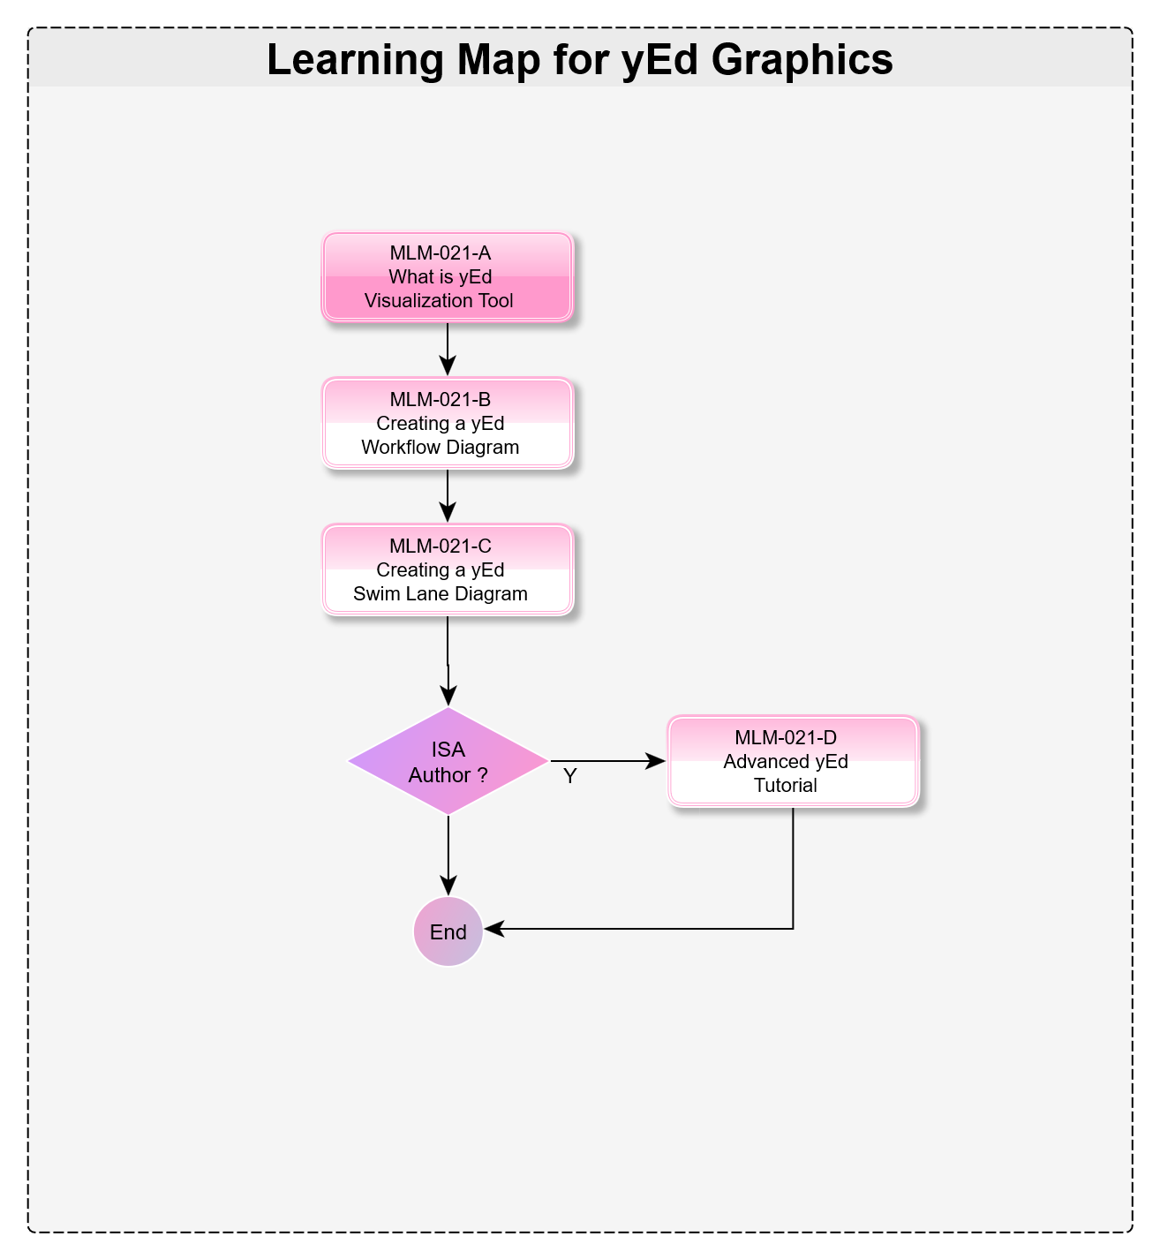


How yEd Graphics is Used in PERA
Micro Learning Module
MLM-021-B
Industry – All
Principal Role – All
Professional Role – All
Enterprise Phase – All
Turn on your audio and click start to begin video
Notes:
This module describes how the yEd graphics application may be used to create various PERA diagrams.
It is intended for authors of MLMs, course materials, and standards.
yEd is a Java diagramming program developed at Stanford University and distributed by yWorks.
Click the START button when you are ready to advance to the next slide.

Slide 2
Typical yEd Diagrams used in PERA
The following yEd diagrams may be created:
MLM Learning Maps
Lifecycle Diagrams
Swim Lane Diagrams
Org. Charts, & other Taxonomies
BPMN Workflow Diagrams
UML Class Diagrams
Fishbone Diagrams
Entity Relationship Diagrams
Network Topology Drawings
Failure Mode and Effects Analysis Diagrams
The first 5 of these are particularly important as they define human aspects of the PERA Model.
Notes:
The following are some diagrams that we may produce using yEd.
MLM Learning Maps
Lifecycle Diagrams
Swimlane Diagrams
Organization Charts and Other Taxonomies
BPMN Workflows
UML Class Diagrams
Fishbone Diagrams
Entity Relationship Diagrams
Network Topology Drawings
Failure Mode and Effects Analysis Diagrams
The first 5 of these are used to define human and organizational aspects of the PERA Model.
Some of the remaining 5 have traditionally been done in PERA using tools like MS Visio or CISCO network tools; however, GraphML may provide an efficient way to transfer graphics to other AI graphic tools.

Slide 3
yEd Example – Learning Maps
These may be simple (like this Learning Map for yEd Graphics), OR
Complex Learning maps for professionals such as Control Engineers or CISOs.
Notes:
These may be simple (like this Learning Map for yEd Graphics), or Complex Learning maps for professionals such as Control Engineers or CISOs (Cybersecurity Information Security Officers).

Slide 4
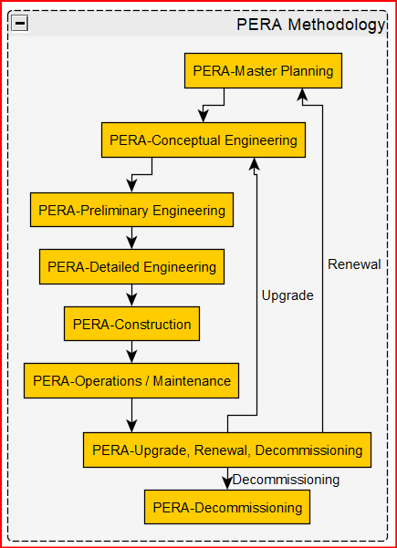
yEd Example - Lifecycle Diagram
This graphic of PERA Lifecycle Phases was created automatically from an Excel® spreadsheet.
Once created, this lifecycle diagram was easily rearranged as a circle using the yEd “Drag & Drop” interface.
The data may also be visualized in different formats, including custom ones that are then saved for future use.
Notes:
This graphic of PERA Lifecycle Phases was created automatically from an Excel® spreadsheet.
Once created, this lifecycle diagram was easily rearranged as a circle using the yEd “Drag & Drag” interface.
The data can also be visualized in various formats, including custom ones that are saved for future use.

Slide 5
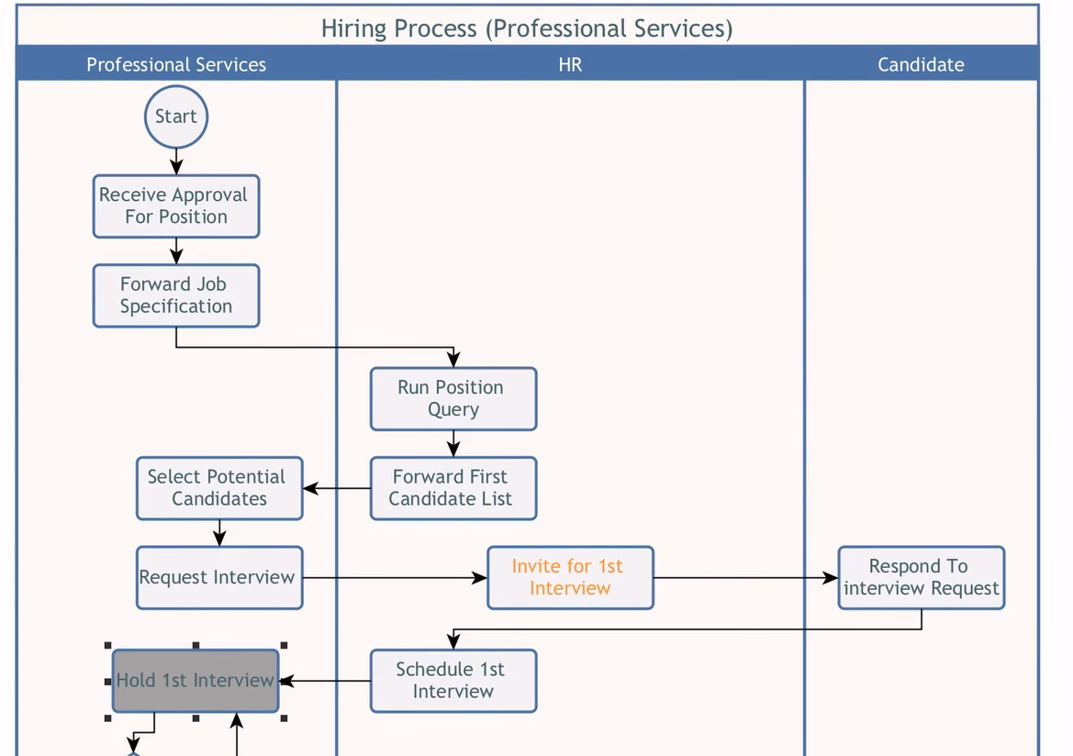
yEd Example - Swimlane Diagrams
Swimlane Diagram from YouTube Course
Notes:
This is an automatically-generated Vertical Swim Lane Diagram.
It may be changed to a horizontal layout with a single click.

Slide 6
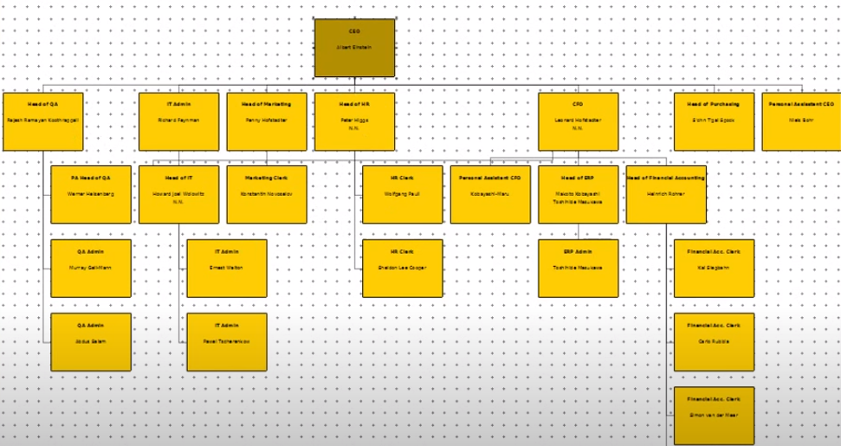
yEd Example - Organization Chart
Spreadsheets and other hierarchical data structures can be imported and automatically displayed
Notes:
Another simple, but useful template, produces Organization Charts from spreadsheet data.
Once created, Blocks and their connections may be manually rearranged with yEd’s “click and drag” interface.
Of course, other packages such as MS Visio can create an Organization Chart from a spreadsheet; however, yEd is free and easier to use.
In addition, other hierarchical data can be imported including other GraphML documents or XML data structures.

Slide 7
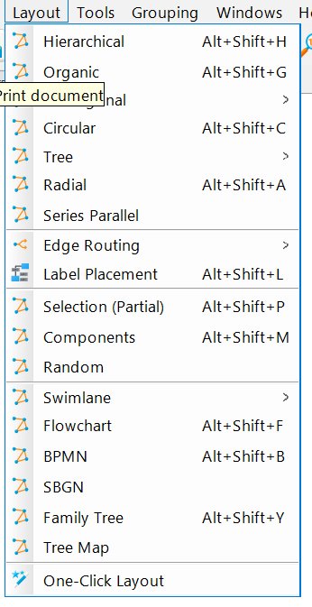
yEd May be Used With Many Other Standard Templates
Logic Flowchart Diagrams
BPMN Workflow Diagrams
UML Class Diagrams
Fishbone Diagrams
Entity Relationship Diagrams
Network Topology Diagrams
Failure Mode and Effects Analysis
Mind Mapping
Custom Diagrams can also be saved
A Library of >50 User-defined Diagrams is available.
Notes:
Many other templates are available that can be useful for Automation and Control Systems, including:
Logic Flowchart Diagrams
BPMN Workflow Diagrams
UML Class Diagrams
Fishbone Cause and Effect Diagrams
Entity Relationship Diagrams
Network Topology Diagrams
Failure Mode and Effects Analysis
Mind Maps
Additionally, users can create and store custom templates, as well as draw from a library of more than 50 User-defined Diagrams.

Slide 8
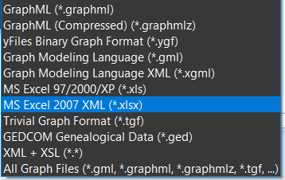
yEd Import Options
yEd quickly generates graphics from Tabular data in many formats including:
Notes:
yEd quickly generates Visualizations from Tabular data input in more than a dozen formats, shown here, including XML and MS Excel.

Slide 9
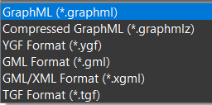
yEd Exports in Many Formats
yEd export formats include:
Notes:
yEd exports in more than a dozen formats, shown here, including GML/XML and TGF Format.

Slide 10
Suggestions for Getting Started with yEd
Download yEd for Windows, IOS, or Linux (all are free)
Search YouTube, e.g., “Basic Editing with yEd”
See MLM-012-C “Create a PERA Learning Map” using Excel.
Create Diagrams using Excel for:
Life Cycles
Definitions and Ontologies
Roles: Skills, Experience, Responsible Role
Key Aspects of Cybersecurity
Enjoy!
Notes:
Download yEd for Windows, IOS, or Linux (all are free)
Search YouTube, e.g., “Basic Editing with yEd”
See MLM-012-C “Create a PERA Learning Map” using Excel.
Create Diagrams using Excel for:
Life Cycles
Definitions and Ontologies
Roles: Skills, Experience, Responsible Role
Key Aspects of Cybersecurity
Enjoy!

Slide 11
More Reading
Related MLMs
See MLM-021-A What is yEd Graphics
See MLM-021-G Why use yEd in PERA
References:
Watch yEd Video Introduction in 90 seconds
See “Basic Editing with yEd” on YouTube
Please click here to share your comments on this learning module with the author.
Notes:
Thank you for taking the time to view this Micro Learning Module.
You may wish to follow these links to view a video introduction to yEd and learn how to use its editor.

Slide 12
Definitions
Business Process Modelling Notation (BPMN™) is a graphical markup notation (language) for describing business processes. BPMN 2.0 is the de facto industrial standard for Business Process Modelling (BPM). It uses an XML-based syntax.
UML Diagrams are based on the Unified Modeling Language (UML), which provides a visualization technique to represent a system, along with its main actors, roles, actions, and artifacts (documents and figures).
GraphML - Standardized format for exchanging graphical data and structure.
Notes:
Business Process Modelling Notation (BPMN™) is a graphical markup notation (language) for describing business processes. BPMN 2.0 is the de facto industrial standard for Business Process Modelling (BPM). It uses an XML-based syntax.
UML Diagram is based on the Unified Modeling Language (UML) and is one visualization technique to represent a system, along with its main actors, roles, actions, and artifacts (documents and figures).
GraphML - Standardized format for exchanging graphical data and structure.

Slide 13

Author
Gary has more than 40 years of experience with enterprise integration and optimization projects, including PERA master planning and project management.
As one of the initial authors of the PERA Handbook of Master Planning, he has used PERA Enterprise Architecture and Master Planning methodologies throughout his career including control and information systems for oil production, pipelines, refining and marine loading, petrochemicals, coal, gas, and oil-fired power plants, polyethylene, ammonia, explosives, paint, pulp and paper, food and beverage, and pharmaceuticals. LNG facilities included world-scale arctic, European, and US Gulf coast complexes.
infrastructure facilities included Fire, Police, and Emergency Response systems for major US cities, as well as emissions reporting and trading systems for more than 100 US Power Plants,
https://creativecommons.org/licenses/by-sa/4.0/
Please click here to provide feedback on this MLM.

