Slide 1


XML Standards and their use in PERA
Micro Learning Module
X
e tensible
MLM-022-A
Industry – All
Principal Role – All
Professional Role – All
Enterprise Phase – All
M
M arkup
L anguage
L
Turn on your audio and click start to begin video
Notes:
This module describes how and why XML is used in the PERA website including the yEd graphic application, that may be used to produce many different XML documents.
Click the NEXT button when you are ready to advance to the next slide.

Slide 2
What is XML and Why Use it?
XML is a foundational information technology with numerous associated standards that extend its capabilities and define specific uses.
These standards can be broadly categorized into several areas:
CORE XML Standards Used in PERA
XML Query and Transformation
XML Linking and Referencing
XML Security
Special Purpose XML-based Standards
Notes:
XML is a foundational information technology with numerous associated standards that extend its capabilities and define specific uses.
These standards can be broadly categorized into several areas:
CORE XML Standards Used in PERA
XML Query and Transformation
XML Linking and Referencing
XML Security
Special Purpose XML-based Standards

Slide 3
Core XML Standards Used in PERA
SOAP (Simple Object Access Protocol): An XML-based messaging protocol for exchanging structured information in web services.
SVG (Scalable Vector Graphics): An XML-based vector image format.
XForms: An XML application for creating web forms.
UBL (Universal Business Language): A library of standard XML business documents.
GraphML: A Graphic Standard for vector diagrams
B2MML: Business to Manufacturing Markup Language (see also ISA95 data transfer standard.
Notes:
The following are core XML Standards used in the PERA website.
SOAP (Simple Object Access Protocol): An XML-based messaging protocol for exchanging structured information in web services.
SVG (Scalable Vector Graphics): An XML-based vector image format.
XForms: An XML application for creating web forms.
UBL (Universal Business Language): A library of standard XML business documents.
GraphML: A Graphic Standard for vector diagrams
B2MML: Business to Manufacturing Markup Language (see also ISA95 data transfer standard.

Slide 4
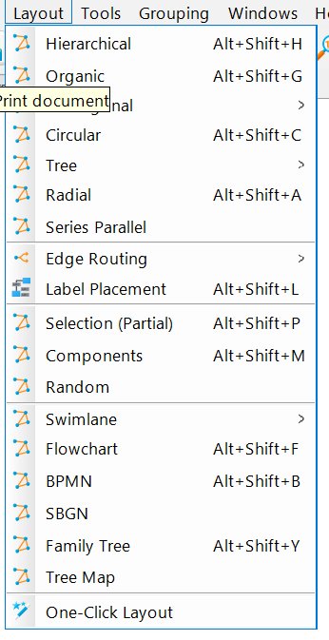
Many Standard XML Templates in yEd GraphML
Logic Flowchart Diagrams
Swim Lane Diagrams
BPMN Workflow Diagrams
UML Class Diagrams
Fishbone Diagrams
Entity Relationship Diagrams
Network Topology Diagrams
Failure Mode and Effects Analysis
Mind Mapping
Custom Diagrams can also be saved
A Library of more than 50 User-defined Diagrams is available.
Notes:
PRINT VERSION OF NARRATIVE
Many custom templates are available in yEd that can be useful for ACS including:
Logic Flowcharts
Swim Lane Diagrams
BPMN Workflow Diagrams
UML Class Diagrams
Fishbone Diagrams
Entity Relationship Diagrams
Network Topology Diagrams
Failure Mode and Effects Analysis
Mind Maps and a library of custom and user-defined diagrams.

Slide 5
Key “Take-away” Messages
Why Use XML Standards ?
XML saves time and improves the quality and consistency of data transfers and reports
Imports and exports information in many formats
Many generic and application-specific packages are available
Human-readable documents may be easily read by AI applications.
5
Notes:
Why use XML standards?
XML saves time and improves the quality and consistency of data transfers and reports.
It allows Import and export of information in many formats
Many generic and application-specific packages are available
Human-readable XML documents may be easily read by AI applications.

Slide 6
More Reading
Related MLMs
MLM-022-B Use of Swimlane Interfaces between Principal Roles
MLM-022-C Use of Workflows between Professional Roles
MLM-021-A What is yEd Graphics
MLM-021-B How yEd is used in PERA
MLM-021-E Advanced yEd Tutorial
References:
See Basic XML Tutorial on YouTube
Please click here to comment on this learning module.

Slide 7

Author
Bill Bosler, P.E., is an Oil & Gas Business Development leader and enterprise -integration SME with 40+ years across upstream, pipelines, refining, petrochemicals, and major capital projects. He combines PERA master planning with ISA-95/IEC-62264 data models to help operators and EPCs turn strategy into measurable value and resilient supply chains.
Bill founded and led Texas Consultants, delivering programs in 30+ countries and partnering with national/international oil companies, pipeline consortia, and global integrators. His work includes the CPC pipeline Customer Management System, refinery and petrochemical optimization programs, and upstream collaboration centers. He has also negotiated greenfield/expansion projects and contributed to standards at API and ISA.
Notable outcomes include reducing an Arctic LNG concept’s capital needs by ~$5B with a 12% ROI lift; accelerating a client’s automation benefits by $4M/year; and saving ~$0.20/bbl on gasoline blending through multi-vendor integration.
He has published widely and presented at AIChE, API, ISA, NPRA and others.

