Slide 1



MLM Production Tips
MLM-024-D
Industry – All
Principal Role – All
Professional Role – All
Enterprise Phase – All
Turn on your audio and click start to begin video
Notes:
This module provides some Production tips for publishing micro learning modules (MLMs).
The intended audience is anyone associated with the creation, review, approval, and publishing of MLMs.
Click the START button when you are ready to advance to the next slide.

Slide 2


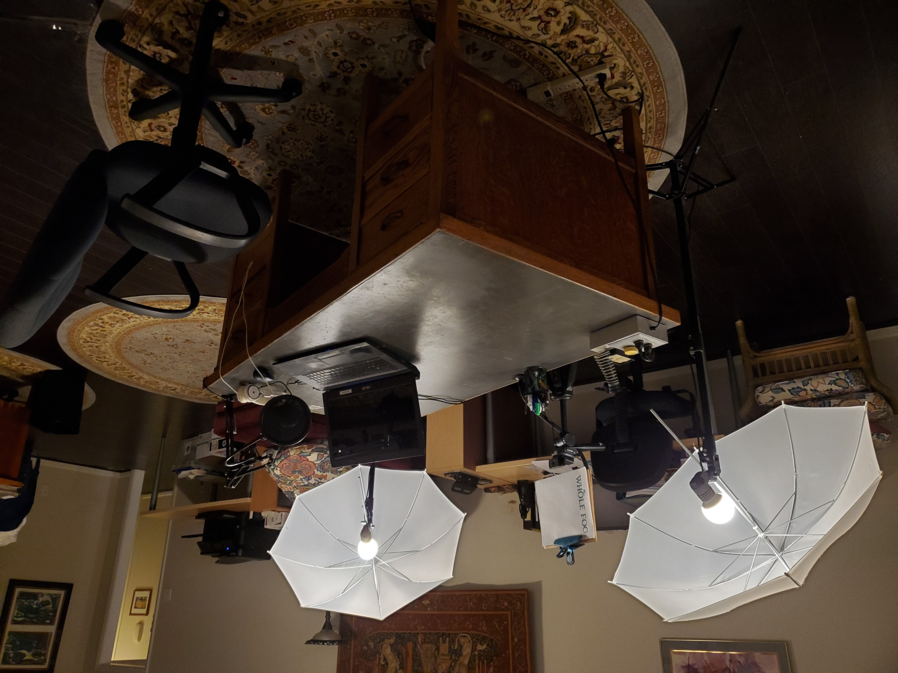
What You Will Need
Software:
Microsoft PowerPoint
Audio recording software
Optional:
Web camera
Video editing software
An image library
Hardware:
Microphone
Other:
A quiet place to record!
Used with permission © ECI, Ltd 2020
Notes:
You will need the following equipment and software to prepare an MLM:
MS PowerPoint to create diagrams and text
A microphone and some audio recording/editing software
You may also want to acquire the following equipment and software:
A web camera and video recording/editing software
A library of images (with authorized copyright)

Slide 3




Microphone Recommendations
Condenser cardioid microphone (~$100)
A very quiet location
A boom arm stand (optional)
A pop filter (optional)
Notes:
The human ear is remarkably sensitive to distortion, background noise and recording level. Therefore, it is recommended that you obtain:
A medium-quality condenser microphone with a cardioid pickup pattern. Quality microphones typically cost about $100 to $200. The Yeti Blue and Yeti Nano are popular microphones that plug into a USB port, but there are many other options.
A very quiet location. Anything from a professional recording studio to a closet full of clothes can work. A small, carpeted room with soft furniture is a good choice. Large rooms with a lot of echo from hard surfaces, such as non-carpeted floors, are not preferred.
An adjustable boom arm stand may help with positioning your microphone for comfort and speech clarity, as well as vibration reduction.
A pop filter/microphone protector is also useful--especially if you are an animated speaker--and can extend the life of your microphone.

Slide 4



Recording Your Narrative
Test your setup first!
Set up your microphone; adjust the gain.
Use audio editing software to record.
Save the audio for each slide in a separate WAV file.
Notes:
Test your setup first before recording hours of material!
Plug in and set up your microphone.
Adjust the gain on your microphone according to the manufacturer’s instructions (in Windows 10, use the Control Panel).
Open the audio editing software (Audacity is free and user-friendly) and begin recording.
Save the audio for each slide in a separate file in WAV format and arrange to give access to the Instructional Designer.

Slide 5




Web Camera Hardware and Software
We recommend that you begin with:
A webcam set to 16 x 9 ratio, medium resolution
A location with bright light (no shadows on your face)
The camera located at eye level
Video recording application
~90º
Notes:
People are less sensitive to video image quality for training materials. Therefore, we recommend that you begin with:
A mid-range webcam. Set the resolution to medium to save image size and update times.
A location with bright natural light or a setting where you can position two bright lamps shining on your face from 90 degrees away from each other (the first lamp illuminates your face, the second fills in any shadows from the first)
The camera located at eye level (a tripod for your camera can make positioning easier)
Free software such as Microsoft Camera, the free online screen/webcam recorder from Apowersoft (https://www.apowersoft.com/free-online-screen-recorder), or Filmora9 (low-cost video editing software)

Slide 6
Recording and Sharing Narrations
Test your setup first.
If you record video, use your best microphone for the audio track.
Save edited videos in MPEG or AVI format.
Share large files with your instructional designer.
Notes:
Test your setup before recording lots of video, particularly the lighting and audio setup.
If you record video, be sure to use your best microphone for the audio track, not the microphone on the webcam.
Save edited videos in MPEG or AVI format.
Use a filesharing service like Dropbox or WeTransfer to share large files with the instructional designer who is helping you.

Slide 7
Creating and Editing Graphics and Text
More advanced content creators can:
Insert videos
Add a talking head narration
Add animations, quizzes and other user interactions
Explain animations in the notes section <like this>
Notes:
Recommendations for more advanced content creators:
Insert videos of important or interesting topics (with instructional designer support, if needed).
Use a USB webcam to record a talking head narration to improve connection with the audience.
Include animations, quizzes and other attention-enhancing tools.
If a particular animation is desired, explain in the notes what you envision <like this> and work with an instructional designer to produce it.

Slide 8
Use of Images
Using images greatly improves attention and retention.
Options include:
Purchase images from a stock image library (Adobe Stock, Getty Images, etc.)—include citations!
Create your own graphics using AI software such as Adobe Firefly or GROK.
Note: Create a record in the DropBox for each image. Indicate the image source and, if appropriate, include documentation that permission has been granted to use the image.
Notes:
Using images greatly improves attention and retention. Options include:
Purchase images from a stock image library (Adobe Stock, Getty Images, etc.).
Create your own graphics (or ask for instructional designer support to create them).
Note: You must kep a record for each image. Indicate the image source and, if necessary, include documentation that permission has been granted to use the image.

Slide 9
Key messages for preparing MLMs
Keep MLMs short.
Use graphics, animations, and videos to retain interest.
Extemporaneous speaking is preferred to reading from a script to keep your tone light and energetic.
Refer to the MLM author’s style guide for format and style tips.
Notes:
Keep it short!
Use graphics, animations, and videos to retain interest (while respecting copyright).
Try not to sound as if you are reading a script (even if you are). Extemporaneous speaking is superior for maintaining audience attention. Keep your tone light and energetic. It might feel silly to be animated, but your audience will appreciate it.
Refer to the MLM author’s style guide for format and style tips.

Slide 10

Author
Gary has more than 40 years of experience with enterprise integration and optimization projects, including PERA master planning and project management.
As one of the initial authors of the PERA Handbook of Master Planning, he has used PERA Enterprise Architecture and Master Planning methodologies throughout his career including control and information systems for oil production, pipelines, refining and marine loading, petrochemicals, coal, gas, and oil-fired power plants, polyethylene, ammonia, explosives, paint, pulp and paper, food and beverage, and pharmaceuticals. LNG facilities included world-scale arctic, European, and US Gulf coast complexes.
infrastructure facilities included Fire, Police, and Emergency Response systems for major US cities, as well as emissions reporting and trading systems for more than 100 US Power Plants,

