Slide 1



What is a Learning Map ?
MLM-011-A
Industry – All
Principal Role – All
Professional Role – All
Enterprise Phase – All
Image from PowerPoint Creative Library (search for “Planning”)
Turn on your audio and click start to begin video
Notes:
This MLM describes learning maps and how they can be used to provide customized learning for specific audiences.

Slide 2
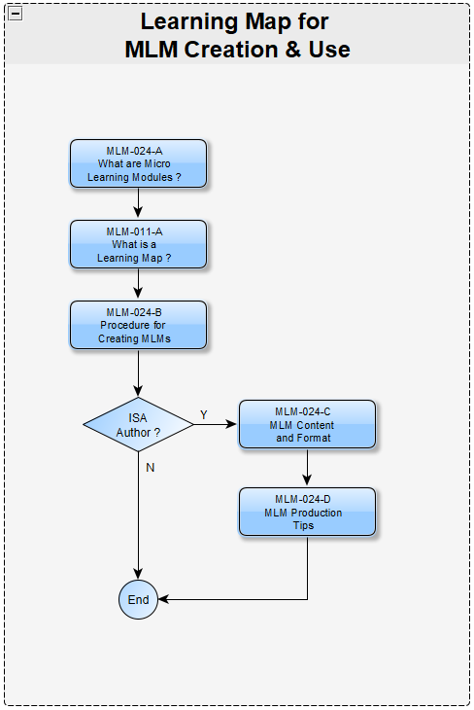
Definitions
A Learning Map is:
A diagram showing
  The relationship of multiple Micro-Learning Modules
  Each block provides a clickable web link to that MLM.
A recommended set of MLMs for a specific professional role or audience,
  For example, a control engineer in a specific industry (e.g., power generation) during a certain phase (e.g., Operations).
  A course may include multiple Learning Maps, or parts of one or more Learning Maps.
  Order of MLMs from a Learning Map is maintained, but sections may be omitted for some audiences.
Course for
Control
Engineer
Notes:
A Learning Map is a diagram showing:
the relationship of multiple Micro-Learning Modules. These MLMs might exist or just planned in the near future.
Note: a Learning Map is a taxonomy, a structure where each item “declares its parent(s)”. This results in an organization that is easily “traversed” as it has no “recycle loops”.
Each block provides a clickable web link to that MLM.
A Learning Map may be focused on:
A topic of interest, such as how to create MLMs (as shown here).
A Course may be assembled from one or more Learning Maps for a specific audience (for example a control engineer) in a specific industry (e.g., power generation), during a specific phase (e.g., operations).
Only a part of a Learning Map might be recommended for most users (a Control Engineer in this example), However, the Author of an MLM might need to understand the next steps to take an MLM and process it for approval.

Slide 3
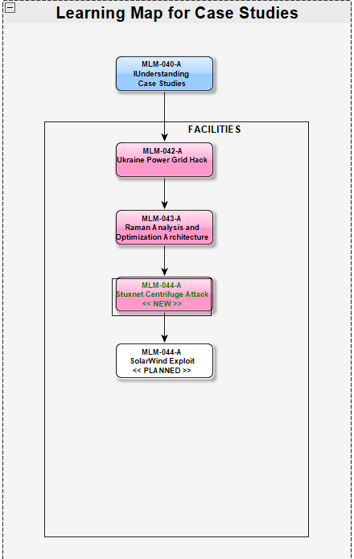
Simple Learning Maps
A Learning Map may be just a
Recommended list of MLMs
For example, these 3 case studies
It may even show planned or
recently added MLMs.
Notes:
Some MLM learning maps may be simple linear lists, like this list of case studies.
It shows a related set MLMs and the order in which they should be viewed.
It can even be used to show planned MLMs or ones that were recently added (shown with black text on a white background).

Slide 4
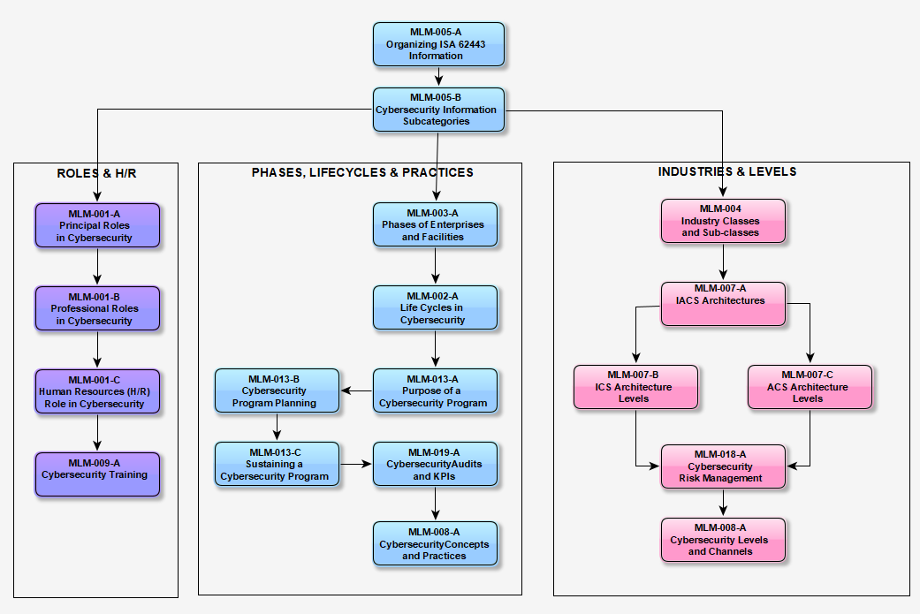
A Learning Map May Guide Users Through Complex Concepts
H/R
Course
Notes:
Learning Maps may also be used to communicate complex concepts.
This Learning Map has been organized (and color-coded) according to the main information class of each MLM, specifically
Principal roles, professional roles, and human resources (purple)
Phases, lifecycles, and practices (in blue), or
Industrial Facility Types and architectural levels (shown in pink)
The whole Learning Map might be included in a course.
Courses can be quickly assembled by drag-and-dropping MLM blocks using the free yEd graphics program that was used to create this PERA Learning Map.
MLMs were designed for easy export to Learning Management Systems (LMS) in standard SCORM format used by most universities and corporate LMS’s.
Since each MLM is 5 to 10 minutes in length, each of the 3 subjects shown here represents approximately an hour of self-paced Learning.

Slide 5
Learning Maps Integrate with Other PERA Materials
May be Integrated with other PERA learning materials including User Guides, whitepapers, blogs, etc.
User Guide or Whitepaper
e.g., “Implementing a Corporate
ACS Cybersecurity Program”
Learning Map for CISO
Learning Map for CTO
Learning Map for H/R Mgr.
MLM
MLM
MLM
MLM
MLM
MLM
MLM
Notes:
MLMs and Learning Maps can be structured to support Marketing Programs. In this case:
a Whitepaper on “Implementing a Corporate ACS Cybersecurity Program” provides links to
Learning Maps for Professional Roles (Chief Information Security Officer, Chief Technical Officer, and Human Resources Manager), that in turn
Provides links to MLMs on specific topics.

Slide 6
Key Messages
Learning maps provide a visual guide to MLMs, their relationships, and recommended viewing order.
Courses can be assembled from Learning Maps for specific audiences.
An MLM can be viewed by clicking its icon on a learning map (or other documents such as User Guides).
Learning Maps and MLMs can be loaded into company LMS (Learning Management Systems) that use the SCORM standard.
Notes:
Learning maps provide a visual guide to MLMs, their relationships, and recommended viewing order.
Courses can be assembled from Learning Maps for specific audiences.
An MLM can be viewed by clicking its icon on a learning map (or other documents such as User Guides.
Learning Maps and MLMs can be loaded into company LMS (Learning Management Systems) that use the SCORM standard.

Slide 7
Further Information
References about Microlearning:
  What is Instructional Design (Purdue University website)
  E-Learning attention spans
  Microlearning: Knowledge management applications and competency-based training in the workplace
Related MLMs
  MLM-024-A What is an MLM ?
  MLM-021-A What is yEd Graphics ?
Please click here to comment on this learning module.
Notes:
We hope you found this MLM useful and interesting.
Here are some web links to micro learning reference material.
Another MLM you might find interesting is
MLM-024-A: What is an MLM ?
Please use the link to provide comments and suggestions.

Slide 8

Author
Gary has more than 40 years of experience with enterprise integration and optimization projects, including PERA master planning and project management.
As one of the initial authors of the PERA Handbook of Master Planning, he has used PERA Enterprise Architecture and Master Planning methodologies throughout his career including control and information systems for oil production, pipelines, refining and marine loading, petrochemicals, coal, gas, and oil-fired power plants, polyethylene, ammonia, explosives, paint, pulp and paper, food and beverage, and pharmaceuticals. LNG facilities included world-scale arctic, European, and US Gulf coast complexes.
Infrastructure facilities included Fire, Police, and Emergency Response systems for major US cities, as well as emissions reporting and trading systems for more than 100 US Power Plants.
https://creativecommons.org/licenses/by-sa/4.0/

