Slide 1
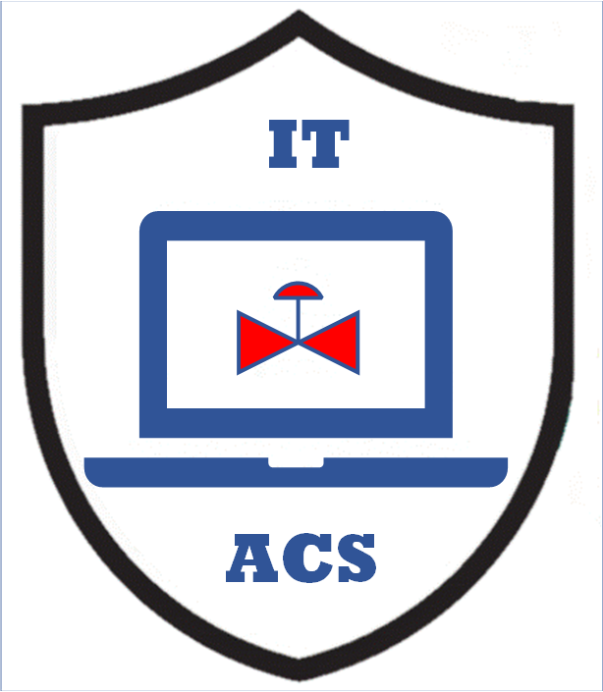


Software Upgrades and Patches
for Plant ICS, OT, and IT Systems
MLM-026-A
Industry – Process Industry
Principal Role – All
Professional Role – Control Engineer +
IT Specialists
Enterprise Phase – Operations
Turn on your audio and click start to begin video
Notes:
PERA addresses all levels in the Enterprise Architecture. This MLM addresses Software Updates and Patch Management) for
Automation and Control Systems (ICS),
Operational Technology (OT) including both IT and ICS infrastructure, and
IT systems including plant and corporate architecture levels.
The intended audience is ICS asset owners along with integration and maintenance service providers supporting the asset owner.
Click the NEXT button when you are ready to advance to the next slide.

Slide 2
Software Patches and Upgrades May Apply to
IT, OT or ICS Systems
Enterprise Architecture
IT – Information Technology Systems (blue)
OT – Operational Technology devices and networks (green)
ICS – Industrial Control Systems (yellow)
Networks communicate within
and between IT, OT, and ICS systems. (blue, green, and yellow)
IT
OT
Architecture Level
ICS
  See MLM-014-A ICS + IT + OT Definitions
Notes:
It is important to define IT, OT, and ICS clearly.
Good working definitions of these are:
- An IT system is used for data-centric computing that does not control equipment.
An ICS is used to monitor events, processes, and devices and to make adjustments to equipment and operating targets.
OT systems may “overlay” both ICS and IT areas. They may use IT infrastructure and technologies in ICS Architectural areas and ICS technologies in IT Architectural areas.
See MLM-014-A for more detailed definitions of IT, OT, and ICS.

Slide 3
IT vs. OT in INDUSTRIAL
ENTERPRISE ARCHITECTURES
With Enterprise Integration, “Digital Twin” Plant Optimization, AI-based Logistics, and MRP systems, “high level” applications increasingly involve real-time data acquisition and regulatory control.
Industrial IT/OT split
CORP & DIVISIONAL
6 & 7
CORP & DIVISIONAL
ENG. &
IT
DP & MIS
TECH
LOCAL
IT
Specialists
5
LOCAL
DP/MIS
WIDE
ENG/TECH
AREA
R
NETWORK
OFFICE
LAN
4
MAINT.
PROD'N
DATA
QUALITY
PRODUCT
MGT
REPORT
HISTORIAN
MGT
TRACKING
IT & OT
Specialists
Collaborate
New
OT
SITEWIDE
& SCHED
INDUSTRIAL
LAN
3
POWER
PROCESS
PROCESS
PROCESS
WAREH'SE
HOUSE
AREA 1
AREA
AREA 3
AUTOMAT'N
SUPRV.
SUPRV.
SUPRV.
SUPRV.
Control
Engineers
2
OPER.
OPER.
OPER.
OPER.
PROPRIETARY
OPER.
DISP.
DISP.
DISP.
DISP.
DCS AND PLC
DISP.
ICS
NETWORKS
1
CONTROLLERS, PLC'S, DATA ACQUISITION DEVICES, ETC.
Notes:
With increased Enterprise Integration, “Digital Twin” Plant Optimization, AI-based Logistics, and MRP systems, “high level” applications increasingly involve real-time control of plant operations.
This requires expertise in real-time control algorithms, model-based control, loop instability and other Industrial Control System (ICS) technologies that have “grown” from plant regulatory control.
Similarly, IT specialists are implementing IT systems in plant environments (like bar code readers or building access badge readers). This requires IT specialists to learn more about intelligent device specifications and real-time data acquisition.
Thus, it is not possible to “draw a line” where Control Engineers stop and IT Specialists begin (if it ever was). Increasingly, systems at levels 3 and 4 must be designed and supported as a “partnership” between ICS and IT resources. We are even seeing IIoT and IoT devices implemented at Levels 1 and 2, and control engineering expertise applied at level 4 and above.

Slide 4
What is a Software Upgrade?
A Software Upgrade is “Any software modification that adds or changes a system feature .“
  Upgrades may apply to IT, OT or ICS systems
  ICS and OT Upgrades typically require retesting and certification before returning systems to service
  Upgrades are typically treated as less urgent than Patches since the reason to apply them is primarily to obtain new or modified features
  A benefit analysis may be necessary to decide when (or whether) to apply an update.
“Software update management” is defined as monitoring, acquiring, testing, scheduling and installing software upgrades and patches to a product.
Notes:
A Software Upgrade is “Any software modification that adds or changes a system feature .“
Upgrades may apply to IT, OT or ICS systems
ICS and OT Upgrades typically require retesting and certification before returning systems to service
Upgrades are typically treated as less urgent than Patches since the reason to apply them is primarily to obtain new or modified features
A benefit analysis may be necessary to decide when (or whether) to apply an update.
“Software update management” is defined as monitoring, acquiring, testing, scheduling and installing software upgrades and patches to a product.

Slide 5
What is a Software Patch ?
A Software patch is “any change to address a software bug, security vulnerability, reliability or operability issue.”
Patches typically include important functionality, security, and cybersecurity updates.
A Benefit / Risk Analysis is necessary to determine whether to implement Patches immediately, at the next plant shutdown, or at all.
Systems and networks at lower levels in the Enterprise Architecture typically require hazard analysis to determine tradeoffs between the cost and risk of patching, and the benefits of more prompt patching.
It is necessary to assign people and resources to determine if patches and updates should be implemented, and if so, to accomplish and document these.
Notes:
A Software patch is “any change to address a software bug, security vulnerability, reliability or operability issue.”
Patches typically include important functionality, security, and cybersecurity updates.
A Benefit / Risk Analysis is necessary to determine whether to implement Patches immediately, at the next plant shutdown, or at all.
Systems and networks at lower levels in the Enterprise Architecture typically require hazard analysis to determine tradeoffs between the cost and risk of patching, and the benefits of more prompt patching.
It is necessary to assign people and resources to determine if patches and updates should be implemented, and if so, to accomplish and document these.

Slide 6
What are ICS Software Updates and Patches?
PERA defines ICS updates and patches as “Any software change in an Automation or Industrial Control System.”
ICS includes regulatory control, alarm and interlock systems and associated Human-Machine Interfaces.
This also includes process safety and cybersecurity in Automation systems.
It is rarely advisable to implement ICS Patches or Updates before the next plant shutdown in order to:
  Avoid risks associated with safety and production losses
  Allow for thorough testing and re-approval
Priorities for ICS systems are based on Safety, Availability, Integrity and Confidentiality (SAIC).
Notes:
PERA defines ICS updates and patches as “Any software change in an Automation or Industrial Control System.”
ICS includes regulatory control, alarm and interlock systems and associated Human-Machine Interfaces.
This also includes process safety and cybersecurity in Automation systems.
It is rarely advisable to implement ICS Patches or Updates before the next plant shutdown in order to:
Avoid risks associated with safety and production losses
Allow for thorough testing and re-approval
Priorities for ICS systems are based on Safety, Availability, Integrity and Confidentiality (SAIC).

Slide 7
What are IT Software Updates and Patches?
IT updates and patches include “Any software change in an IT system.”
Since IT data processing and reporting systems do not include control of equipment or processes, failures do not risk plant safety and production losses.
Failures of IT systems may risk significant financial impacts or loss of sensitive data. It is therefore necessary to decide:
  When (and whether) to apply updates and patches
  Whether thorough testing and re-approval are required before restarting IT systems.
Priorities for IT systems are Confidentiality, Integrity, and Availability (CIA).
Notes:
IT updates and patches include “Any software change in an IT system.”
Since IT data processing and reporting systems do not include control of equipment or processes, failures do not risk plant safety and production losses.
Failures of IT systems may risk significant financial impacts or loss of sensitive data. It is therefore necessary to decide:
When (and whether) to apply updates and patches
Whether thorough testing and re-approval are required before restarting IT systems.
Priorities for IT systems are Confidentiality, Integrity, and Availability (CIA).

Slide 8
What are OT Software Updates and Patches ?
An OT system “contains both ICS and IT devices and Infrastructure” and may impact operation of plant equipment or processes:
OT systems must obey ICS Safety, Availability, Integrity and Confidentiality priorities (SAIC).
However, OT systems may contain IT devices and infrastructure, so data Confidentiality, Integrity, and Availability requirements must be addressed.
The effect of these conflicts must be resolved as part of the OT system design and operating procedures.
This will require assessment of costs and benefits and will require involvement by both ICS and IT staff.
Notes:
An OT system “contains both ICS and IT devices and Infrastructure” and may impact operation of plant equipment or processes:
OT systems must obey ICS Safety, Availability, Integrity and Confidentiality priorities (SAIC).
However, OT systems may contain IT devices and infrastructure, so data Confidentiality, Integrity, and Availability requirements must be addressed.
The effect of these conflicts must be resolved as part of the OT system design and operating procedures.
This will require assessment of costs and benefits and will require involvement by both ICS and IT staff.

Slide 9
How to Test ICS, OT and Plant IT Systems ?
Testing of ICS systems:
ICS testing often involves “digital twin” or equipment modelling
Penetration testing is not recommended for ICS or OT systems.
Testing of OT systems:
OT systems connect to IT devices and infrastructure, so data confidentiality risk must be addressed with additional hardware, software, and procedures if necessary.
Testing of IT Plant systems:
IT systems may use “black box” and “white box” statistical testing for systems where cost and risk of testing does not support shutdown, testing and restart.
Notes:
Testing of ICS systems:
ICS testing often involves “digital twin” or equipment modelling
Penetration testing is not recommended for ICS or OT systems.
Testing of OT systems:
OT systems connect to IT devices and infrastructure, so data integrity risk must be addressed with additional hardware, software, and procedures.
Testing of IT Plant systems:
IT systems may use “black box” and “white box” statistical testing for systems where cost and risk of testing does not support shutdown and thorough acceptance testing.

Slide 10
Benefits of Update and Patch Management
Update and Patching strategy at all levels in the enterprise architecture is based on assessed costs and risks.
Patches and updates are managed according to documented procedures.
Regulatory compliance is assured and documented
Certified “Golden Copy” of installed software is always available
Asset Inventory and patch management costs are identified and planned
Provides a foundation for metrics such as KPIs to communicate to leadership
Notes:
Benefits of Update and Patch Management
Update and Patching strategy at all levels in the enterprise architecture is based on assessed costs and risks.
Patches and updates are managed according to documented procedures.
Regulatory compliance is assured and documented
Certified “Golden Copy” of installed software is always available
Asset Inventory and patch management costs are identified and planned
Provides a foundation for metrics such as KPIs to communicate to leadership

Slide 11
Key Messages
The following are key messages in this MLM:
Software Updates and Patches are different and require different risk and cost assessment
ICS, IT and OT systems have different requirements and priorities (SAIC, CIA, and both).
Update Management is necessary and must be staffed and funded.
Staff and resources must be planned for testing after Patching and Updates and before restarting systems. Testing is very different for ICS and IT.
Configuration management requires software procedures, records and backup versions.
Notes:
The following are key messages in this MLM:
Software Updates and Patches are different and require different risk and cost assessment
ICS, IT and OT systems have different requirements and priorities (SAIC, CIA, and both).
Update Management is necessary and must be staffed and funded as part of maintenance management.
Staff and resources must be planned for testing after Patching and Updates and before restarting systems. Testing is very different for ICS and IT.
Configuration management requires software procedures, records and backup versions.

Slide 12
Further Information
Related MLMs
  MLM-014-A : ICS + IT + OT Definitions
  MLM-026-B : Security Update and Patch Management of Plant Systems for Vendors
  MLM-026-C: Update, Testing, and Patching of plant systems for EPC and Service Providers.
References:
  ISA TR62443-2-3 Patch Management in the ICS Environment
  Also search for cybersecurity articles at ISA Global Cybersecurity Alliance
  Please click here to provide feedback on this MLM.

Slide 13

Author
Gary has more than 40 years of experience with enterprise integration and optimization projects, including PERA master planning and project management.
As one of the initial authors of the PERA Handbook of Master Planning, he has used PERA Enterprise Architecture and Master Planning methodologies throughout his career including control and information systems for oil production, pipelines, refining and marine loading, petrochemicals, coal, gas, and oil-fired power plants, polyethylene, ammonia, explosives, paint, pulp and paper, food and beverage, and pharmaceuticals. LNG facilities included world-scale arctic, European, and US Gulf coast complexes.
infrastructure facilities included Fire, Police, and Emergency Response systems for major US cities, as well as emissions reporting and trading systems for more than 100 US Power Plants,
https://creativecommons.org/licenses/by-sa/4.0/

