Slide 1
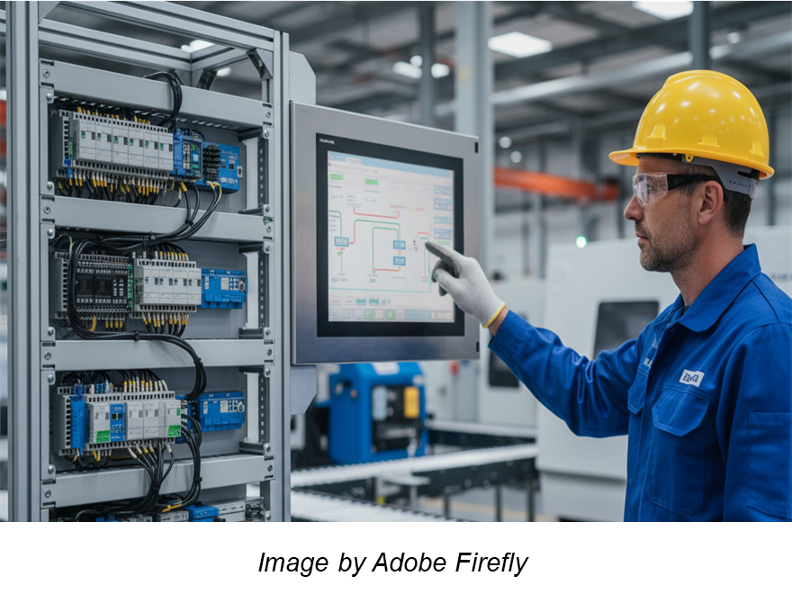


Cybersecure Operation of PLCs and RTUs
MLM-035-C
Industry – Process
Principal Role – Owner
Professional Role – Control Engineer
Enterprise Phase – Master Planning
Turn on your audio and click start to begin video
Notes:
PRINT VERSION OF NARRATIVE
This Micro-Learning Module (MLM) discusses principles for the secure operation of PLCs and RTUs. It describes recommended precautions and procedures as well as a work process for responding to anomalous events such as operating errors or cyber attacks.
The intended audiences for this MLM are ACS engineers, IT teams dealing with ACS cyber defense, consultants, systems integrators, and managers making decisions about how to achieve ACS cyber security.

Slide 2
PLC and RTU Cybersecurity Measures
Security control
Physical security control within defined boundaries
Password assignment and management (different for ACS, OT, and IT zones)
Always maintain “Golden Image copy” of PLC/RTU & HMI programs
Permit Remote access using only secure, approved methods
PLCs/RTUs must be “locked down” to prevent unauthorized changes
Monitor industrial data transmission (for suspicious patterns)
Integrate cybersecurity alarms into plant operating procedures
Track Target Security Levels and Achieved Security Levels
Track Maturity Level of cybersecurity practices
Respond to cybersecurity incidents according to company policies
Notes:
The following PLC cybersecurity measures are discussed:
Security control
Physical security control within defined boundaries
Password assignment and management (different for ACS, OT, and IT zones)
Always maintain “Golden Image copy” of PLC/RTU & HMI programs
Permit Remote access using only secure, approved methods
PLCs/RTUs must be “locked down” to prevent unauthorized changes
Monitor industrial data transmission (for suspicious patterns)
Integrate cybersecurity alarms into plant operating procedures
Track Target Security Levels and Achieved Security Levels
Track Maturity Level of cybersecurity practices
Respond to cybersecurity incidents according to company policies

Slide 3
Response to Security Events & Incidents
Restart BCP Process
Normal Plant Operation
Deploy enhanced monitoring
Continue Monitoring
Detection of an event
Yes
Cyber Incident Confirmed?
No
Create a brief report
Investigation
Active Incident Response process
Completed
Detected Errors or Negligence?
Yes
Conduct Forensics
Conduct Recovery
No
Recovery Completed
Create a document
Create a document
Submit of detailed Incident report to management
Notes:
This is an example of an approved workflow for addressing security incidents detected by operations.
In the event that the incident is confirmed to be a Cybersecurity Incident (e.g., a cyber attack or operating error) , the required incident response work process is described, including reporting requirements.

Slide 4
Recommended ACS Cybersecurity Actions
Control physical perimeter access
Mount in a secure area, and lock cabinets where feasible
Block unused ports (e.g., USB and LAN ports)
Prevent connection of unauthorized devices to the network
Control Logical Security
Password management (together with H/R)
“Golden Image” copy for all programs and validation processes for changes
Programming devices must never be connected to the internet
Asset Inventory Management
Maintain accurate asset inventory for all intelligent industrial devices
Track Vulnerability Bulletins from CISA and applicable vendors
Notes:
The following ACS Cybersecurity Actions are recommended:
Control physical perimeter access
Mount in a secure area, and lock cabinets where feasible
Block unused ports (e.g., USB and LAN ports)
Prevent connection of unauthorized devices to the network
Control Logical Security
Password management (together with H/R)
“Golden Image” copy for all programs and validation processes for changes
Programming devices must never be connected to the internet
Asset Inventory Management
Maintain accurate asset inventory for all intelligent industrial devices
Track Vulnerability Bulletins from CISA and applicable vendors

Slide 5
Software Patching and Updates
PLC / RTU Patching
Apply company PLC Patching and Update procedures
Patching & Update instructions should be clearly defined for each device
In every case, a decision is required on whether patches or updates are urgent
If possible, conduct non-urgent patches during planned shutdowns
Use only certified programming devices for a specific plant
Testing all control devices and industrial computers
As a part of the initial acceptance procedure
After modification of programs or hardware
After updates of the application program
After significant repairs/modifications and before equipment restart
Notes:
Software patching and updates require the following:
PLC / RTU Patching
Apply company PLC Patching and Update procedures
Patching & Update instructions should be clearly defined for each device
In every case, a decision is required on whether patches or updates are urgent
If possible, conduct non-urgent patches during planned shutdowns
Use only certified programming devices for a specific plant
Testing all control devices and industrial computers
As a part of the initial acceptance procedure
After modification of programs or hardware
After updates of the application program
After significant repairs/modifications and before equipment restart

Slide 6
Asset Inventory Management
Tracking both Hardware and software assets
Adhere to the company’s Asset Management process
Manage data in the Configuration Management System
Use Intrusion Detection System (IDS) for scanning
Use the PLC/RTU vendors’ maintenance tools
Tracking the Vulnerability Bulletins for each device
Received from the product vendor
Obtained from periodic publications from CISA
Corrective actions
Always act according to urgency and criticality
Perform thorough operational testing after completion
Notes:
An Accurate Asset Inventory is essential and requires:
Tracking both Hardware and software assets
Adhere to the company’s Asset Management process
Manage data in the Configuration Management System
Use Intrusion Detection System (IDS) for scanning
Use the PLC/RTU vendors’ maintenance tools
Tracking the Vulnerability Bulletins for each device
Received from the product vendor
Obtained from periodic publications from CISA
Corrective actions
Always act according to urgency and criticality
Perform thorough operational testing after completion

Slide 7
Monitor Operating Data Flows
Monitor data transmissions (for suspicious patterns)
Detect anomaly conditions and behavior for each zone (ACS, OT, and IT)
Verify that commands are issued only from authorized locations
Monitor data transmissions and compare to the typical baseline
Monitor parameter values and rates
Minimize the use of “external” programming tools
Use of on-site tools owned by the operator
Never connect through public internet, and preferably not wireless media
Install updates using only genuine CDs and hardware from the vendor
Configuration Management systems – ref; ISA 108
https://www.isa.org/standards-and-publications/isa-standards/isa-standards-committees/isa108
Notes:
It is recommended to monitor and control operating data flows including:
Monitor data transmissions (for suspicious patterns)
Detect anomaly conditions and behavior for each zone (ACS, OT, and IT)
Verify that commands are issued only from authorized locations
Monitor data transmissions and compare to the typical baseline
Monitor parameter values and rates
Minimize the use of “external” programming tools
Use of on-site tools owned by the operator
Never connect through public internet, and preferably not wireless media
Install updates using only genuine CDs and hardware from the vendor
Configuration Management systems – ref; ISA 108

Slide 8

Author
Daniel Ehrenreich
Daniel has over 33 years of experience with the control of industrial operations and the integration of cybersecurity solutions.
He is a control engineering consultant, workshop lecturer, and an expert in cyber-secure operation for ACS.
Daniel has contributed his knowledge and expertise to multiple ISA 62443 workgroups.
Since 2016, acting as the Chairman of the annual ICS-Cybersec Conference taking place in Israel
Please click here to provide feedback on this MLM.
https://creativecommons.org/licenses/by-sa/4.0/
Notes:
Daniel Ehrenreich has over 32 years of experience in controlling industrial operations and integrating cybersecurity solutions.
He is a control consultant, workshop lecturer, and expert at SCCE- Secure Communications and Control Experts. Daniel has also contributed his expertise to multiple ISA 62443 workgroups and conducted free podcast sessions to educate engineers worldwide. Since 2016, acting as the Chairman of the annual ICS-Cybersec Conference taking place in Israel.

