Slide 1
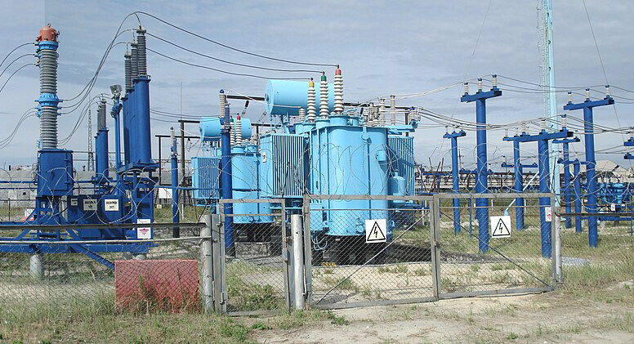



Cyberattacks on Ukraine’s Power Grid 2015-2016 (Part 1)
Micro Learning Module
Author
MLM-043-A
Industry – Power
Principal Role – Owner
Professional Role – All
Enterprise Phase – Master Planning
Vytautas Butrimas
Soviet-style Electrical Substation
Wikimedia Creative Commons
Author’s presented views do not represent the official position of NATO
Turn on your audio and click start to begin video
Notes:
PRINT VERSION OF NARRATIVE
This module addresses the first of two cyber attacks that targeted Ukraine’s power grid in December 2015 and 2016.
Its intended audience are CISOs, CEOs, CTOs of power utilities and other energy sector enterprises such as oil, gas, and nuclear.
Click the NEXT button when you are ready to advance to the next slide.

Slide 2
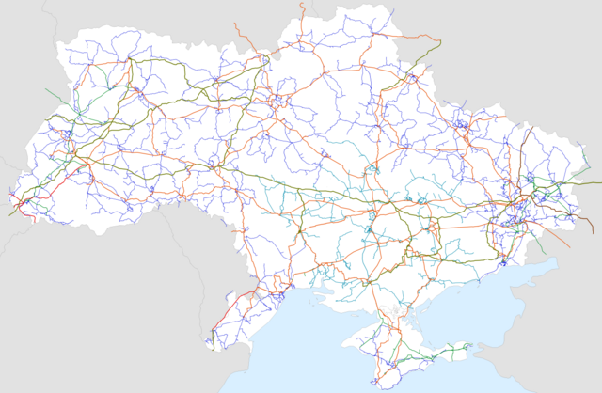
What led to events on December 23, 2015?
Russia’s annexation of Ukraine’s Crimea province (2014)
In November 2015, an unknown group blew up pylons supporting electric supply to Crimea
Demonstrators interfered with repair operations
Russian Minister of Energy blamed Ukraine’s Government
Ukraine Power Transmission Network
Wikimedia Creative Commons
Notes:
PRINT VERSION OF NARRATIVE
The blackout in a region of Ukraine in 2015 occurred during a military conflict between Ukraine and Russia.
Russia’s annexation of Ukraine’s Crimea province (2014) 22 November 2015 -- an unknown group blew up some pylons that supported the electric power supply to Crimea. Demonstrators interfered with repair operations. The Russian Minister of Energy blamed Ukraine’s Government

Slide 3
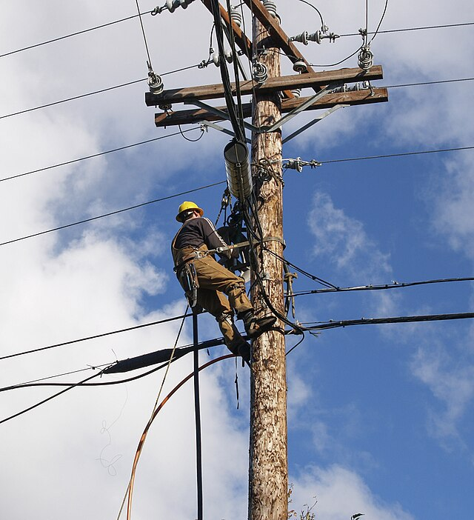
What happened on December 23, 2015?
December 23, 2015
Remote cyber intrusions at three electric power distribution companies…
…caused a blackout impacting approximately 225,000 customers
Power was restored after a few hours
Electrical Lineman
Wikimedia Creative Commons
Notes:
PRINT VERSION OF NARRATIVE
On December 23, 2015, remote cyber intrusions at three regional electric power distribution companies (Oblenergos) caused a blackout impacting approximately 225,000 customers
Power was restored after a few hours via manual action.

Slide 4
How the attack was executed - Preparation
Intrusion, reconnaissance, preparation phase (several months)
Malware was delivered via spear-phishing e-mails with malicious attachments
Attacker established a foothold, obtained credentials, and increased access to other parts of the network
Attacker compromised connected operational networks of the power grid control system
“He’s trying to reach the section breakers, is he trying to switch them off?”
- Operator’s reaction to someone taking over his control screen and opening substation breakers
Notes:
PRINT VERSION OF NARRATIVE
Intrusion, reconnaissance, preparation phase (several months)
Malware was delivered via spear phishing emails with malicious attachments
The attacker established a foothold, obtained credentials, and increased his access to other parts of the network
A way was found into the connected operational networks of the power grid control system
“He’s trying to reach the section breakers, is he trying to switch them off?”
- Operator’s reaction at someone taking over his control screen and opening substation breakers
https://us-cert.cisa.gov/ics/alerts/IR-ALERT-H-16-056-01

Slide 5
How the attack was executed
Execution phase
Access to SCADA control was used to remotely open breakers at >30 substations
Serial-to-ethernet servers were disabled with bad firmware
UPS was disabled with bad firmware
Wiper malware was applied to workstations
Denial-of-service attack was conducted against the utility’s telephone system
Response of the power utility operator
Went to manual control after loss of SCADA
Engineers traveled to substations to close breakers
Notes:
PRINT VERSION OF NARRATIVE
Execution phase
Access to SCADA control was used to remotely open breakers at over 30 substations
Serial-to-ethernet servers compromised/disabled with bad firmware resulted in operator loss of view and control (an operator’s worst nightmare)
UPS was disabled with bad firmware
Wiper malware was applied to workstations
In parallel with the main attach, a denial-of-service (DoS) attack targeted the operator’s telephone system. Customers could not report a loss of service.
Response of the power utility
Went to manual restoration (closing breakers) at the affected substations after losing remote monitoring and control capability
Engineers and other support staff traveled to each of the affected substations to manually close the breakers

Slide 6
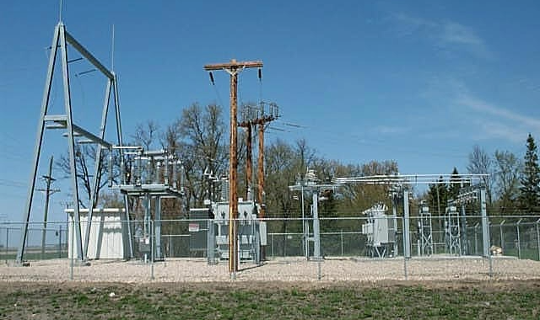
Key Messages
Think of your operations as a target and be prepared.
Political conflicts can spill over into industrial operations.
The cyber intruder seeks to avoid detection and the presence may only become apparent after an attack has been executed.
Internet-connected business networks must be separated from control networks.
Remote access policies should be strictly enforced
Capability to monitor equipment and control networks for anomalous behavior is required for early detection of and response to a breach.
Refer to ISA/IEC 62443 Part 3-3: System security requirements and security levels.
Remote Electrical Substation
Wikimedia Public Domain
Notes:
PRINT VERSION OF NARRATIVE
The following are the key messages to take away from this MLM:
Think of your operations as a target and be prepared.
Political conflicts can spill over into industrial operations. Your operations may get “caught in the crossfire”.
The cyber intruder seeks to avoid detection and the presence may only become apparent after an attack has been executed.
Internet-connected business networks must be separated from control networks.
Remote access policies should be strictly and actively controlled.
Capability to monitor equipment and control networks for anomalous behavior is required for early detection and response to a breach.
You may find it useful to refer to ISA/IEC 62443 3-3 Security for industrial automation and control systems Part 3-3: System security requirements and security levels for ways to defend against and improve the resilience of critical systems to advanced cyber attacks.

Slide 7
Further Information
Related MLMs
Cyberattacks on Ukraine’s Power Grid 2015-2016 Part 2
References:
https://www.isa.org/intech-home/2017/march-april/features/ukrainian-power-grids-cyberattack
ISA/IEC 62443 3-3 Security for industrial automation and control systems Part 3-3: System security requirements and security levels
Grid operators description of the attack on December 23rd https://www.youtube.com/watch?v=bV47gBsrDkc
https://us-cert.cisa.gov/ics/alerts/IR-ALERT-H-16-056-01
Notes:
PRINT VERSION OF NARRATIVE
Select the Resources tab (at the top of the screen) to view and/or print this MLM, including the speaker notes. Some people like to review the slides and written narrative after listening to the micro learning module. Some like to print them and follow along as they listen to the video. It’s up to you.

Slide 8
Author – Vytautas Butrimas
Vytautas Butrimas has been working in defense and cyber security roles for over 30 years including:
Vice-minister at the Ministry of Communications and Informatics, Republic of Lithuania responsible for Information Society programs.
Defense Policy and Planning Director, Lithuanian Ministry of National Defense (MoND) responsible for preparing the first Military Defense Strategy.
Deputy Director responsible for IT security at the Communications and Information System Service (CISS) responsible for preparing the first National Defense System Cybersecurity Strategy
Chief Adviser for the MoND of Lithuania with a focus on cybersecurity policy, including the national task force that wrote the Lithuanian Law on Cybersecurity
Member (Presidential appointee) of the National Communications Regulatory Service’s Council (RTT-Coucil)
Cybersecurity Subject Matter Expert for the NATO Energy Security Center of Excellence (NATO ENSECCOE) who performed a Cyber Risk Study of the ICS Used in the NATO Central Europe Pipeline System (CEPS)
https://creativecommons.org/licenses/by-sa/4.0/

