Slide 1
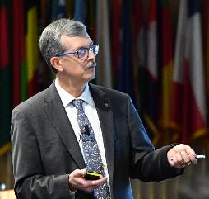


Industrial Cybersecurity for the CISO Part 1
What is industrial cybersecurity?
Micro Learning Module
Author
Corporate Portfolio
MLM-050-A
Industry – Process
Principal Role – Owner
Professional Role – CISO
Enterprise Phase – All
CISO
Chief
Inform
-ation
Security
Officer
Vytautas Butrimas
Author’s presented views are his own
Turn on your audio and click start to begin video
Notes:
PRINT VERSION OF NARRATIVE
This module addresses what a Chief Information System Officer or CISO needs to know in order to work with Automation and Control Systems (ACS).
Click the START button when you are ready to advance to the next slide.

Slide 2
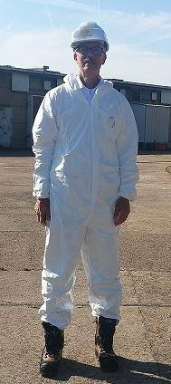
What’s Different about Industrial Cybersecurity?
Corporate Portfolio
CISO
Chief
Inform
-ation
Security
Officer
Process Safety
Is the highest
Security Priority
Photo of the author during plant visit
Unless otherwise indicated photos are
provided by the author under
Creative Commons
Plant Remit
Notes:
PRINT VERSION OF NARRATIVE
What may be missing for a CISO who works hard to protect data and information at the enterprise is an appreciation for safety.
This is how I had to prepare before visiting one of the pumping stations on an aviation fuel pipeline spanning 4 countries and extending for 5000 km. I had to dress up this way since I wanted to get up close to where physical processes governed by the laws of physics and chemistry were taking place behind me and below my feet. I found that my hosts who were the plant engineers were not so worried about losing data or information as they were about ensuring the pipeline performed its functions in a way that was safe for the operators and the surrounding public in addition to reliably and efficiently providing aviation fuel to military and civilian airbases. They performed these tasks with the help of industrial control systems and many other devices used to monitor and control the fuel flowing into, out of and down the pipeline.

Slide 3
“Houston, we have a problem”
There is a knowledge/understanding gap.
Those responsible for office or enterprise information systems approach cybersecurity in a different way than those responsible for monitoring and controlling a physical process.
Both groups do not necessarily have the same security objectives.
Notes:
PRINT VERSION OF NARRATIVE
The film “Apollo 13” has an interesting scene where NASA engineers are proposing what needs to be done in order to save the crew of a crippled spacecraft that suffered an explosion. In the midst of a heated discussion, one engineer essentially yelled out “Wait a minute! None of these solutions will work, since in 18 hours the crew will no longer be alive. The battery power to run the spacecraft life support and navigation systems will run out well before the spacecraft returns to earth.” There was a knowledge-understanding gap to be bridged between what the problem was and how best to solve it.
The purpose of this MLM is to bridge a similar gap in understanding and objectives in ensuring the cybersecurity of an industrial enterprise, manufacturer, or utility. This should be of concern to the Chief Information Security Officer or CISO since many aspects of his work in protecting information and data are now colliding with the world of industrial operations, where the main emphasis is less on the importance of data security and more on monitoring and controlling a physical process governed by the laws of physics and chemistry. Some CISOs are now charged with ensuring the cybersecurity of industrial operations in addition to what some may think is their primary task of ensuring data confidentiality, integrity, and availability of their office-oriented information systems.
This MLM will provide an awareness for the CISO of the essential aspects that need to be understood before implementing a cybersecurity policy in an industrial setting.

Slide 4
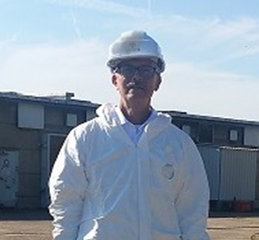

Dialogues with CISOs of Industrial Facilities
Thanks for showing me the server room, would it be possible to meet with your senior plant engineers?
PowerPoint
Stock Image
Visitor
Yes, that can be arranged; but I have never met them before.
CISO
Notes:
PRINT VERSION OF NARRATIVE
This is just one conversation I have had with a CISO during a visit to an industrial site:
Visitor: “Thanks for showing me the server room, would it be possible to meet with your senior plant engineers?”
CISO: “Yes, it can be arranged, but I never met them before….”

Slide 5

Dialogues with CISOs of Industrial Facilities
I am a new CISO and I am having trouble talking with my engineers. Could you advise me on how to speak their language?
PowerPoint
Stock Image
Newly-appointed CISO
of an oil company
Notes:
PRINT VERSION OF NARRATIVE
Another conversation I had:
CISO: “I am a new CISO and I am having trouble talking with my engineers, could you advise me on how to speak their language?”
-Newly-appointed CISO of an oil company
This is why I wrote these three MLMs for the CISO – to educate new CISOs about the unique challenges of implementing cybersecurity measures in an industrial environment. A deep knowledge of office cybersecurity is not enough to understand how to protect the process.

Slide 6
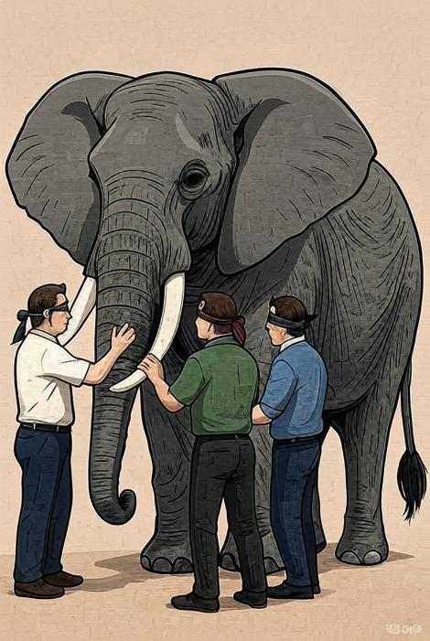

The IT - Industrial Cybersecurity Understanding Gap
I didn’t even know what a PLC was.
Image created by Gary Rathwell on Oct 27, 2025 using GROK.
We just didn’t have that baseline knowledge.
PowerPoint
Stock Image
I had to google: “What is a PLC?”
Software security analyst
Image Created by G. Rathwell and Grok
6
Notes:
PRINT VERSION OF NARRATIVE
There is an IT and industrial cybersecurity understanding gap. This graphic is based upon the story of the blind monks meeting an elephant -- they are all touching different parts of the same object and they all accurately describe the part they touch without truly describing the item as a whole.
This was a conversation I had with someone studying the Stuxnet incident. He didn't know what a PLC (Programmable Logic Controller) was. This demonstrates the gap between the IT world and the industrial world.
This is a good example that illustrates the difficulty an information technology-oriented person or CISO familiar with the security issues behind the use of office data processing and communications devices when confronted with a device used to monitor and control a physical process found in an industrial setting. In researching the STUXNET malware, the IT-oriented security specialist ran into a problem in understanding what part of the malware code was supposed to do. The Windows OS vulnerabilities exploited in the malware were just a small part of the actual code used to disrupt an industrial operation that, by the way, did not use a Windows OS but a proprietary system used in a Program Logic Controller made by another manufacturer.

Slide 7


Patching and Updates: The Engineering View
Can you tell me about your patching policy?
We consider patching to be an unacceptable industrial risk.
PowerPoint
Stock Image
Image by G. Rathwell and Adobe Firefly
Software Security Analyst
Plant Engineer
7
Notes:
PRINT VERSION OF NARRATIVE
Something else I've heard in my conversations about patching and updates. If you're an IT cybersecurity person, you know how important patching is. But you may run into something that I ran into, which is an engineer who told me "we consider patching to be an unacceptable industrial risk".
I understand now why patching can be a problem in an industrial operation. You don't like to change things unless there's a very good reason. Things are set to run in advance in a certain way, and a patch can cause problems.
To the CISO, patching and updating is a long-standing, accepted best practice to ensure the cybersecurity of the computers, servers and routers found in an office or enterprise environment. However, patches and updates for an industrial environment must be tested in a laboratory-safe setting before being applied to what may be a time-sensitive and specially-tuned environment. A patch that turns out to be faulty in the office environment can quickly be remedied by uninstalling it on the computer and the work can proceed along without disruption. On the other hand, an untested patch applied to an industrial operation could result in degraded or malfunctioning equipment that can result in loss of life, damage to property and environment.
For this reason, the CISO should not be surprised at the reaction of his or her plant engineers to a proposed cybersecurity procedure.

Slide 8

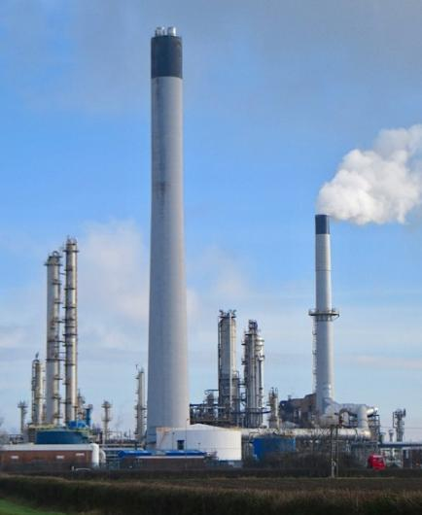

What, then, is Industrial Cybersecurity?
It includes enterprise-wide security policies and capabilities, employed to ensure the safety, reliability, and desired performance of the physical processes being monitored and controlled.
The goal is to protect the control system process, people, equipment, and environment.
PowerPoint
Stock Image
Image by
Adobe Firefly
Responsible for plant safety
Production Rate and Quality
Environmental Protection
Responsible for data security
Photo by Paul Harrop, Wikimedia, CC BY-SA 2.0
Notes:
PRINT VERSION OF NARRATIVE
What, then, is Industrial Cybersecurity?
It refers to the enterprise-wide security polices, and capabilities employed to ensure the safety, reliability, and desired performance of the physical processes being monitored and controlled.
The goal is to protect the control system process, people, environment and equipment.
I'll be talking about the differences between this and IT. In IT, you are worried about the information, but here you are worried about the physical process, to make sure it operates safely and within set bounds.

Slide 9






Key Messages
The information technology environment of the office is not the same as an industrial environment, governed by the laws of physics and chemistry.
Care must be taken when applying a cybersecurity policy to an industrial environment.
PowerPoint
Stock Image
Office
Factory
Notes:
PRINT VERSION OF NARRATIVE
The information technology environment of the office is not the same as an industrial environment, which is governed by the laws of physics and chemistry
Care must be taken when applying a cybersecurity policy to an industrial environment.

Slide 10
Further Information
Related MLMs
  MLM-050-B Industrial Cybersecurity for the CISO, Part 2
  MLM-050-C Industrial Cybersecurity for the CISO, Part 3
References:
  Butrimas, V., IT and ICS cybersecurity: a “Tale of Two Cities”, https://scadamag.infracritical.com/index.php/2017/08/21/1984/
  Butrimas, V., Hybrid CoE Working Paper 18: Defending critical infrastructure: The challenge of securing industrial control systems, Hybrid CoE, June 2022, https://www.hybridcoe.fi/publications/hybrid-coe-working-paper-18-defending-critical-infrastructure-the-challenge-of-securing-industrial-control-systems/
  Industrial Cybersecurity Tips for CISOs, Tripwire, accessed 2021-07-01 https://www.tripwire.com/-/media/tripwiredotcom/files/feature/industrial_cybersecurity_tips_for_cisos.pdf
Please click here to provide feedback on this MLM.
Notes:
PRINT VERSION OF NARRATIVE
Here are some Related MLMs and References.
Some people like to review the slides and written narrative after viewing the MLM video. Others prefer to print this “book format” PDF and follow along as they listen to the video. It’s up to you.

Slide 11
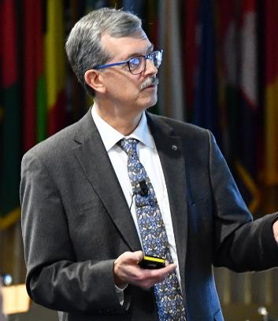
Author – Vytautas Butrimas
Vytautas Butrimas has been working in defense and cyber security roles for over 30 years including:
Vice-minister at the Ministry of Communications and Informatics, Republic of Lithuania responsible for Information Society programs.
Defense Policy and Planning Director, Lithuanian Ministry of National Defense (MoND) responsible for preparing the first Military Defense Strategy.
Deputy Director responsible for IT security at the Communications and Information System Service (CISS) responsible for preparing the first National Defense System Cybersecurity Strategy
Chief Adviser for the MoND of Lithuania with a focus on cybersecurity policy, including the national task force that wrote the Lithuanian Law on Cybersecurity
Member (Presidential appointee) of the National Communications Regulatory Service’s Council (RTT-Council)
Cybersecurity Subject Matter Expert for the NATO Energy Security Center of Excellence (NATO ENSECCOE) who performed a Cyber Risk Study of the ICS Used in the NATO Central Europe Pipeline System (CEPS)
Member of ISA 99 Workgroup 14 (Substation security profiles))
Former Co-chair ISA 99 Workgroup 16 (Incident management), WG 13 (MLM)
https://creativecommons.org/licenses/by-sa/4.0/

