Slide 1
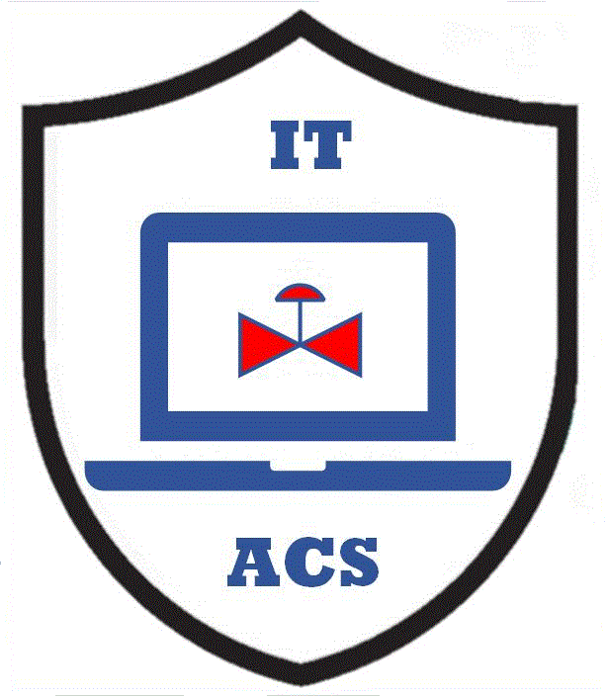
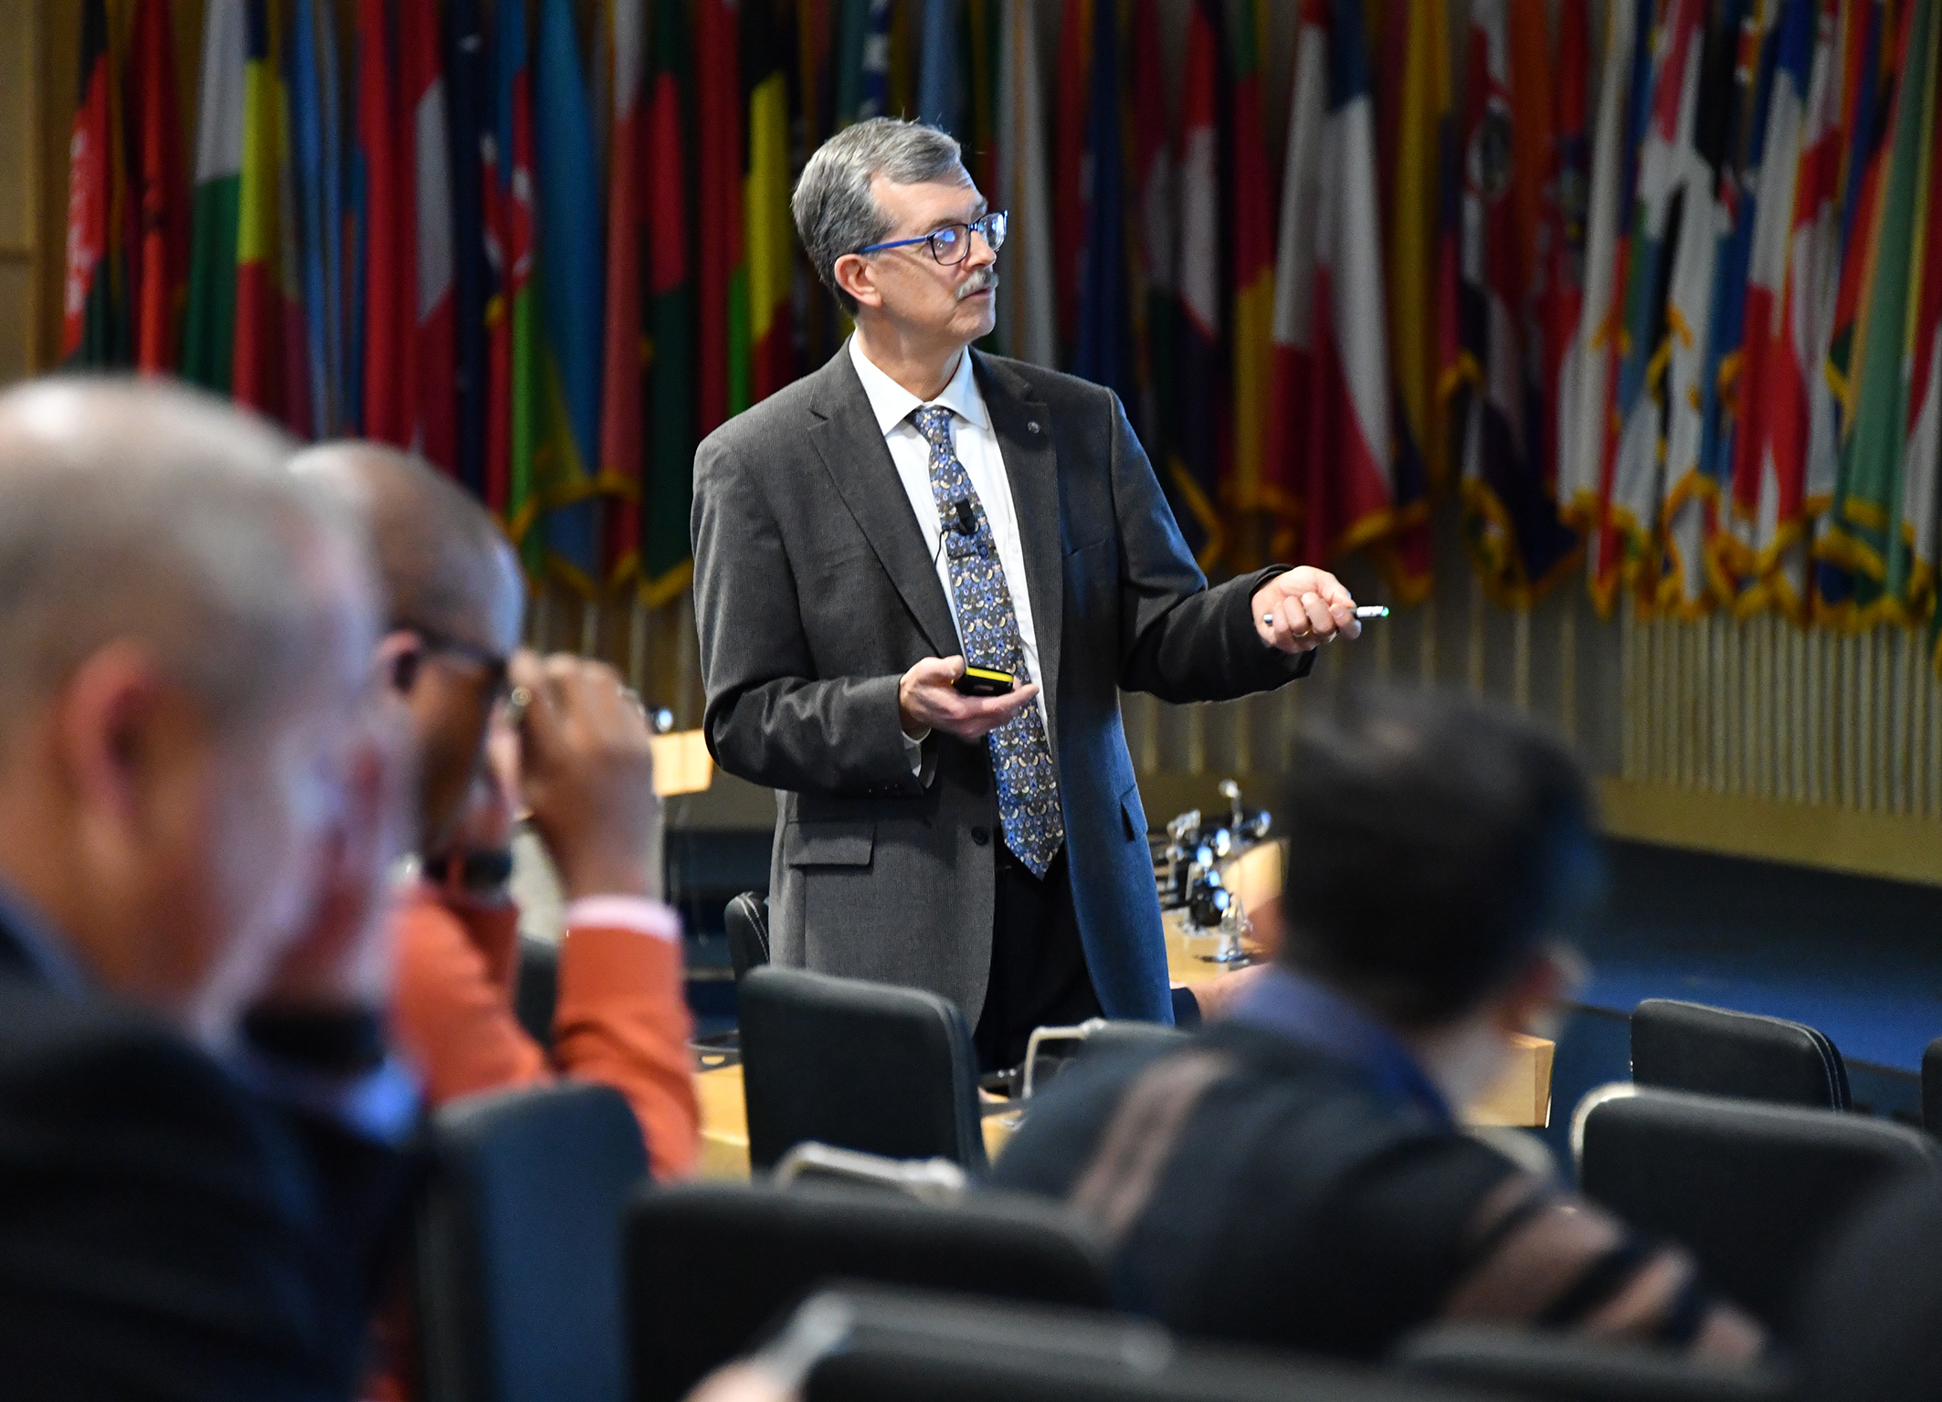


Industrial Cybersecurity for the CISO – Part 3 Approach to Industrial Cybersecurity
Author
Micro Learning Module
MLM-050-C
Industry – Process
Principal Role – Owner / Operator
Professional Role – CISO
Enterprise Phase – Master Planning
Vytautas Butrimas
Author’s presented views are his own
Turn on your audio and click start to begin video
Notes:
This module addresses what a Chief Information System/Security Officer (or CISO) needs to know to work with Automation and Control Systems (ACS). IT will shed some light on the importance of defining what it is that needs to be protected in an industrial or manufacturing environment where the focus is more on protecting the physical process equipment rather than enterprise data.
Click the NEXT button when you are ready to advance to the next slide.

Slide 2
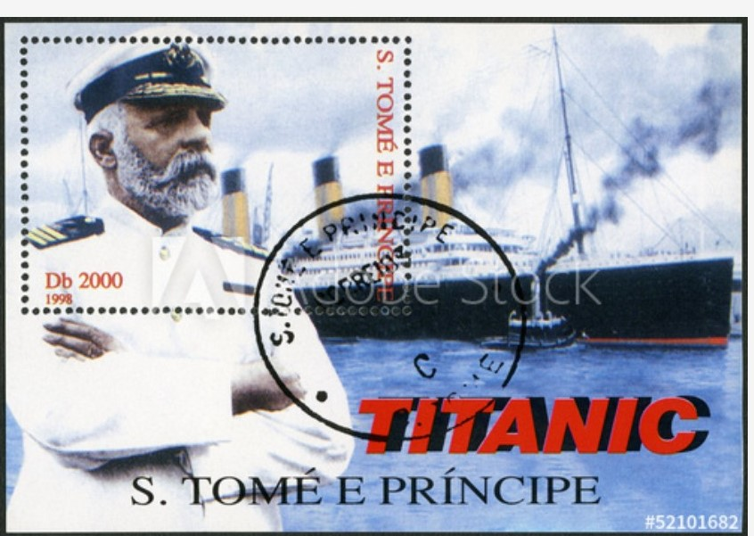
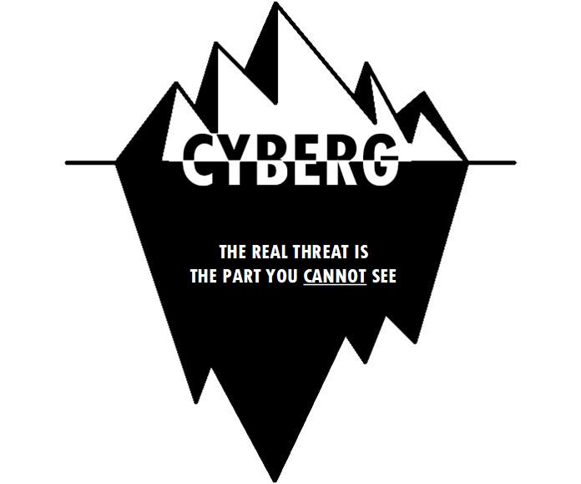
Being Aware of OT/ACS Security Challenges
2
Cpt. Edward Smith H.M.S. Titanic
Used with permission
http://cyberg.us/
Notes:
Remember the story of the captain of the HMS Titanic on the fateful evening in April 1912? The Titanic received warnings from other ships in the area that they had sighted many dangerous icebergs and decided to stop sailing and drift for the night until daylight would allow them to steam a safe course. For some reason, the captain of the Titanic chose to ignore these warnings and gave orders to keep on the same course at top speed through the night.
Actionable information was given to a leader and the leader chose to ignore it and, instead of avoiding a risk, decided to keep on going ahead. I call this “cyberg thinking”. There is even a website devoted to this term that you can visit. I like the 4th definition on the site: “A cyber-related condition whereby a threat, or warning of a possible threat, results in either the misinterpretation or misunderstanding of a given situation, resulting in a decision in which no corrective action is taken” – V. Butrimas http://cyberg.us/ .
I hope that after this MLM, you as the CISO will heed the warnings and avoid the mistake of the captain of the Titanic.
https://www.forbes.com/sites/jeanbaptiste/2019/08/13/alert-new-critical-security-flaws-affecting-all-windows-versions-millions-of-users-update-now/#28cba7a0470d
2

Slide 3
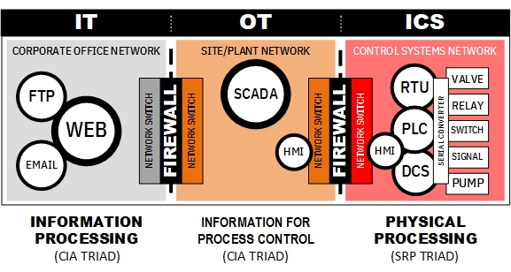
IT, OT and ACS role in operations of critical infrastructure
Business
Operations
ACS
Graphic used with permission of Bob Radvanovksy
http://icsmodel.infracritical.com/
Notes:
Once again, we will return to where IT, OT and ACS are found in an industrial or manufacturing environment. There are exceptions, perhaps many, that do not fully apply to what I have depicted in this chart. It is intended to reinforce the idea that IT cybersecurity policies for the business and operational sides need to be viewed and implemented in a coordinated and comprehensive way. Nothing should be left to chance. Defensive measures should be placed where they should be and not where we, the CISOs, think they should be. Think back to the heroic defense of Greece by the 300 Spartans at Thermopolis. Their leader led his force ably and effectively but did not take into account the possibility of a back mountain trail that would easily offer an opportunity for a surprise attack from behind.
Again, here we see depicted a rough picture of where IT and associated hardware and software are found in an industrial enterprise. Some may think that protecting the IT and OT is sufficient to protect the ACS side where the physical process is taking place. Protecting the control room where the SCADA is not enough. I have heard some highly-placed government officials say that putting an industrial-strength firewall between the OT and the internet-facing IT side of the enterprise should be sufficient– wrong! Take a look at the next slide.
3

Slide 4
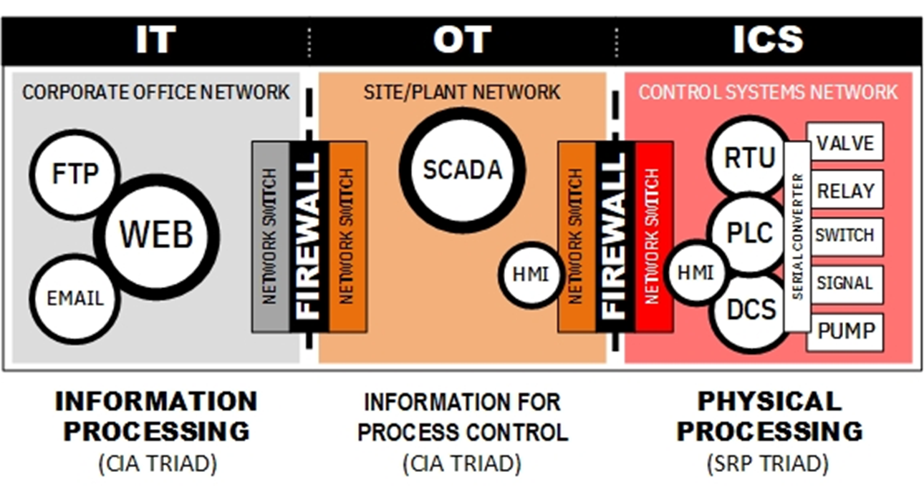

The Physical Process (ACS) is also a target
Saudi Aramco “wiper” 2012
Colonial pipeline “disruptionware” 2021
Falcon (EDR sensors) 2024
Steel Mill 2014/2022
Water 2023
Ukraine 2016
Ukraine 2015
Viasat/Enercon 2022
Stuxnet 2010
Triton SIS 2017
Saudi Arabia
Norsk Hydro 2019
Typhoon (Volt, Salt, Flax) 2022-today
Graphic used with permission of Bob Radvanovksy
http://icsmodel.infracritical.com/
TSMC 2018
Notes:
Yes, we do have cyber attacks on the IT side of industrial enterprises. A cyber attack that wiped the data from 30,000 office PCs and servers found in the administrative part of Saudi Aramco in 2012 hit the office IT side very hard but did not reach the equipment and software used to manage the operations in the oil fields and petrochemical and refinery plants. However, we see a disturbing trend in cyber attacks on the hardware and software used to monitor and control a physical process at those same industrial plants. The cyber attacks on parts of Ukraine’s power grid in 2015 and 2016 affected the breakers at substations which resulted in up to a quarter of a million customers losing electricity. The Triton or Trisis cyber attack in 2017 focused on compromising the safety systems of a petrochemical plant in Saudi Arabia. The ransomware or as I would rather call it “disruption-ware” planted on the IT side of the Colonial pipeline in May of 2012 caused the operator of the (unaffected) operational side to shutdown an 8000km-long pipeline for safety reasons. So you see, we need to protect not only the IT and OT, but also the ACS, where the most sensitive operations are taking place because they are governed by the laws of physics and chemistry.

Slide 5
Cross-Trained Professionals Are Needed
IT Cybersecurity
Control system
OT/ACS
IT
Graphic used with permission
of Joe Weiss
IT-OT-ACS
Cybersecurity specialists
Notes:
Now we find another issue having to do with protecting the control system or ACS side. In this diagram, we see that the number of computer science-trained professionals and their approach to protecting the confidentiality, integrity, and availability (CIA) of information and data is dominating the approach to cybersecurity. The engineers on the far right may not know about IT-based cybersecurity practice but are very concerned with the safety, availability, integrity (SAI), and performance of their operations. They also may not be aware that applying an IT-based security policy on one of their field devices (such as a sensor) may cause it to malfunction.
The IT security policy maker may not realize that performing a virus scan on a control network may cause the system to fail since the field devices do not have the computing power found on the desktop of the CISO. What is needed is an understanding of the peculiar security requirements of both the office IT and the industrial side of the enterprise. I hope that after viewing this MLM you, as the CISO and together with your engineer colleagues, will help make the smaller red circle expand. Where we have IT, OT, and ACS security specialists or at least a team coming from both environments that will have a shared body of knowledge about industrial cybersecurity and how to protect both the IT administrative side and the physical process on the operations side.

Slide 6

IT and ACS misunderstandings in policymaking
Listen to what the engineers are telling you!
“[Your proposed] cybersecurity requirements state that they are intended to address critical information infrastructure (including industrial control systems), however, your draft requirements do not address industrial control systems”
(Response to government draft regulations from a utility operator.)
Notes:
Let's avoid IT and ACS misunderstandings. Seek out and listen to what the engineers are telling you and avoid having the kind of conversation depicted on this slide. As the CISO, you can talk to the government as they implement laws regarding these systems. Here is an example from my work in government of a response we received from a utility operator.
This statement is reflective of the IT-ACS understanding gap. Each of the groups need to visit each other in their respective worlds. The IT people are making these policies, but they need to understand the different security requirements of the ACS environment.
6

Slide 7
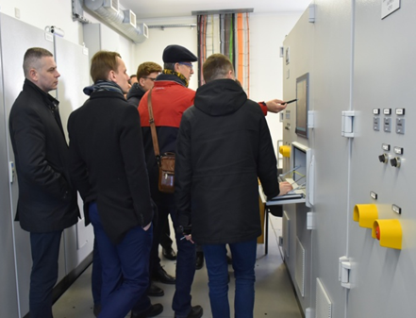
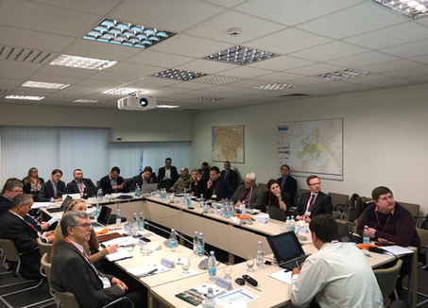
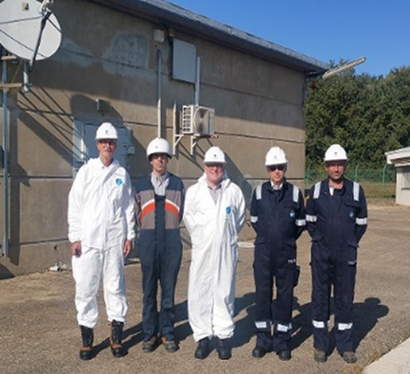
Place yourself near your engineers and work as a team!
Photos by the author, used with permission
The team should contain experienced professionals who can converse in the language of engineering, industrial automation, OT, ACS, and Industrial IoT.
The CISO must see himself/herself as the hands-on coach of a winning team.
Do more than visit… Create multidisciplinary councils and go out into the field.
Notes:
Place yourself near your engineers and work as a team. The team should contain experienced professionals who can converse in the language of engineering, industrial automation, OT, ACS, and Industrial IoT. The CISO must see himself/herself as a hands-on coach of a winning team.
As one engineer has said, “Do more than visit, create IT/OT/ACS/IIoT security executive and technical level councils and working groups with the field folks and regularly go out into the field during field acceptance testing (FAT).”

Slide 8
Key Messages
Cross-trained professionals are needed to fill a serious gap
Avoid IT and ACS misunderstandings in policy-making
Place yourself near your engineers and work as a team
Notes:
Cross-trained professionals are needed to fill a serious gap.
Avoid IT and ACS misunderstandings in policy-making.
Place yourself near your engineers and work as a team.

Slide 9
Author – Vytautas Butrimas
Vytautas Butrimas has been working in defense and cyber security roles for over 30 years including:
Vice-minister at the Ministry of Communications and Informatics, Republic of Lithuania responsible for Information Society programs.
Defense Policy and Planning Director, Lithuanian Ministry of National Defense (MoND) responsible for preparing the first Military Defense Strategy.
Deputy Director responsible for IT security at the Communications and Information System Service (CISS) responsible for preparing the first National Defense System Cybersecurity Strategy
Chief Adviser for the MoND of Lithuania with a focus on cybersecurity policy, including the national task force that wrote the Lithuanian Law on Cybersecurity
Member (Presidential appointee) of the National Communications Regulatory Service’s Council (RTT-Council)
Cybersecurity Subject Matter Expert for the NATO Energy Security Center of Excellence (NATO ENSECCOE) who performed a Cyber Risk Study of the ICS Used in the NATO Central Europe Pipeline System (CEPS)
Member of ISA 99 Workgroup 14 (Substation security profiles))
Former Co-chair ISA 99 Workgroup 16 (Incident management)
https://creativecommons.org/licenses/by-sa/4.0/
Please click here to provide feedback on this MLM.

