Slide 1

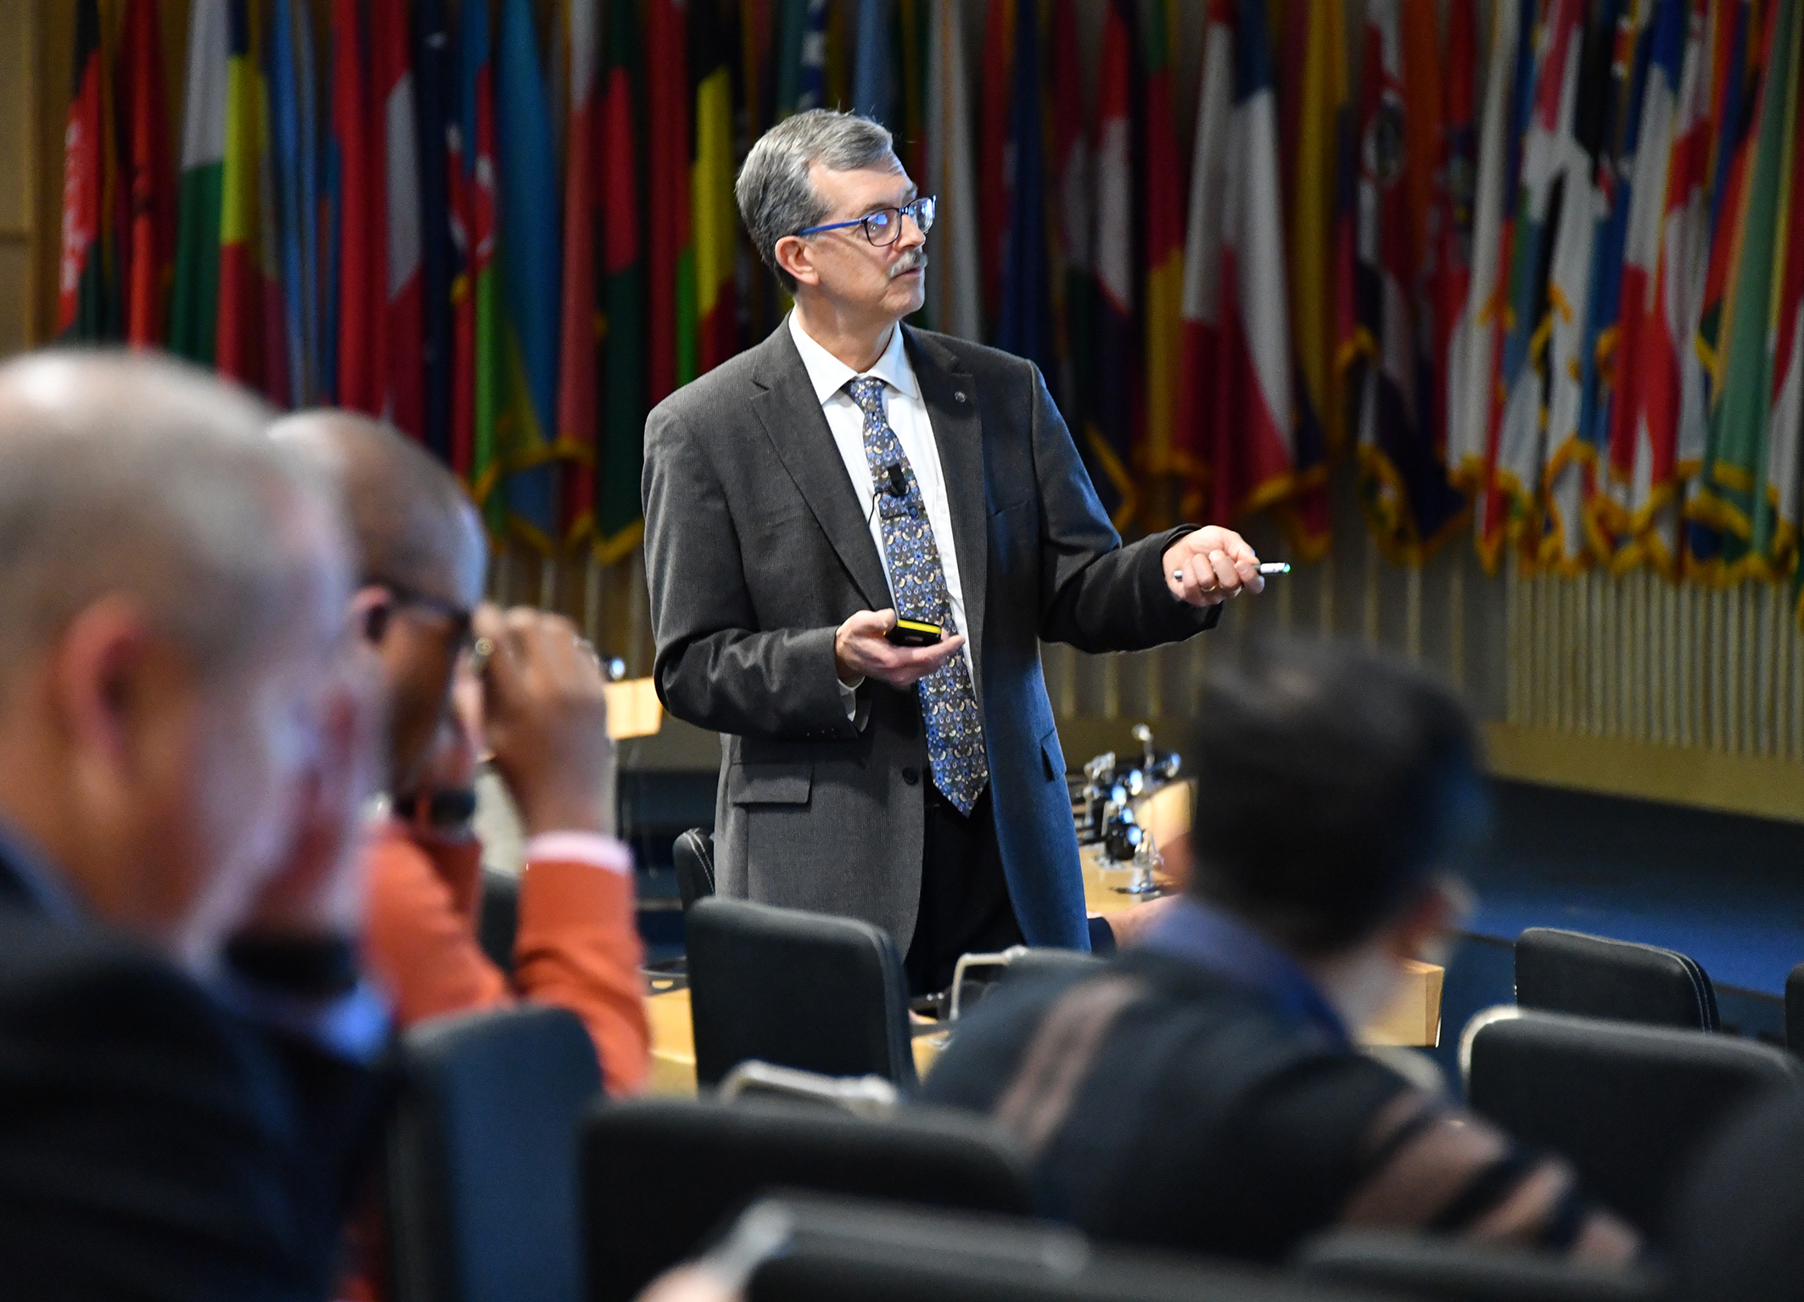


Industrial Cybersecurity for the CISO Annex 1
Micro Learning Module
Author
MLM-050-D
Industry – Process
Principal Role – Owner
Professional Role – All
Enterprise Phase – Master Planning
Vytautas Butrimas
Author’s presented views do not represent the official position of NATO
Turn on your audio and click start to begin video
Notes:
This module provides a selection of cybersecurity references and links that may be useful for CISOs:
Click the NEXT button when you are ready to advance to the next slide.

Slide 2
Annex 1: Industrial Cybersecurity References
The following is a selection of cybersecurity references and links that may be useful for CISOs:
Overview of industrial cybersecurity. Video lecture “Cybersecurity of Critical [x] infrastructure”, Riga conference Oct 2019
I will also share a link to a presentation made to the DSS ITSEC 2019 Conference in Riga which will give you an idea of I start at the 1 hour 7 minute mark https://www.facebook.com/DSSITSEC/videos/688528324963820/
Information Technology vs Operational Technology issue
Butrimas, V. The Cybersecurity Dimension of Critical Energy Infrastructure, perConcordiam Vol 3-4 pp.12-17. 2012 https://perconcordiam.com/v3n4-eng/
Cyber mishap causes nuclear power plant shutdown Hatch, http://www.homelandsecuritynewswire.com/cyber-mishap-causes-nuclear-power-plant-shutdown
IT and ICS cybersecurity: a “Tale of Two Cities” , http://scadamag.infracritical.com/index.php/2017/08/21/1984/
Weiss, J., Are the Good Guys as Dangerous as the Bad Guys – an Almost Catastrophic Failure of the Transmission Grid, Control Global, 11/02/2017 https://www.controlglobal.com/blogs/unfettered/are-the-good-guys-as-dangerous-as-the-bad-guys-an-almost-catastrophic-failure-of-the-transmission-grid/
Horden, N., Cybersecurity in Public-Safety Communications, Mission Critical Communications, September-October 2018 pp. 14-19. http://digital.olivesoftware.com/Olive/ODN/MissionCriticalArchive/default.aspx?olv-cache-ver=20181018023533
Cybersecurity capacity identification and building
NCSS Good Practice Guide, ENISA 2016, https://www.enisa.europa.eu/publications/ncss-good-practice-guide
National Cyber Security Strategies Guidelines & tools, ENISA https://www.enisa.europa.eu/topics/national-cyber-security-strategies/national-cyber-security-strategies-guidelines-tools
List Cyber Security Strategy Documents, NATO CCDCOE, https://ccdcoe.org/library/strategy-and-governance/
Butrimas, V., National Cyber Security Organisation: Lithuania, NATO CCDCOE 2015, https://ccdcoe.org/library/publications/national-cyber-security-organisation-lithuania/

Slide 3
Industrial Cybersecurity References
III. Importance of applying the correct CEIP policies and strategies
Butrimas, V., Towards a Cyber Safe Critical Infrastructure: Answering the 3 questions, http://scadamag.infracritical.com/index.php/2018/02/21/towards-cyber-safe-critical-infrastructure-answering-3-questions/ February 21, 2018.
Microsoft Cybersecurity Policy Framework, https://www.microsoft.com/en-us/cybersecurity/content-hub/Cybersecurity-Policy-Framework 2018
IV. Public Private Partnership best practice
US DHS Industrial Control System CERT (ICS-CERT) , https://us-cert.cisa.gov/ics
KraftCERT Norway’s ICS-CERT, https://www.kraftcert.no/english/index.html
CyberGym: Who We Are. https://www.cybergym.com/company/
V. Multi-stakeholder cyber threat protection efforts
A Digital Geneva Convention to protect cyberspace, Microsoft, https://www.microsoft.com/en-us/cybersecurity/content-hub/a-digital-geneva-convention-to-protect-cyberspace 2017
Parker, B. (2017) Bots and bombs: Does cyberspace need a ‘Digital Geneva Convention’?. Irinnews. Available from http://www.irinnews.org/analysis/2017/11/15/bots-and-bombs-does-cyberspace-need-digital-geneva-convention [Accessed 16th October 2018]
OSCE
OSCE CONFIDENCE-BUILDING MEASURES TO REDUCE THE RISKS OF CONFLICT STEMMING FROM THE USE OF INFORMATION AND COMMUNICATION TECHNOLOGIES https://www.osce.org/pc/227281?download=true
United Nations
United Nations General Assembly (2015) Report of the Group of Governmental Experts on Developments in the Field of Information and Telecommunications in the Context of International Security. A/70/174 (22nd July)
Tikk, E. and Kerttunen, M. (2018) Parabasis. Cyber diplomacy in stalemate. Norwegian Institute of International Affairs. Available from https://www.nupi.no/Publkasjoner [Accessed 16th November 2018]

Slide 4
Industrial Cybersecurity References
VI. Some noteworthy cyber-attacks against Industrial Control Systems
Stuxnet malware at nuclear enrichment facility
See Ralph Langer’s Deep Dive on Stuxnet lecture: https://www.youtube.com/watch?v=zBjmm48zwQU
http://www.digitalbond.com/blog/2016/06/20/s4-classic-video-langners-stuxnet-deep-dive/
https://www.langner.com/to-kill-a-centrifuge/ or https://www.langner.com/wp-content/uploads/2017/03/to-kill-a-centrifuge.pdf
See Kim Zetter’s book on Stuxnet listed on page 6 (Books) of these references
Steel mill in Germany
https://ics.sans.org/media/ICS-CPPE-case-Study-2-German-Steelworks_Facility.pdf
https://www.bsi.bund.de/SharedDocs/Downloads/EN/BSI/Publications/Securitysituation/IT-Security-Situation-in-Germany-2014.pdf?__blob=publicationFile&v=3
Against ICS in Ukraine
https://www.eset.com/int/industroyer/
https://ics.sans.org/media/E-ISAC_SANS_Ukraine_DUC_5.pdf
Slowik, J, Reassessing the 2016 Ukraine Electric Power Event as a Protection-Focused Attack https://www.dragos.com/wp-content/uploads/CRASHOVERRIDE.pdf
Hatman/Triton malware compromises safety instrumented systems at energy facility
https://ics-cert.us-cert.gov/sites/default/files/documents/MAR-17-352-01%20HatMan%E2%80%94Safety%20System%20Targeted%20Malware_S508C.pdf
https://dragos.com/blog/trisis/TRISIS-01.pdf
http://scadamag.infracritical.com/index.php/2018/08/28/targeting-control-and-safety-instrumented-systems-sis-new-escalation-of-cyber-threats-to-critical-energy-infrastructure/

Slide 5
Industrial Cybersecurity References
VII. Malware crafted to target ICS or which has indirectly affected ICS
NotPetya
https://www.us-cert.gov/ncas/alerts/TA17-181A
https://www.crowdstrike.com/blog/petrwrap-ransomware-technical-analysis-triple-threat-file-encryption-mft-encryption-credential-theft/
https://www.itnews.com.au/news/maersk-had-to-reinstall-all-it-systems-after-notpetya-infection-481815?eid=65&edate=20180130&utm_source=20180130&utm_medium=newsletter&utm_campaign=sc_weekly
http://www.darkreading.com/attacks-breaches/ransomware-attack-on-merck-caused-widespread-disruption-to-operations/d/d-id/1329503
https://www.wired.com/story/notpetya-cyberattack-ukraine-russia-code-crashed-the-world/ (nice story on implications of NotPetya by journalist Andy Greenberg and worth reading)
CrashOveride/industroyer
https://ics-cert.us-cert.gov/alerts/ICS-ALERT-17-206-01
https://www.eset.com/int/industroyer/?source=newsroom&campaign=industroyer
https://ics.sans.org/media/E-ISAC_SANS_Ukraine_DUC_6.pdf
Using cyrpto mining malware on ICS systems (new trend)
https://www.wired.com/story/cryptojacking-critical-infrastructure/?mbid=email_onsiteshare

Slide 6
Industrial Cybersecurity References
VIII. About ICS standards
ISO standards for Petroleum and related https://www.iso.org/ics/75/x/
htttp://nvlpubs.nist.gov/nistpubs/SpecialPublications/NIST.SP.800-82r2.pdf
About ISA https://www.isa.org/standards-and-publications/isa-standards/
“Quick Start Guide: An Overview of the ISA/IEC 62443 Standards” https://gca.isa.org/isagca-quick-start-guide-62443-standards
ANSI/ISA-62443 Security for Industrial Automation and Control Systems http://isaeurope.com/iec62443/
Good news for ICS protection: ISA providing new ISA/IEC 62443 based industrial cybersecurity training, http://scadamag.infracritical.com/index.php/2017/03/17/good-news-for-ics-protection-isa-providing-new-isaiec-62443-based-industrial-cybersecurity-training/
IEC 61850 is a standard for vendor-agnostic engineering of the configuration of Intelligent Electronic Devices for electrical substation automation systems to be able to communicate with each other. https://en.wikipedia.org/wiki/IEC_61850
https://www.api.org/~/media/Files/Policy/Cybersecurity/2018/Defense-in-Depth-Cybersecurity-in-the-Natural-Gas-and-Oil-Industry.pdf
IX. About conferences and trainings in cybersecurity of ICS
https://ics-cert.us-cert.gov/Training-Available-Through-ICS-CERT
https://www.isa.org/isa-training/online-training/
https://www.isa.org/events-conferences/
BlackHat https://www.blackhat.com/
Dale Petersons S4 conference lectures https://www.youtube.com/c/S4Events/videos
Chaos Computer Club http://www.ccc.de/en/
CS3STHLM – the Stockholm international summit on Cyber Security in SCADA and Industrial Control Systems https://cs3sthlm.se

Slide 7
Industrial Cybersecurity References
X. Selected sources for current information about ICS https://ics-cert.us-cert.gov/
Subscribe to newsletters https://us-cert.cisa.gov/ics
https://ics-cert.us-cert.gov/ICS-CERT-Feeds
Overview of Cyber Vulnerabilities for ICS https://ics-cert.us-cert.gov/content/overview-cyber-vulnerabilities ,accessed on October 23 2018
Professional Journals
https://www.isa.org/standards-and-publications/isa-publications/intech-magazine/
Books
Robert Radvanovsky (Editor),‎ Jacob Brodsky (Editor) , Handbook of SCADA/Control Systems Security, Second Edition 2nd Edition, https://www.amazon.com/Handbook-Control-Systems-Security-Second/dp/1498717071/ref=mt_hardcover?_encoding=UTF8&me=
Ralph Langner, Robust Control System Networks: How to achieve reliable control after Stuxnet. https://www.amazon.com/Robust-Control-System-Networks-Langner/dp/1606503006
Greenberg, Andy, Sandworm A new era of cyberware https://www.amazon.com/Sandworm-Cyberwar-Kremlins-Dangerous-Hackers/dp/0385544405
Zetter, K., Countdown to Zero Day Stuxnet and launch of the worlds first cyber weapon, https://www.penguinrandomhouse.com/books/219931/countdown-to-zero-day-by-kim-zetter/
Joe Weiss, Protecting Industrial Control Systems from Electronic Threats, https://www.amazon.com/Protecting-Industrial-Control-Systems-Electronic/dp/1606501976/ref=sr_1_fkmr0_1?s=books&ie=UTF8&qid=1519289278&sr=8-1-fkmr0&keywords=Joe+Weiss+Electronic

Slide 8
Industrial Cybersecurity References
XI. Strategy choices coming in the future
Butrimas, V., International Implications of securing our SCADA/control system environments , Robert Radvanovsky (Editor),‎ Jacob Brodsky (Editor) , Handbook of SCADA/Control Systems Security, Second Edition 2nd Edition, pp. 82-104. https://www.amazon.com/Handbook-Control-Systems-Security-Second/dp/1498717071/ref=mt_hardcover?_encoding=UTF8&me=
SCADASEC List : Where to discuss industrial control systems with colleagues from all over the world https://groups.io/g/scadasec
Industry 4.0 / Fourth Industrial Revolution is “Coming to a Scada near you.”
Recommendations for implementing the strategic initiative INDUSTRIE 4.0 https://www.acatech.de/wp-content/uploads/2018/03/Final_report__Industrie_4.0_accessible.pdf
Brave new Industrie 4.0 https://www.youtube.com/watch?v=ZrZKiy2KPCM
Cyber-Physical Systems: http://nvlpubs.nist.gov/nistpubs/SpecialPublications/NIST.SP.1500-201.pdf
Rob Joyce, Chief, Tailored Access Operations, National Security Agency, USENIX Enigma 2016 Conference - Disrupting Nation State Hackers, https://www.youtube.com/watch?v=bDJb8WOJYdA
Demchak, Chris C. and Shavitt, Yuval (2018) "China’s Maxim – Leave No Access Point Unexploited: The Hidden Story of China Telecom’s BGP Hijacking,"Military Cyber Affairs: Vol. 3 : Iss. 1 , Article 7. DOI: https://doi.org/10.5038/2378-0789.3.1.1050 Available at: https://scholarcommons.usf.edu/mca/vol3/iss1/7

Slide 9
Industrial Cybersecurity References
XII. Last but not least
Butrimas, V., Ensuring the security and availability of critical infrastructure in a changing cyber-threat environment: Living dangerously, Routledge Handbook of International Cybersecurity, T., Enekken, Kerttunen, M., Ed., Routledge 2020. https://www.routledge.com/Routledge-Handbook-of-International-Cybersecurity-1st-Edition/Tikk-Kerttunen/p/book/9781138489011
NATO CMX Exercises with cyber and critical infrastructure https://www.hzscr.cz/hasicien/article/nato-annual-crisis-management-exercise-cmx-2012.aspx
https://enseccoe.org/en/newsroom/nato-ensec-coe-preparing-for-the-flagship-ttx-coherent-resilience-2019/399
International cyber norms for states: GCSC Global Commission on Stability of Cyberspace https://cyberstability.org/
Butrimas, V., The Cybersecurity Dimension of CEI perConcoridam page 12 https://perconcordiam.com/v3n4-eng/ 2012
http://www.theguardian.com/uk-news/2014/jan/23/londons-victoria-line-suspended-after-control-room-is-flooded-with-cement
San Bruno pipeline rupture 2010 report https://www.cpuc.ca.gov/uploadedFiles/CPUC_Public_Website/Content/Safety/Natural_Gas_Pipeline/News/AgendaStaffReportreOIIPGESanBrunoExplosion.pdf
http://www.ntsb.gov/doclib/reports/2002/PAR0202.pdf
Integrity Management of Gas Transmission Pipelines in High Consequence Areas https://dms.ntsb.gov/public/57000-57499/57122/569749.pdf
List of downloadable reports on pipeline accidents https://web.archive.org/web/20080509192228/http://www.ntsb.gov/publictn/P_Acc.htm
Title: Pipeline Accident Report: Pipeline Rupture and Release of Gasoline, Olympic Pipeline Company, Bellingham, Washington, June 10, 1999 NTSB Report Number: PAR-02-02, adopted on 10/8/2002 [Summary | PDF Document]NTIS Report Number: PB2002-916502 https://web.archive.org/web/20080410164408/http://www.ntsb.gov/publictn/2002/PAR0202.pdf

Slide 10
Industrial Cybersecurity References
Selection of Selection of references for industrial cybersecurity
XII-b. Last but not least
https://www.controldesign.com/articles/2015/the-father-of-the-plc-explains-its-birth/ Richard “Dick” Morley
https://en.wikipedia.org/wiki/Taum_Sauk_Hydroelectric_Power_Station
IEA Digitalisation and Energy https://www.connaissancedesenergies.org/sites/default/files/pdf-actualites/digitalizationandenergy3.pdf
Guidance on Improving Resilience of National and Cross-Border Energy Networks, 13 November 2017 NU AC/98-D(2017)0005 NATO Industrial Resources and Communication Services Group (IRCSG Industry)
DC Metro Crash 2009 http://www.ntsb.gov/publictn/2010/RAR1002.pdf https://trid.trb.org/view/934283 https://www.ntsb.gov/investigations/AccidentReports/Reports/RAR1002.pdf
https://ics.sans.org/media/Media-report-of-the-BTC-pipeline-Cyber-Attack.pdf more speculative from Bloomberg https://www.bloomberg.com/news/articles/2014-12-10/mysterious-08-turkey-pipeline-blast-opened-new-cyberwar
IT vs OT vs ICS models http://icsmodel.infracritical.com/ http://icsmodel.infracritical.com/
Top 10 tuning tips for control engineers https://www.controleng.com/articles/top-10-tuning-tips-for-control-engineers/
https://www.createdigital.org.au/measure-manufacturing-equipment-efficiency/
Eight 8 questions to ask about your industrial control systems security https://www.csoonline.com/article/3262641/critical-infrastructure/8-questions-to-ask-about-your-industrial-control-systems-security.html
Modbus guide for field technicians http://www.modbusbacnet.com/includes/pdf/MODBUS_2010Nov12.pdf
https://www.controleng.com/articles/inside-the-competition-for-the-first-plc/
https://www.auma.se/produkter/marknader/olja-gas/auma-sa072-162-med-ac012/
Texas City refinery explosion 2005 https://www.youtube.com/watch?v=c9JY3eT4cdM
https://www.csb.gov/file.aspx?DocumentId=5596
https://www.youtube.com/watch?v=goSEyGNfiPM

Slide 11

Industrial Cybersecurity References
XII-c. Last but not least
Boeing 737 Max Crash Report https://transportation.house.gov/imo/media/doc/2020.09.15%20FINAL%20737%20MAX%20Report%20for%20Public%20Release.pdf
https://www.ntsb.gov/investigations/AccidentReports/Pages/PLD18MR003-preliminary-report.aspx
Diesel Gate https://www.bbc.com/news/business-34324772
https://www.controlglobal.com/blogs/unfettered/diesel-cheat-scandal-affects-almost-12-million-vehicles-an-industrial-strength-cyber-event/
Maroochy Shire 2000 Case Study https://www.mitre.org/sites/default/files/pdf/08_1145.pdf
http://www.pbs.org/wgbh/nova/next/tech/cyber-attack-german-steel-mill-leads-massive-real-world-damage/
https://www.pbs.org/wgbh/nova/article/cyber-attack-german-steel-mill-leads-massive-real-world-damage/
http://www.wired.com/2015/01/german-steel-mill-hack-destruction/
https://news.microsoft.com/transform/hackers-hit-norsk-hydro-ransomware-company-responded-transparency/
https://www.linkedin.com/pulse/how-search-icsscada-systems-using-shodan-muhammad-mesbah/
Purdue Model http://www.pera.net/
Brodsky, J., http://scadamag.infracritical.com/index.php/2017/07/27/how-a-process-works/
https://dale-peterson.com/2019/02/14/ics-security-patching-never-next-now/
https://www.rockwellautomation.com/en-us/products/software/factorytalk.html
http://sccs.sourceforge.net/man/sccs.me.html
https://arstechnica.com/tech-policy/2014/05/photos-of-an-nsa-upgrade-factory-show-cisco-router-getting-implant/
https://www.nytimes.com/2019/02/12/us/politics/trump-china-wireless-networks.html

Slide 12
Author – Vytautas Butrimas
Vytautas Butrimas has been working in defense and cyber security roles for over 30 years including:
Vice-minister at the Ministry of Communications and Informatics, Republic of Lithuania responsible for Information Society programs.
Defense Policy and Planning Director, Lithuanian Ministry of National Defense (MoND) responsible for preparing the first Military Defense Strategy.
Deputy Director responsible for IT security at the Communications and Information System Service (CISS) responsible for preparing the first National Defense System Cybersecurity Strategy
Chief Adviser for the MoND of Lithuania with a focus on cybersecurity policy, including the national task force that wrote the Lithuanian Law on Cybersecurity
Member (Presidential appointee) of the National Communications Regulatory Service’s Council (RTT-Coucil)
Cybersecurity Subject Matter Expert for the NATO Energy Security Center of Excellence (NATO ENSECCOE) who performed a Cyber Risk Study of the ICS Used in the NATO Central Europe Pipeline System (CEPS)
https://creativecommons.org/licenses/by-sa/4.0/
Please click here to provide feedback on this MLM.

