Slide 1



Level 1 & 2 Field Device and Network Design
MLM-078-B
Industry – All
Principal Role – Owner, EPC, and Vendor
Professional Role – Control Engineer
Enterprise Phase – Design
Turn on your audio and click start to begin video
Notes:
This MLM describes ways to engineer Intelligent Industrial Devices at Level 1 and 2 of the PERA model using the ISA 108 standard and recommended data management practices.
Click the NEXT button when you are ready to advance to the next slide.

Slide 2
How to Engineer Intelligent Industrial Devices and Netorks?
Can existing automation practices and systems address the problems of Intelligent Industrial Devices (IIDs) ?
Owner/Operator’s Critical Information Repository (CIR).
Proposed new Work Process standards.
Integration with other “Risk Based” standards.
What is new and useful about iSA-108 ?

Slide 3
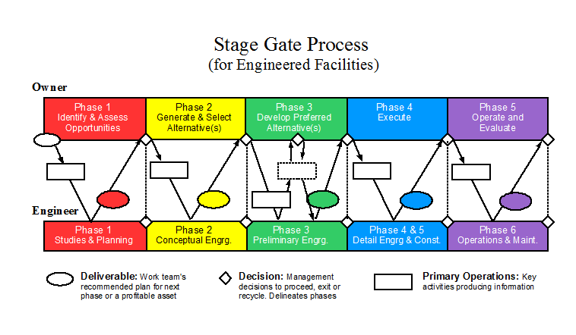

Can Existing Engineering Automation Tools
Solve the “Data Management” Problem ?
Data is developed in “silos” and is often not effectively transferred between Engineering, Construction & Operating Phases
Feasibility Studies, Master Planning
Process Cost _{Licensor} Estimates,
P&IDs, & 3D models Design Simulator Data Engineering Drawings, Document Managem’t
Construction Tracking, Scheduling, As-builts
Operations, Maintenance, Inventory, Production, Quality
Design Data
Design Philosophy Documents

Slide 4
Can Existing Engineering Automation Tools Solve this Problem ?
The large volume of project data requires use of automation tools (e.g. CADD, Databases, Modeling, etc.). Large projects must use them, so ISA 108 requirements must integrate with these tools as well as “traditional” engineering procedures.
However, the existing automation tools used in each Phase and by each Discipline are usually different and incompatible.
Existing automation tools provide no “single source” of approved design information.
Thus, existing automation tools actually make IDM data transfer between Phases and Organizations even more difficult, time consuming & expensive.
Page 8

Slide 5

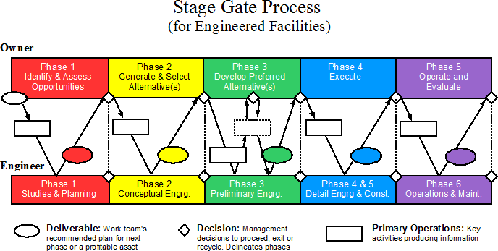

“Critical Information Repository”
Is an Example IID Data Management Solution
CIR is controlled by facility Owner/Operator.
CIR uses Standard data format
Work processes insure validity of CIR changes.
Deliverables at end of Phase
Data is developed in “silos” and is often not effectively transferred between Engineering, Construction and Operating Phases
Process Licensor Design Simulator
3D models Construction Simulator Tracking, Document Scheduling Managemt As-builts
Operations Maintenance Inventory Production Quality

Slide 6
Example CIR IID Data Management Solution
This Critical Information Repository (CIR) will be the responsibility of
the Owner/Operator and will span all Enterprise Phases.
CIR will hold at least the key information on all “High Risk” or “High
Impact” Intelligent Devices (including SIS/SIL & CyberSecurity).
The CIR data will be uploaded at the end of each enterprise Phase (contractual requirement from all subcontractors).
Loading IID data to the CIR, and changes to approved CIR data requires formal work processes, including technical & management approvals (Engineering Change Control).
Consistent Engineering Data formats (e.g. STEP) and Multi-vendor field communication protocols (e.g. FDI) are required.

Slide 7
Example CIR IID Data Management Solution
An audit of CIR data is required at end of each enterprise phase, and after major maintenance turnarounds and upgrades.
The CIR will provide a full historical record for each “Service Tag, including:
Original approved design basis, specifications, configuration data
/information, etc.
Design changes with reasons and approvals (including “As-builts”)
Maintenance events including failures and in-kind replacements
Modifications by maintenance and site engineering, including approved designs and approvals.
Current approved configuration (for comparison with active field configuration).

Slide 8
Other IID CIR Implementation Alternatives
There are many ways that a CIR could be implemented ranging from simple to sophisticated, depending on the scale and complexity of the facility or enterprise.
A small liquid storage and loading site with a few dozen tags might
use a spreadsheet or even a paper system (file cabinet).
A centralized “internal cloud” database might be implemented to support multiple large facilities such as refineries or pipelines.
A “block chain” or a “mediated” system might enforce Engineering Management of Change as part of an “Asset Management System.
Whatever technology is chosen, it must be implemented as part of a
coordinated Intelligent Device Management (IDM) program.

Slide 9
What do ISA 108 Work Processes look like ?
They are similar to existing engineering and maintenance Work Processes and
may vary in detail and format as determined by each Enterprise.
Work processes are divided into “Pools” by Phase and Stakeholder
Pools are Divided into “Swim-lanes” by Role within the Stakeholder
organization.
Swim-lanes are divided into Procedures that produce Deliverables (like Drawings, Work Permits, etc.)
Procedures are composed of Tasks that are assigned to one person and can be completed without management supervision. In some cases, certified qualifications are required for the person who performs a Task.
Interfaces are defined between Pools, Swim-lanes, Procedures and Tasks
Various Forms, Checklists, Standard Designs and Documents, etc., may be used by Pools, Swim-lanes, Procedures and Tasks.

Slide 10
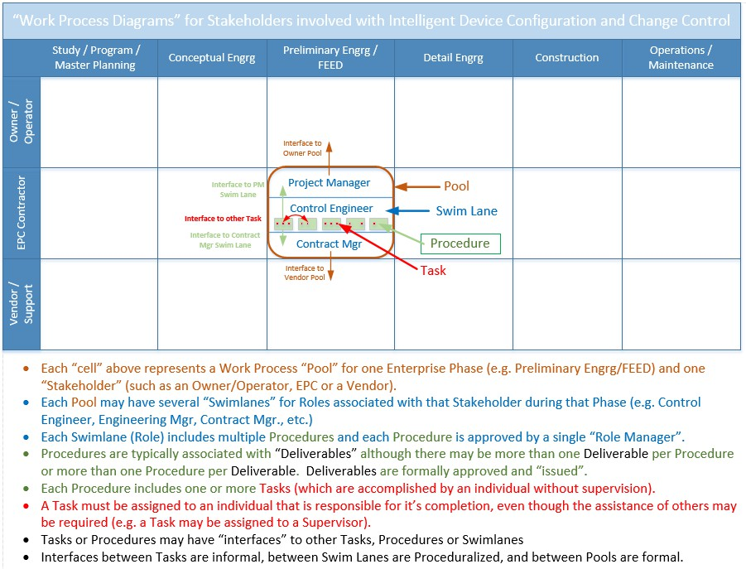
Work Process Diagrams for Stakeholders
(c) Enterprise Consultants International, Ltd.

Slide 11
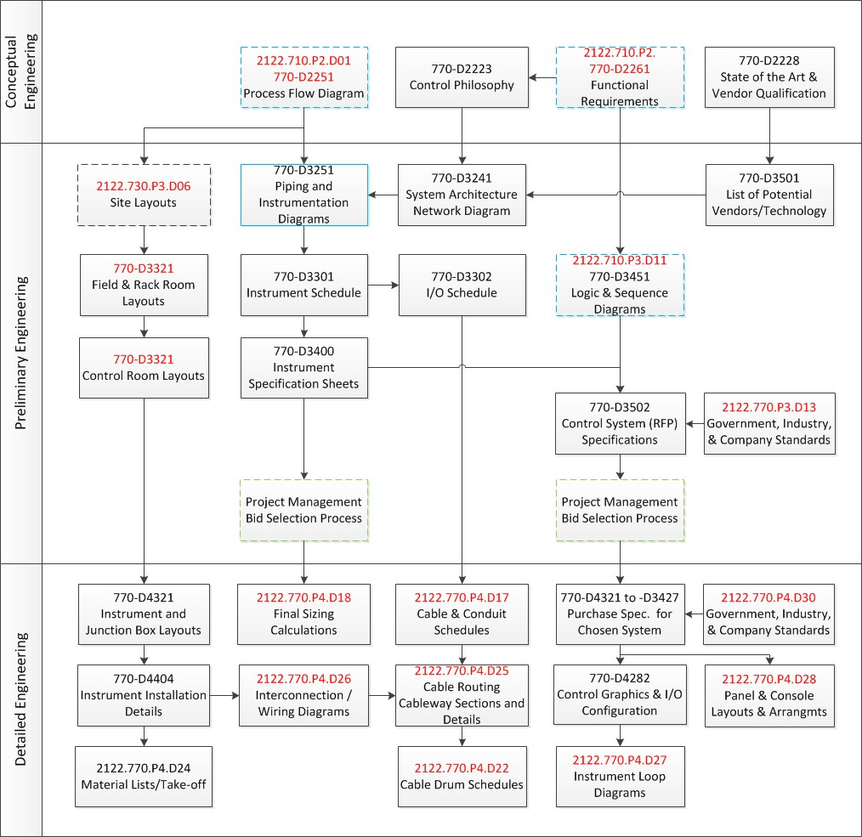
Example Control System Procedures & Deliverables
Control Systems Swim Lane for Preliminary Engineering
Interfaces to other Swimlanes (Process Engrg &
Project Management)
Control Systems Preliminary Engineering Procedure
Deliverables will be connected with Procedures and Work Processes.

Slide 12
Each Deliverable may have:
Each Deliverable may have associated Work Processes, Procedures and Tasks, and these may in turn have:
Forms (e.g. ISA-12 Specification Sheets)
Work Flow Diagrams
Example Drawings, “Go-by” Documents, Reference Designs, etc.
Metrics including KPIs
ISA 108 will use standard Engineering forms such as ISA Instrument Specification Sheets or API Pump Sheets as a base, but will add additional data.
Deliverables may be eliminated and the associated Procedures, Forms, etc. will also be deleted.

Slide 13
Using an IID May add Hundreds of Data Elements to the Instrument Specification
Project Unit P.O.
Item
DATA SHEET SPEC
TAG DWG
As with other Spec Sheet data, fields may be filled in by different Roles (e.g. Process Engr. or Controls Engr.), and during different Phases.
Contract
SERVICE
1 Fluid
MFR Serial
Crit Pres PC
DATE
2
Flow Rate Inlet Pressure
Outlet Pressure Inlet Temperature
Spec Wt/Spec Grav/Mol Wt
Viscosity/Spec Heats Ration
^{Vapor Pressure P}v
^{*Required C}v
*Travel
Allowable/*Predicted SPL
Units
Max Flow
Norm Flow
Min Flow
Shut-Off
3
4
5
6
7
8
9
10
11
12
13
14
15
16
17
18
19
20
21
22
23
24
SERVICE CONDITIONS
LINE
Pipe Line Size & Schedule
Pipe Line Insulation
In Out
53
54
55
56
57
58
59
60
61
62
63
64
*Type
*Mfr & Model
Norriseal
For more information, see OGI Pilot Spec Sheets
*Type
*Size
*Size
On/Off
Eff Area
Modulating
Max Press/Temp
*Norriseal Model
*Body/Bonnet Matl
*Liner Material/ID
End In Connection Out
Flg Face Finish
ACTUATOR
Spring Action Open/Close
*Max Allowable Pressure
*Min Required Pressure Available Air Supply Pressure Max
VALVE BODY/BONNET
Bench Range Act Orientation Handwheel Type
Min
Vertical
25
26
27
28
29
End Ext/Matl
*Flow Direction
*Type of Bonnet Lub & Iso Valve
*Packing Material
65
66
Air Failure Valve
Set At
Intelligent Device Process Data
67 Input Signal
68
69
*Type
*Mfr & Model
30
31
*Packing Type Seals/Gaskets
70
71
POSITIONER
*On Incr Signal Output Incr/Decr Gauges
32
33
*Type
*Size
72
73
By-Pass
*Cam Characteristic
34
35
36
37
38
39
40
41
42
*Characteristic
*Balanced/UnBalanced
^{*Rated C}v
74
75
76
77
78
79
80
81
82
TESTS AIR SET SWITCHES
Type
*Mfr & Model Contacts/Rating Actuation Points NEMA Rating
Intelligent Device Asset & Maintenance Data
TRIM
*Plug/Ball/Disk Material
*Seat Material
*Cage/Guide Material
*Stem Material NACE Required?
^{F}L
^{X}T
*Mfr & Model
*Set Pressure Filter
Gauge
43
83
*Hydro Pressure
44
45
46
47
48
49
50
51
52
Specials/Accessories
84
85
86
ANSI/FCI Leakage Class
Intelligent Device Criticality
Rev
Date
Revision
Orig
App

Slide 14
Data is Delivered to Owner/Operator at the end of each Enterprise Life Cycle Phase
Owner
Rep ito |  | os ry
Owner
Owner
Owner
Owner
Repos itory
Repos itory
MOC
Repos itory
Repos itory
MOC
MOC
W/P At Prelim Eng Milestones
W/P At Detail Eng (incl. Vendoc Hand Over)
W/P At Mechanical Completion Handover
W/P At
Handover to
Operations
Upload & Check
EPC
Work Vers |  | ing ion
EPC
Constr
Work Vers |  | ing ion
Commiss
ion
Operatio
ns
Working Version
Working Version
Working Version
Preliminary Engineering
Detail Eng,
/ Procuremt As-Ordered
Construction (as-built)
Commission (as configured)
Maintain & Upgrade

Slide 15
Development of IID Data During Each Phase
ISA Generic Product Class
Spec Sheet & Alarm/Alert
Template
Colored lines indicate changes
by EPC during Engineering and Construction Phases,
by Owner at hand-over at the end of each Phase, and
possibly at milestones during each phase.
Note that once accepted to the CIR, changes cannot be made without an auditable Engineering Management of Change procedure.
Vendor Product Spec
Sheet & Config. Template
Complete Tag “Passport” record at Startup
Complete Tag “Passport” including maintenance & modification record

Slide 16
Integration of Other Risk-based Engineering Standards and Work Processes
ISA 108 must integrate with existing control system standards and associated Work Processes, including:
ISA 84 (Safety Instrumented Systems),
ISA 95 (moving control domain data to MES)
ISA 99 (Industrial Cyber Security),
ISA 100 (Industrial radio LANs, etc.)
ISA 108 is structured to be similar to ISA 84 to facilitate management of intelligent SIS/SIL devices and use by control engineers familiar with ISA 84, etc.

Slide 17
Integration of Other Risk-based Engineering Standards and Work Processes
ISA 108 uses a similar Risk Assessment methodology. When the risk of a certain device is assessed, it could be: a safety system that must work very reliably (ISA 84), a cyber security risk (ISA 99) or a risk of major financial loss that could be prevented by IID maintenance monitoring and diagnostics (ISA 108).
 | RISK ASSESSMENT MATRIX
 | SEVERITY PROBABILITY | Catastrophic (1) | Critical (2) | Marginal (3) | Negligible (4)
 | Frequent (A) | High | High | High | Medium
 | Probable(B) | High | High | Medium | Medium
 | Occasional (C) | High | Medium | Medium | Low
 | Remote (D) | Medium | Medium | Low | Low
 | Improbable (E) | Medium | Low | Low | Low
Page 21

Slide 18
Integration of Other Risk-based Engineering Standards and Work Processes
The same risk assessment Procedure can decide if a risk requires
ISA 84, 99 or 108 (or possibly all three).
If ISA 84 or 99 are required, the user is referred to the appropriate standard, however, neither of these define the full set of IDM requirements (and IIDs are usually involved).
ISA 108 procedures may then refer the user to appropriate other
standards, and/or require procedures defined in ISA 108.
An Alarm/Alert “Template” (with appropriate “defaults”) will be automatically determined from the Risk Assessment. Correctly selected defaults should dramatically reduce the “Alarm/Alert Flood” experienced when vendors “turn on everything” by default.

Slide 19

Author
Gary has more than 40 years of experience with enterprise integration and optimization projects, including PERA master planning and project management.
As one of the initial authors of the PERA Handbook of Master Planning, he has used PERA Enterprise Architecture and Master Planning methodologies throughout his career including control and information systems for oil production, pipelines, refining and marine loading, petrochemicals, coal, gas, and oil-fired power plants, polyethylene, ammonia, explosives, paint, pulp and paper, food and beverage, and pharmaceuticals. LNG facilities included world-scale arctic, European, and US Gulf coast complexes.
infrastructure facilities included Fire, Police, and Emergency Response systems for major US cities, as well as emissions reporting and trading systems for more than 100 US Power Plants,
https://creativecommons.org/licenses/by-sa/4.0/
Please click here to provide feedback on this MLM.

