Slide 1



What is CFIHOS
Capital Facilities Information Hand-over Standard
MLM-082-B
Industry – Process Industry
Principal Role – Owner / Operator
Professional Role – Control Engineer +
Procurement
Enterprise Phase – Engineer, Procure,
Construct + Operations
Turn on your audio and click start to begin video
Notes:
This MLM describes procurement practices using the Capital Facilities Information Hand Over Standard, including acceptance procedures
Click the NEXT button when you are ready to advance to the next slide.

Slide 2
What is CFIHOS ?
CFIHOS is:
A Eurozone standard coordinated by USPI with over 30 members including Owner/Operators, EPCs, Manufacturers & Technology suppliers.
Based on success of Hand-Over practices in Shell and other majors
Focused on Oil, Gas, Petrochemicals and Power Industry
Issued in draft, and is currently seeking application feedback
CFIHOS uses MongoDB to develop the EIS (Engineering Information System) to manage:
Standard Product Class Libraries (ISO 15926, IEC 61987 CDD)
Lists of EPC and Vendor Deliverables (e.g., Drawing Registers)
Product Specification Data (IEC 61987 LoPs, ISA 108, ISA 20)
Hand-over data requirements and formats
Standard contractor and vendor Contract Templates

Slide 3
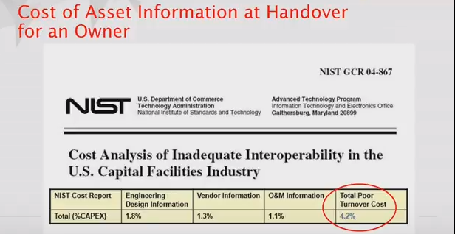
Why is CFIHOS Needed ?
High cost of current Handover practices.
For example, NIST estimates over 4% of the Total project cost is wasted through inefficient transfer of Engineering, Vendor, and Operation Maintenance information.

Slide 4
What Does CFIHOS Include?
Standards, work processes, and tools to assist with efficient handover of Engineering information to Operations and Maintenance.
Template contracts to facilitate specification of requirements and acceptance procedures for:
Engineering
Constructors and Field Contractors
Vendors
Standards defining information and formats to be delivered to the Owner/Operator by:
Engineering
Constructors and Field Contractors
Vendors
Master Product Class Library including:
Standard names of instruments, pumps, vessels, etc.
Specification parameters for above
Definition of Deliverable data for all of the above

Slide 5
How can Hand-over be Improved ?
Data Handover must be consolidated from many different sources. It should be:
Complete
Consistent
Compliant
Correct
Requires an Owner’s EIS (Engineering Information System) to provide tools to transfer data from EPC to Owner systems including:
% Complete Reporting,
Engineering Change Control,
Data Validation
The Owner’s EIS should be consistent with maintenance systems used by the Owner during Operations (rather than EPC systems).
Data Handover can no longer be a “Post Project” activity. Instead, it must be “Continuous” during the Project.

Slide 6
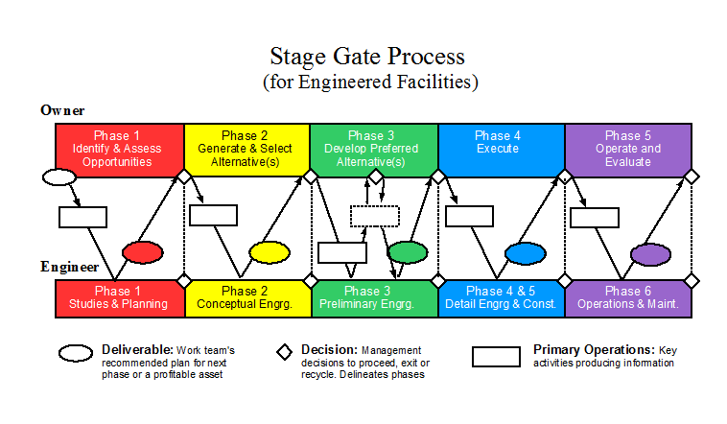
Engineering Data Transfer should not be left to the end of the Project
Owner’s Engineering Information System (EIS) is controlled by facility Owner/Operator. but is accessible by EPC, vendors, etc.
EIS uses Standard CFIHOS data formats
MoC Work processes insure validity of EIS changes.
Deliverables at end of Phase
Owner’s Engineering Info System
Data is developed in “silos” and is often not effectively transferred between Engineering, Construction and Operating Phases
Process Licensor Design Simulator
3D models Simulator
Document Managemt
Construction Tracking, Scheduling
As-builts
Operations
Maintenance
Inventory
Production
Quality
Notes:
A formal review and approval step (or “Stage Gate”) is required at the end of each Project Phase, and prior to beginning the next Phase.
At this point, the Owner and the Engineer exchange “Requirements” and “Deliverables”. The are a rich set of Deliverables that are exchanged in well-established formats at specific points (usually the end of each project Phase).
The person(s) on the Owner/Client side review and approve deliverables. Approval is required before the next Phase of the project may proceed.

Slide 7
How can an Owner’s Information System (EIS) Facilitate CFIHOS Benefits?
Standard Product Class Libraries, data and format standards, and Contract Templates. are loaded and tested.
A SaaS (Software as a Service) web-based system is currently available. To get started with CFIHOS, a client needs only to login with a standard personal computer and train their people.
Ongoing improvements and additions to CIFHOS library will be loaded as they become available. Upgrade costs are included in the monthly service fee (approx. $1 /tag/year.)
The same EIS server is accessed by many companies. Each user therefore benefits from the reliability, efficiency, and shared learning curve.

Slide 8
EIS and ICS Configuration Data
After the initial load, EIS MoC controls all plant changes.
Enterprise Business Systems
Engr.
Design
Data
Comp.
Maint.
Mgmt.
System
EIS & CIR
(Level 4)
Asset Managemnt System(s) Level 3
Initial Engineering and Vendor data is loaded into the Owner’s EIS in CFIHOS format.
ACS Data
Process Control Systems & SIS
Level 3
Engr.
Design
Data
Standard Formats
CFIHOS
IID Config.
Tools & Gateways
3rd Party Engineering
(EPC or
Packages)
HSE & Regulatory Requiremts Event
Database
Intelligent Field Devices (Level 0
or 1)
Vendor
Data
From there it goes to many systems in their preferred format.
ACS/SIS Data goes to Intelligent Field Devices via either the AMS (preferred) or Process Control System and IID Config. Tools

Slide 9
How can an EIS Facilitate CFIHOS Improvements?
The EIS is specifically designed to help Owner/Operators transfer EPC and Vendor information during engineering, hand-over, maintenance and turn-around activities. It is optimized to provide:
Easy access to Technical information (reduce man-hours spent searching for information).
“Single Source of Truth” for plant personnel, so latest version of drawings and data is clearly indicated, and history is available online.
Engineering Change Control to ensure accuracy of information.
Online Work Processes for Turnover and Maintenance activities.
On-demand Information and Training for site personnel.

Slide 10
CFIHOS Articles and Conferences
USPI description of CIFHOS conferences and meetings
https://uspi.nl/index.php/projects/frameworks-methodologies/cfihos-overview/conferences-and-workshops
CFIHOS, ISO 15926 and related standards by Datum360
https://www.datum360.com/standards
Will CFIHOS help ?
Are you CFIHOS ready ? - by Aveva
View CFIHOS Infographic
Article on CFIHOS by Hexagon/Intergraph
https://hexagonppm.com/about/compliance/cfihos
Article on CFIHOS by Meridian
https://www.bluecieloecm.com/cfihos-2015-data-integrity-at-handover/

Slide 11

Author
Gary has more than 40 years of experience with enterprise integration and optimization projects, including PERA master planning and project management.
As one of the initial authors of the PERA Handbook of Master Planning, he has used PERA Enterprise Architecture and Master Planning methodologies throughout his career including control and information systems for oil production, pipelines, refining and marine loading, petrochemicals, coal, gas, and oil-fired power plants, polyethylene, ammonia, explosives, paint, pulp and paper, food and beverage, and pharmaceuticals. LNG facilities included world-scale arctic, European, and US Gulf coast complexes.
infrastructure facilities included Fire, Police, and Emergency Response systems for major US cities, as well as emissions reporting and trading systems for more than 100 US Power Plants,
https://creativecommons.org/licenses/by-sa/4.0/
Please click here to provide feedback on this MLM.
Notes:
Gary has more than 40 years of experience with enterprise integration and optimization projects, including PERA master planning and project management.
As one of the initial authors of the PERA Handbook of Master Planning, he has used PERA Enterprise Architecture and Master Planning methodologies throughout his career including control and information systems for oil production, pipelines, refining and marine loading, petrochemicals, coal, gas, and oil-fired power plants, polyethylene, ammonia, explosives, paint, pulp and paper, food and beverage, and pharmaceuticals. LNG facilities included world-scale Arctic, European, and US Gulf coast complexes.
infrastructure facilities included Fire, Police, and Emergency Response systems for major US cities, as well as emissions reporting and trading systems for more than 100 US Power Plants,

