Slide 1
IFPAC Plenary Session
An Industry 4.0 perspective
What will Industry 4.0 will mean for those involved in Industrial Control
Notes:
This MLM was presented at the IFAC Plenary Session of the 73rd Annual Instrumentation and Automation Symposium for the Process Industries in March 2018 to consider how Industry 4.0 concepts might influence industrial control systems. These concepts remain relevant today, so the presentation was updated in 2025 and converted into an MLM (Micro Learning Module).

Slide 2
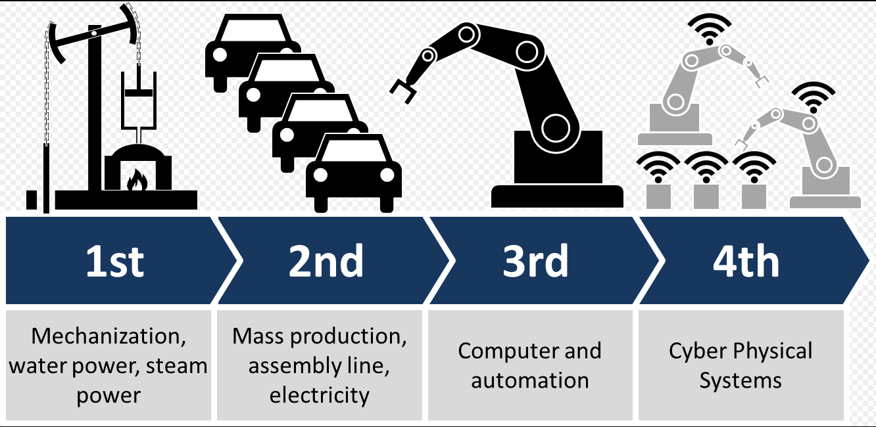
What is Industry 4.0 ?
According to Wikipedia
Notes:
According to Wikipedia, there have been 4 major generations of industrial automation:
1 Steam power
2 Mass production and assembly lines
3 Computers and Digital Automation
4 Merging of computers and physical manufacturing systems to provide integration between multiple industrial processing units.

Slide 3


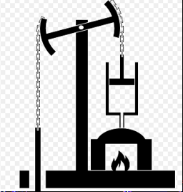

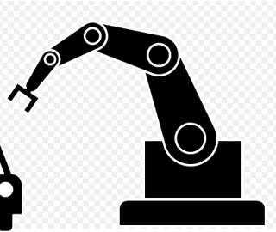
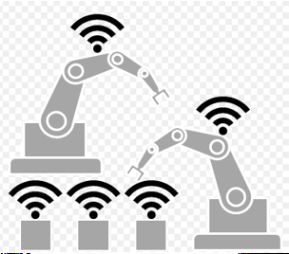

How has the Human Role Changed ?
Human sets goals.
Automation directs and carries out most actions using IIoT.
Human directs
Automation that
carries out actions.
Human acts with
“force multiplier”.
Human acts with
Improved efficiency.
Notes:
To view this from a human perspective, each generation has changed the role of people in industry.
I am old enough to have lived through Industry 3.0
Automation has eliminated many jobs, but operations are now safer and more cost-effective.
In 1972, 10.9 incidents per 100 US workers were reported, compared to 2.9 per 100 in 2016 .
That is almost a 4x reduction in 40 years, and many higher-level jobs were created.

Slide 4
How has the use of Standards developed?
1.0
2.0
3.0
4.0
Productivity was greatly Improved, but Boilers blew up.
Professionals were required to approve Boiler Designs including Drawings and Change Control
Certified Operators and Maintenance Engineers were required to operate boilers.
Equipment designs
and documented
Operator procedures
improved efficiency.
Equipment Mainten-
ance Standards were
Developed.
Certified Maintenance
Staff were required
Automation improved
overall safety & cost.
Configuration changes
became so easy that
“Approved Design
Documentation” was
often lost.
Since only “working
Configuration” existed,
operating problems
were often solved by
human memory and
judgement.
As machines talk directly to machines, human memory & judgement will be lost.
Record of “Approved design” will be needed, including Engineering Change Control.
Certified maintenance and operating staff will be required.

Slide 5
Let’s define Some Terms
  What is Industry 4.0?
  Machines communicating directly with other machines to manufacture products with minimum supervision.
  What is the Internet of Things (IoT)
    A method for connecting Smart sensors and devices to the Internet
  What is the Industrial Internet of Things (IIoT)
  Similar to IoT, but designed for Industrial Environments and therefore “fire-walled” from it
What are “Cloud Services”?
  Application Servers accessed by IP networks
Internet or Private Cloud Servers and BIG DATA
IoT
(Internet
of Things)
IIoT
Industry 4.0
Notes:
Let’s define some Terms:
What is Industry 4.0 ?
Machines communicating directly with other machines to manufacture products with minimum supervision.
This term started in Germany in Discrete Manufacturing
Germany is the most advanced in its Implementation
What is the Internet of Things (IoT)?
A method for connecting Smart sensors and devices to the Internet
What is the Industrial Internet of Things (IIoT)?
Similar to IoT, but designed for Industrial Environments and therefore “fire-walled” from it
What are “Cloud Services”?
These are Application Servers accessed by IP networks
They may be based on the Internet Cloud or a Private Cloud
These typically contain databases that handle BIG DATA.

Slide 6
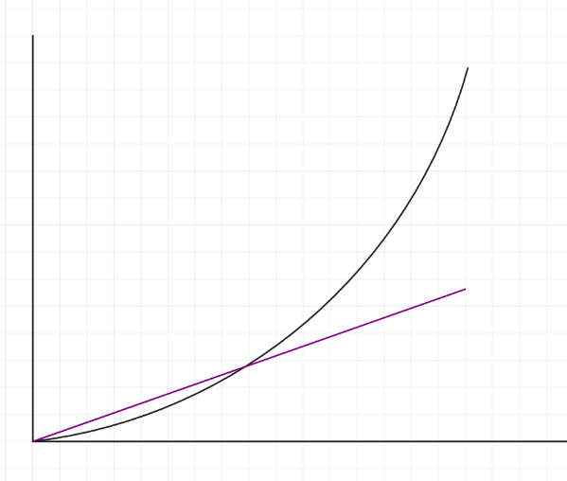
How Quickly Should You Move Toward Industry 4.0?
You can’t shoot a duck if you aim where it is, but you will also miss if you shoot too far ahead.
Humans project linearly, but Industry 4.0 seems to be growing exponentially !
Linear projection underestimates growth by 4th and 5th years
Optimistic Linear projection (instinctive) overestimates growth in the first two years
1 year
2 yrs
3 yrs
4 yrs
5 yrs
Notes:
An expert is someone who can hit a target that others cannot hit.
A genius is someone who can hit a target that others cannot see.
Industry 4.0 will probably obey Moore’s Law (exponential growth)
However, about 5 years is as far as most of us can project (and plan).
Perhaps an Elon Musk can plan out 10 or 20 years, but you had better be a genius and a billionaire…
and as most of us geniuses know, it is hard to be both !

Slide 7
What Should You do to Move toward Industry 4.0?
Plan to disrupt your industry in 5 to 10 years
  You can be a disruptor or a disruptee
  Or…you can sell the company
Lay the ground-work today
  Train staff to embrace change
  Select and adopt new standards for IIDs (Intelligent Industrial Devices)
  including instruments, actuators, controllers & PLCs, and Industrial Network components (e.g. for Foundation Fieldbus, Profibus, Modbus, Hart, etc.
Let’s discuss some examples of how Standards will apply.
Notes:
Whether your company is a manufacturer, or a products or services provider, when new technologies disrupt markets, companies that do not respond will disappear.
Companies like Xerox, Kodak, Digital Equipment Corp (DEC), and many others have shown what happens to companies that defend old products during times of exponential change.
However, responses must be carefully planned, and 5 years seems a practical time frame (see above graph).
During the initial “flat” 2 to 3 year period, two key areas should be addressed in your planning:
People – in order to deal with exponential change, organizations must encourage staff to embrace change, including investment in new processes, products and increased risk.
Standards - Since Industry 4.0 is about communication and integration between Intelligent devices, a key decision is what communication standards will be used.
If cell phone manufacturers had not first agreed international communication standards, mobile phones as we know them would not exist.
These standards will vary by industry. Standards for process industries will be different from discrete manufacturing or transportation, etc.
Let’s discuss some examples of how standards will apply to your company’s operations.

Slide 8
Standards will Impact all Enterprise Phases
  IID Design & Development – New Standard Product Class Libraries* and Specs
  IID Manufacturing – Utilize Manufacturing with IIoT (self optimizing)
  Control System Fabrication – New Data-driven Engineering Methods (Engineering design tells machines what to make)
  Installation and Handover – CFIHOS** (Owner specifies required product data and formats, acceptance testing, etc. when ordering)
  Maintenance and Support – ISO 14224 data requirements. Repair and monitor with IIoT & IoT protocols (respectively).
  Replacements and upgrades – Product Class & parameters = replacement –
  IEC 61987, 61630, etc.
  * Product Class Library and List of Parameters
  ** Capital Facilities Information Hand-Over Standard
Notes:
Control System Industry involves both Manufacturing and Process Industries.
Control System Design & Development
New Standard PCLs* and Standard Specs (customers will expect this capability in products).
Control System Manufacturing
Use IoT and IIoT communications in your facilities to optimize maintenance and production
Fabrication
New Process and Manufacturing Engineering Standards
Installation and Handover
CFIHOS (requires types of documentation and standardized data formats).
Maintenance and Support
Use IIoT and IoT protocols (respectively).
Replacements and upgrades
Product Class Libraries (this will make purchasing compatible replacements for products and parts easier for suppliers and customers.

Slide 9
How Does this Fit in Control & Information Systems?
TYPICAL PHYSICAL ARCHITECTURE
Internet or Private Cloud Servers and BIG DATA
CORP & DIVISIONAL
6 & 7
CORP & DIVISIONAL
ENG. &
Tablet
6
DP & MIS
TECH
Tablets
MAINT.
MANAGEMENT
LOCAL
5
G
LOCAL
G
OPC-UA
DP/MIS
PROPRIETARY
EIS/TECH
WIDE AREA NETWORK
R
PROTOCOLS
OFFICE
G
G
R
LAN
4
3
ALARM &
PROD'N
PROCESS
QUALITY
PRODUCT
EIS
(LOCAL)
4
ALERT
MGR
REPORT
HISTORIAN
MGT
TRACKING
& SCHED
SITEWIDE
R
INDUSTRIAL
G
G
LAN
3
POWER
PROCESS
PROCESS
TANK FARM
WAREH'SE
HOUSE
AREA 1
AREA 2
SUPRV
AUTOMAT'N
Tablet
SUPRV.
DCS HOST
DCS HOST
(OMMS).
.
FDI Host
5
OPER.
OPER.
OPER.
OPER.
PROPRIETARY
OPER.
FDI
2
DISP.
DISP.
DCS AND PLC
DISP.
DISP.
DISP.
NETWORKS
G
G
1
INTELLIGENT DEVICES, PLC’S, Analyzers, Instruments, etc.
1
Process IIoT & IoT
2
Notes:
(See Yellow Circled Numbers)
1) IIoT Protocols will be needed for machine to machine coordination (for both Manufacturing and Process industries)
2) IoT may be needed for secure remote support (and perhaps analysis as a “cloud service”). If so, need STRONG cyber security to separate
3) Plan on Alarm and Alert Processors that may even have an independent network ( Probably both IoT and IIoT)
4) Manage Engineering and Smart device configuration on an EIS (Engineering Information Systems) and reference it to detect unauthorized changes
5) Plan on Industrial terminals that will connect to IIoT networks (from vendor or OEM) – carefully controlled devices (e.g. kept on site)
6) Plan on Industrial terminals that will connect to IoT networks. These will be used by technicians for instant access to Technical Data (including vendors)

Slide 10
New Standards and the Instrumentation Data Model
(new Standards in Red)
● Engineering
Design Data
PFD, P&ID,
BPCS & SIS
Lists, Control
Narratives, etc.
● ISA S20
Spec Sheet
Forms with
Data Fields
● ISA S108
Configuration
Data File with
Data Fields
Enterprise Management System (EMS)
Engineering Information System (EIS)
Maintenance Management System (MMS)
Other EMS subsystems
Source
Destination
Requirements Standards:
● ISA 95 (mod.), ISA 99
● ISA S108
Communication Technologies:
● FDI (EDD, FDT-DTM), OPC/UA
● FieldComm (standardized
Fieldbus, Profibus, Hart, Modbus,
etc.)
Data Exchange Standards:
● ISO 15926 Part 8 –Exchange
Data
● IEC 61987- Industrial process
measurement & control devices
● CFIHOS Hand-over Standard
Notes:
This diagram shows some key standards that will influence the design and execution of Control Systems.
Information “Sources” such as engineering design data,will be specified by:
Existing standards like ISA 20 (Specification Sheets) and
New standards like ISA 108 (Intelligent device Configuration and Change Control)
These information Sources will be operated on using new Design Requirements, Communication, and Data Exchange standards.
Together, these define the Industry 4.0 Operating Environment.
Ultimately the information generated at the Automation Level by Industry 4.0 must be sent to “higher level” systems where humans monitor, report and set operating goals.

Slide 11
Use of New Standards – IID Configuration Management
End Design/Spec Sheets
Based on ISA 20/IEC 61987 +
Special Vendor Config Param
IAMS
DCS / SCADA
Instrument Configuration Parameters + Vendor Documentation
Instrument Configuration Parameters + Vendor Documentation
Initial Design or Engineered
Change
“Gold Standard” Approved
Data Repository
Field Device
Class Libraries of smart instruments + Class Level Documentation +
Physical Device Parameters +
Configuration Parameters +
Special Vendor Config. Parameters
Instrument Configuration Parameters
MoC
Gateway
Hand-Held
Data
Comparison
Red = Automated, New & Exciting
Discrepancy
Report
Notes:
The process of Configuring Intelligent Industrial Devices (IIDs) must be changed using new standards that allows management of environments where humans will have less and less direct involvement.
To facilitate this, it is proposed that a Change Controlled “Gold Standard Repository” should be maintained in order to be able to identify
inadvertent or malicious changes that may be made in IID configuration at the Control System Level.
Cyber attacks (that may change control behavior while trying to hide their presence).
Configuration changes from earlier approved design requirements.

Slide 12
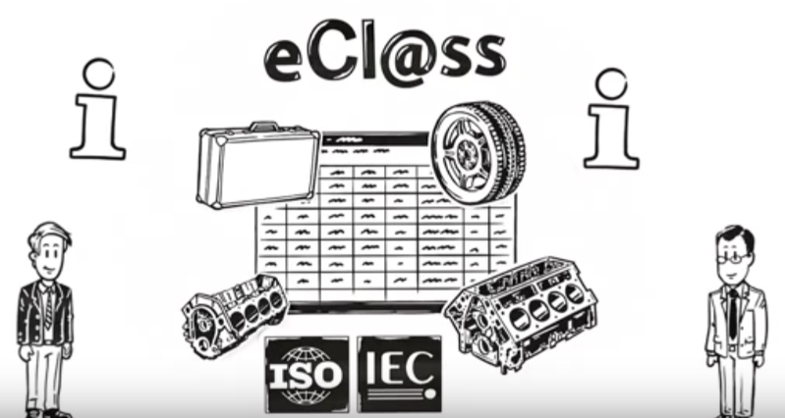
Engineering with Industry 4.0
Vendor enters
Product Information
Purchaser searches
Product Information
https://www.eclass.eu/
© e-Cl@ss.com
Suppliers and purchasers agree on parameter formats for a given “product class”
Purchasers use the system to streamline the purchasing process
Suppliers keep their product information updated so past/future customers can easily find the right product
Designers (and/or CAD programs) can automatically select and order parts.
Notes:
Product catalogs are evolving to allow more direct interaction with engineering design and maintenance systems. For example:
eClass is a new commercial service (website) that grew out of IEC and ISO standardized Product Class Libraries
Suppliers and purchasers agree on parameter formats for a given “product class”.
Extensive data is input by Suppliers, allowing full specification of their products.
Since eClass started recently in Germany, most companies participating are German. However, the benefits are clear for North America, using this system, and others like it.

Slide 13
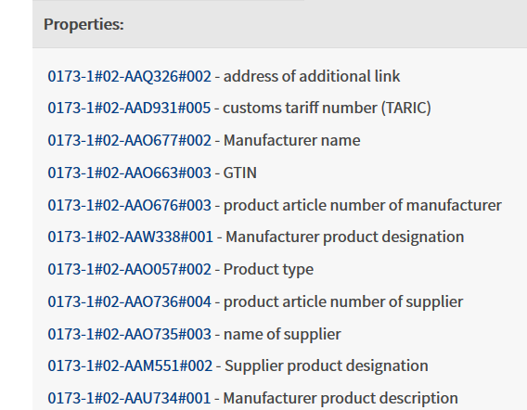
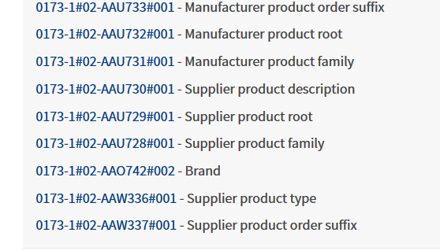
e-Cl@ss example
© e-Cl@ss.com
Notes:
Product Class Libraries exist for a large number of Process Industry Devices, for example:
This eClass PCL page is for “36-68-90-90 process analyzers”. It shows the first few parameters (of many hundred) that characterize analyzers in the IEC 61987 Product Class Library
With Bob Sherman’s help we are building Product Class naming and parameters for analyzers including
Sample Probes (inline and extractive),
samplers (grab and composite), and
analyzers (by technology)
These will be integrated with the IEC 61987 ontology, Fieldcom and FDI package standards
Purchasers will use the system to streamline the purchasing process (common digital spec sheets)
Vendors use the system to translate purchaser requirements to (standardized) product specifications and parameters.

Slide 14
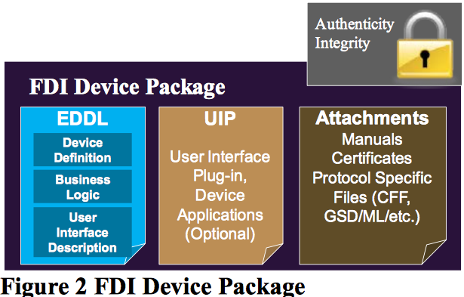
Each IID will Require an FDI Device Package
© Fieldcomm Group
Notes:
A key aspect of Industry 4.0 is direct communication between Field Devices (IIDs).
As a result, standards developed by Fieldcomm Group, which are designed to promote this communication, will be increasingly important.
FieldComm Group is a non-profit organization set up by major control and instrumentation suppliers.
FDI is an Important standard managed by Fieldcomm.
Each FDI Device Package contains 4 sections that define how it communicates with other IIoT devices:
Authentication Integrity (insures, like a “veri-signed device driver”, that the source is trusted, and the package is unchanged since it was sent)
EDDL – Standard defines device communication protocols
UIP – Optional Applications interface for the device.
Attachments (Manuals, Certificates, etc., in an authenticated and locked file.
Together, these Packages provide tens of megabytes of information on each IID

Slide 15
Take-away Messages
Industry 4.0 is a fundamental change whereby machines directly coordinate their operations with other machines.
We must distinguish between IoT, IIoT and “Cloud Services”
Make an Industry 4.0 Plan. If you don’t know where you are going, you probably won’t get there.
Industry 4.0 will impact all Enterprise Phases from Master Planning to Operations.
Industry 4.0 Plan must use existing plant Control and Information Architectures and practices, but it will also change them.
The selection of new Intelligent Device communication standards will be critical. These will probably also be industry-specific.
Cyber Security will be a “gating item” controlling the rate of adoption.
Online catalogs will bring major engineering and maintenance benefits.
Distribution of Industrial Intelligent Device information will be electronic, standardized, and massive.
Notes:
The following are the main “take-away messages from this MLM.
Industry 4.0 is a fundamental change whereby machines directly coordinate their operations with other machines.
We must distinguish between IoT, IIoT, and “Cloud Services”
Make an Industry 4.0 Plan. If you don’t know where you are going, you probably won’t get there.
Industry 4.0 will impact all Enterprise Phases from Master Planning to Operations.
Industry 4.0 Plan must use existing plant Control and Information Architectures and practices, but it will also change them.
The selection of new Intelligent Device communication standards will be critical. These will probably also be industry-specific.
Cyber Security will be a “gating item” controlling the rate of adoption.
Online catalogs will bring major engineering and maintenance benefits.
Distribution of Industrial Intelligent Device information will be electronic, standardized, and massive.

Slide 16

Background –Gary Rathwell
 | Gary has been president of Enterprise Consultants International (ECI) since 2000, offering master planning, project management and metrology services to industrial clients. He is also active in promoting PERA enterprise management concepts, and is working with international standards bodies, including ISA-108, ISA-S95, ISA-99, and IEC 61987, to develop industrial enterprise information and control standards. Gary has over forty years of experience in the automation and operation of process manufacturing facilities. He is experienced in the application of control and information systems for refineries, pipelines, oil fields, petrochemicals, plastics, and explosives. He has also been responsible for the design and implementation of 25 technical computing systems, including Engineering Information Systems (EIS) and Engineering Automation Systems (EAS), ranging from the second engineering CAD system in Canada to recent EIS and EAS systems implemented in world-scale remote projects with thousands of users.

