Slide 1



Analyzer Reliability and Security
MLM-084-C
Industry – Process Industry
Principal Role – All
Professional Role – Control Engineers +
Analyzer Specialists
Enterprise Phase – All
Turn on your audio and click start to begin video
Notes:
This MLM discusses reliability and cybersecurity measures for analyzers in process Industry plants.
It is intended for engineers and analyzer specialists who support these systems.
Click the START button when you are ready to advance to the next slide.

Slide 2
Where do Analyzers Fit in Plant Networks
TYPICAL PHYSICAL ARCHITECTURE
Internet or Private Cloud Servers and BIG DATA
CORP & DIVISIONAL
4
6 & 7
CORP & DIVISIONAL
ENG. &
Tablet
DP & MIS
TECH
Tablets
MAINT.
MANAGEMENT
LOCAL
5
G
LOCAL
G
OPC-UA
DP/MIS
PROPRIETARY
5
EIS/TECH
WIDE AREA NETWORK
R
PROTOCOLS
OFFICE
G
G
R
LAN
4
ALARM &
PROD'N
PROCESS
QUALITY
PRODUCT
E I S
(LOCAL)
2
ALERT
MGR
REPORT
HISTORIAN
MGT
TRACKING
& SCHED
SITEWIDE
R
INDUSTRIAL
G
G
LAN
3
POWER
PROCESS
PROCESS
TANK FARM
WAREH'SE
HOUSE
AREA 1
AREA 2
SUPRV
AUTOMAT'N
Tablet
SUPRV.
DCS HOST
DCS HOST
(OMMS).
.
FDI Host
3
OPER.
OPER.
OPER.
OPER.
PROPRIETARY
OPER.
FDI
2
DISP.
DISP.
DCS AND PLC
DISP.
DISP.
DISP.
NETWORKS
G
G
1
1
INTELLIGENT DEVICES, PLC’S, Analyzers, Instruments, etc.
Notes:
1) Analyzers may be connected to proprietary industrial networks along with PLCs, DCS, SCADA, and local HMIs
2) Manage Engineering and Smart device configuration on an Engineering Information System and use it to detect unauthorized changes
3) Industrial network protocols like FDI will require configuration management software on Engineering Workstations or local tablets
4) Analyzers may need remote support (from vendor or OEM). May even need access from “cloud service” process optimization (like UOP).
5) If so, will need STRONG cyber security to separate remote link from plant control networks.

Slide 3
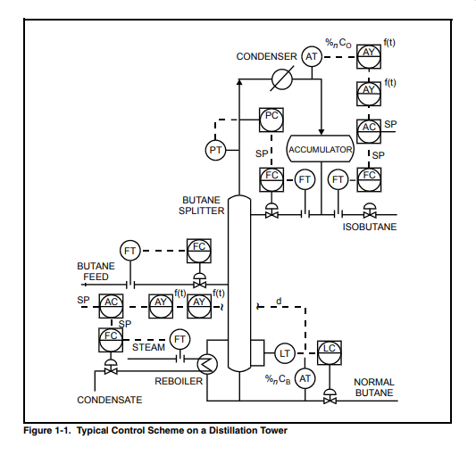

Analyzer Control System P&ID
(Process & Instrumentation Diagram)
Analyzer (%_{n} C_{O}) measures Isobutane in Distillation Column
(C_{O} = Overhead stream)
Analyzer (%_{n} C_{B}) measures Butane in Distillation Column
(C_{B} = Bottoms stream)
Together they are used to control the separation of Butane Feed into product streams that contain primarily Isobutane and Normal Butane
Notes:
Slide 5.
Analyzer Control System Process and Instrumentation Diagram.
This P&ID defines an example of a distillation separation process with the sensors and control loops shown. At the left, you see the butane feed, which goes to the butane splitter distillation column. This distillation column is one of the tallest in an oil refinery because of the difficulty of separating normal butane from isobutane.
The mixed butane feed is split into normal butane and isobutane in the distillation tower. Isobutane, being the lightest component goes to the top of the tower, and normal butane goes to the bottom.
An analyzer labeled "% CO" measures the % of Isobutane in the Column "Overhead" product. This analyzer is used to control the draw-off rate of the isobutane (the overhead product).
A change in this draw-off rate will, in turn, change the reflux rate to the top of the distillation column, and thereby the temperature of the upper distillation trays.
A second analyzer labeled "% CB" measures % of Normal Butane in the column "Bottom" product, and this is used to control the amount of heating steam that is fed to the reboiler at the bottom of the distillation column. This, in turn, changes the temperature in the bottom trays of the distillation column.
Together, these two analyzers control the separation of Isobutane and Normal Butane.

Slide 4
Control Response and Stability
1) The composition control loop Speed of Response and Stability of Control are influenced by:
Response time of each analyzer is 0.3 to several minutes
Response times of the process controller(s) and control valve(s)
2) Response time of each analyzer is influenced by:
Sample lag time in the sample line
Conditioning components and the analyzer may be 30 to 60 seconds
3) The total response time of the process to an operator action is influenced by:
Liquid and Gas Flow rates
Equipment sizes and piping configurations
Speed of response of the composition control loop
These responses may be modeled with a “transfer function” and stability analyzed with a “Bode Plot” (see references)
Notes:
Slide 8
Control response and stability.
1) The speed of response for this composition control loop, and the stability of control, are influenced by two considerations:
1) the response time of the two analysis systems, and
2) the response time of the physical process
2) Response time of the analysis systems is influenced by:
2a) the lag time in the sample transfer line from the process extraction probe to the sample conditioning system.
2b) the lag time in the components of the sample conditioning system
2c) the lag time in each analyzer from the analyzer inlet to the detector. Depending on the analyzer type, this could be from 0.3 seconds to several minutes.
3) The response time of the physical process is influenced by:
3a) liquid and gas flow rates through the process, and
3b) the size of the process vessels, equipment, and pipelines.
The response time of the physical process may vary widely, depending on the process scale and technology involved but is typically several minutes.
The response dynamics of the analysis system and the physical process may be modeled using a transfer function. The stability of this transfer function can be analyzed with a Bode plot or other mathematical techniques. See reference texts at the end of this module.
However, for typical plant work, the analysis system response is much faster than the process response. Thus, these stability analysis techniques are not required for analyzers. Analyzer designers will, however, try to minimize the analysis system lag times to make control as responsive as possible. Process engineers, however, may utilize the transfer function and Bode plots to optimize the performance of the process system, and in rare cases, the analysis system stability.
A continuous spectrometer, such as a Raman process analyzer, will give a value in tenths of a second for a single-phase, single component mixture. An analyzer such as a gas chromatograph or a Raman on a multi-phase multi-component sample might give a response time of several seconds. During this time, however, the gas chromatograph may be doing one measurement while the Raman does hundreds of measurements, averages them, and delivers a result that is statistically more representative.

Slide 5




Control Response and Stability (continued)
This shows a “step change” in the concentration of feed to a process. This may result in one of the following charts of process output concentration.
If analyzer response time is “faster” than the process response time, controllers may stabilize control with only a 25% overshoot.
If total analysis response time is long relative to the process response time, controller must be “detuned” resulting in sluggish loop response.
If input concentration change is too large, or control loop gain is too high, instability may occur.
Conc. Feed
Time
Off Spec
Conc. Out
Time
Conc.
Off Spec
Time
Conc.
Shutdown
Time
Notes:
Slide 9
Control response and stability (continued).
On the right, you see four charts that show the process response that an operator may see on a chart recorder or DCS screen.
Chart 1 - shows a “step change” in the process feed concentration that will result in various product changes, depending on the relative dynamics of the analyzer and process response times.
Chart 2 - If the analyzer response is faster than the process response time, the control system may stabilize the process.
Chart 3 - If the total analyzer response time is too long relative to the process response time, the process may change while the analyzer develops that signal. In this case, the control system must be “detuned,” resulting in a sluggish response to control the process.
Chart 4 - If the input concentration change is too large, or if the control loop gain is too high, instability may occur despite the best efforts of the analysis and control systems. This might result in the graph on the right where you see a drop in product concentration quickly corrected by the control system. However, it then overshoots high, and then overshoots low, then high and then right off the bottom of the chart, causing the process to “trip”. Manual control actions must then be taken to get the process back in control.

Slide 6
Communication Protocols & Industrial Standards
(new Standards in Red)
● Engineering
Design Data
PFD, P&ID,
BPCS & SIS
Lists, Control
Narratives, etc.
● ISA S20
Spec Sheet
Forms with
Data Fields
● ISA S108
Configuration
Data File with
Data Fields
Enterprise Management System (EMS)
Engineering Information System (EIS)
Maintenance Management System (MMS)
Other EMS subsystems
Source
Destination
Data Standards:
● ISA S20, ISA 95
● ISA S108
Communication Technologies:
● FDI (EDD, FDT-DTM), OPC/UA
● FieldComm (standardized
Fieldbus, Profibus, Hart, Modbus,
etc.)
Data Exchange Standards:
● ISO 15926 Part 8 –Exchange
Data
● IEC 61987- Industrial process
measurement & control devices
● CFIHOS Hand-over Standard
Notes:
New Data Formats, Communications Technologies, and Data Exchange standards are evolving to move data from design databases to plant operations including EMS, EIS and MMS.

Slide 7
Configuration Management will be Needed
End Design/Spec Sheets
Based on ISA 20/IEC 61987 +
Special Vendor Config Param
IAMS
DCS / SCADA
Instrument Configuration Parameters + Vendor Documentation
Instrument Configuration Parameters + Vendor Documentation
Initial Design or Engineered
Change
“Gold Standard” Approved
Data Repository
Field Device
Class Libraries of smart instruments + Class Level Documentation +
Physical Device Parameters +
Configuration Parameters +
Special Vendor Config. Parameters
Instrument &
Analyzer Configuration Parameters
MoC
Gateway
Hand-Held
Data
Comparison
Red = New technologies
Discrepancy
Report
Notes:
Secure Configurations Management systems are becoming essential to reliable and secure plant operations.
These typically hold design parameters and accomplish programming and download of changes. They also provide “Management of Change” functions and maintain a “golden copy” of the approved configuration and/or programs contained in field devices including instrumentation, analyzers, PLCs and industrial networks.
They also compare programs installed with the Golden Copy and may manage part numbers and software versions including comparison with bulletins about known bugs and cyber vulnerabilities.

Slide 8
Cyber Security is Essential
Cyber Security will be a major factor in the rate of adoption of Online Analyzers
Smart instruments are cheap and powerful, but vulnerable.
Remote access and “fleet support” is inevitable but dangerous.
Protect Smart Analyzers from the 5 Attack Vectors
Physical access may allow compromise of any software.
Co-manage Network and Wireless threats with Plant IT and Instrument Engineers
Manage Supply Chain (Specification and Configuration) with the Instrument/Analyzer Engineer. 30 Mb per device ! Checksums.
Control access by portable devices with Instrument Maintenance and IT.
Five Main Attack Vectors
Notes:
As examples of these attack vendors, cyber criminals could:
Steal money by adjusting flow meter and/or quality parameters during a transfer.
Influence the stock price of a competitor by causing a major environmental release (perhaps at a critical time)
Hold required quality data hostage (e.g. by encrypting data)

Slide 9
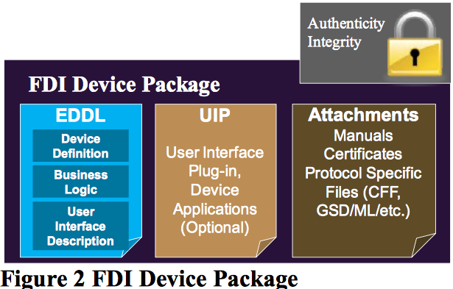
Each IID will Require an FDI Package
© Fieldcomm Group
Notes:
A key aspect of Industry 4.0 optimization is direct communication between Intelligent Industrial Devices (IIDs).
As a result, standards developed by Fieldcomm Group, that are designed to promote this communication, will be increasingly important. FieldComm Group are a non-profit organization set up by major control and instrumentation suppliers.
FDI is an Important standard managed by Fieldcomm.
Each FDI Device Package contains 4 sections that define how it communicate with other IIoT devices:
Authentication Integrity (insures, like a “veri-signed device driver”, that the source is trusted, and the package is unchanged since it was sent)
EDDL – Standard defines device communication protocols
UIP – Optional Applications interface for device.
Attachments (Manuals, Certificates, etc., in a Authenticated and locked file.
Together, these Packages provide tens of megabytes of information on each IID

Slide 10
Key “Take-away” Messages
Analyzers must fit within existing plant Control and Information Architectures, and Engineering & Maintenance practices
The selection of new Intelligent Device communication standards will be critical, particularly around communications.
Cyber Security will be a “gating item” controlling the rate of adoption.
Distribution of Industrial Intelligent Device information will be electronic, standardized, and massive.
  Please click here to provide feedback on this MLM.
https://creativecommons.org/licenses/by-sa/4.0/
Notes:
The following are Key Messages to “take away”
Analyzers must fit within existing plant Control and Information Architectures, and Engineering & Maintenance practices
The selection of new Intelligent Device communication standards will be critical, particularly around communications.
Cyber Security will be a “gating item” controlling the rate of adoption.
Distribution of Industrial Intelligent Device information will be electronic, standardized, and massive.

Slide 11

Author
 | Gary is president of Enterprise Consultants International (ECI) since 2000, offering master planning, project management and metrology services to industrial clients. He is also active in promoting PERA enterprise management concepts, and is working with international standards bodies to develop industrial enterprise information and control standards. Gary has over forty years experience in the automation and operation of process manufacturing facilities. He is experienced in the application of control and information systems including; Site-Wide Process Optimization, Complex Batch Operations and many process analyzer systems including a custody transfer analyzers and approximately 100 Power Plant Continuous Emissions Stack Monitoring Systems (CEMS). He has also been responsible for design and implementation of 25 technical computing systems including Engineering Information Systems (EIS), and Engineering Automation Systems (EAS) ranging from the second engineering CAD system in Canada, to the latest EIS and EAS systems implemented in world-scale projects with thousands of users.

