Slide 1
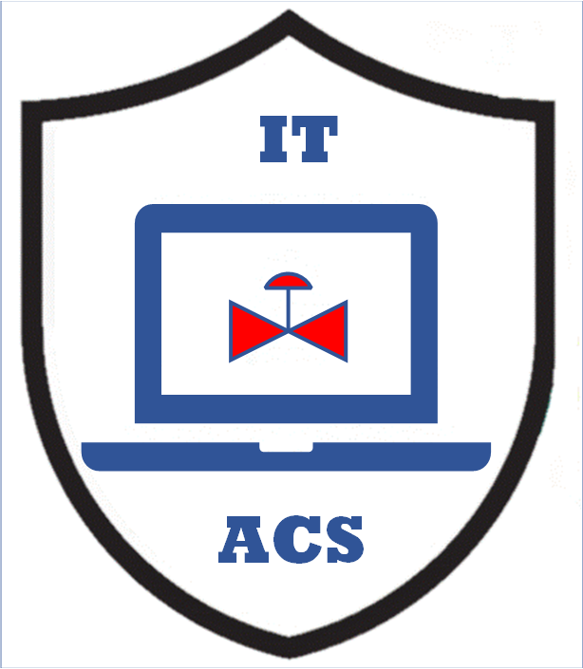


Secure Analyzer Gateways
And
Remote Operations Centers
MLM-085-B
Industry – All
Principal Role – All
Professional Role – Analyzer Specialists +
Control Engineers
Enterprise Phase – All
Turn on your audio and click start to begin video
Notes:
This MLM provides an introduction to the use of Secure Analyzer Gateways and Remote Operations Centers
It is intended for Online Analyzer Specialists, design and plant Control Engineers.
Click the START button when you are ready to advance to the next slide.

Slide 2
What is a Secure Analyzer Gateway ?
A standardized device that interfaces with sophisticated analyzers, enabling:
  Secure remote support by analyzer integrator or supplier
  AI-based device monitoring and reporting
  Secure communication interface for site optimizers
  Secure communication interface for Quality Laboratory
  Local interface for operators and maintenance staff.
Notes:
A Secure Analyzer Gateway is a standardized device that interfaces with sophisticated analyzers and enables:
Secure remote support by the analyzer integrator or supplier
AI-based device monitoring and reporting
Secure communication interface for site optimizers
Secure communication interface for the Quality Laboratory
Local interface for operators and maintenance staff.

Slide 3
Why are Secure Analyzer Gateways Needed ?
Secure Analyzer Gateways are needed to provide more effective maintenance and optimization support. This is because:
Gas Chromatographs have slower response times (often several minutes) and are difficult to maintain.
New, faster, lower-cost analyzers, including UV and Infrared Spectrometers, Raman, and Mass spectrometers, require even more sophisticated design and support staff.
More sophisticated analyzer models and optimization algorithms are required to effectively use the results of existing and improved analyzers.
Increased cybersecurity requirements make remote maintenance and optimization support difficult or impossible.
Notes:
Secure Analyzer Gateways are needed to provide more effective maintenance and optimization support. This is because:
Gas Chromatographs have slower response times (often several minutes) and are difficult to maintain.
New, faster, lower-cost analyzers, including UV and Infrared Spectrometers, Raman, and Mass spectrometers, require even more sophisticated design and support staff.
More sophisticated analyzer models and optimization algorithms are required to effectively use the results of existing and improved analyzers.
Increased cybersecurity requirements make remote maintenance and optimization support difficult or impossible.

Slide 4
Secure Analyzer Gateway (SAG)
Standard SAG Features:
Modular commodity “edge devices”
Supports many Analyzer Interfaces
OPC UA, MQTT, Modbus, and Ethernet TCP/IP communication protocols
Supports common PLCs for process optimization
Communicates to Central Analyzer Remote Operations Center (ROC)
Certified Cybersecurity
MQTT
Remote Operations Center (ROC)
Internet
MQTT (data diode)
Secure Analyzer Gateway
(SAG)
PLCs
(for Sampling & Process Optimization)
Ethernet
Modbus
Analyzer Interface
Online Analyzer Local HMI
Notes:
Secure Analyzer Gateways require the following standard features:
Modular commodity “edge devices”
Supports many Analyzer Interfaces
OPC UA, MQTT, Modbus, and Ethernet TCP/IP communication protocols
Supports common PLCs for process optimization
Communicates to Central Analyzer Remote Operations Center (ROC)
Certified Cybersecurity

Slide 5
Typical Multi-site Company Configuration
Analyzer Remote Operations Center
(ROC)
Internet or Private Networks
MQTT
One Way
Data Link
MQTT
MQTT
MQTT
Secure Analyzer Gateway (SAG)
Secure Analyzer Gateway (SAG)
Secure Analyzer Gateway (SAG)
Secure Analyzer Gateways
support Modbus, Ethernet
& MQTT interfaces
Fieldbus
Modbus
Ethernet
Raman Analyzer &
Local HMI
InfraRed Analyzer &
Local HMI
Raman Analyzer &
Local HMI
Multiple analyzer systems
Notes:
Local SAG systems support Modbus, Ethernet and other Fieldbus Interfaces to Analyzers and HMI.
Remote connections to ROC support MQTT interfaces
Maintenance support and troubleshooting, operating information and optimization is shared across multiple company facilities.

Slide 6
Example Large Process Plant Site Configuration
Multiple similar Analyzers with OPC UA Interfaces
Requires SAG support of OPC UA, MQTT, and Ethernet TCP/IP
Analyzer Remote Operations Center
Internet
Instrument &
Analyzer Maint
System (IAMS)
Process Optimizer
Model(s)
MQTT
One Way
Data Link
Secure Analyzer Gateway (SAG)
Secure Ethernet Network
Quality
Laboratory
Process
Data Historian
OPC UA
Existing Industrial Network
OPC UA
OPC UA
OPC UA
Online Analyzer Local HMI
Online Analyzer Local HMI
Online Analyzer & Local HMI
Notes:
Large company sites may require:
SAG support of OPC UA, MQTT, and Ethernet TCP/IP interfaces
Support for existing Sitewide Industrial Networks
Interfaces with Process Data Historians and/or Quality Laboratory
Interfaces to Engineering and Process Optimizer Models
Interfaces to Instrument and Analyzer Maintenance Systems

Slide 7
Remote Operations Center (ROC)
Supports multiple analyzer systems, including Analyzer Diagnostics, Reporting, Analyzer FFT and Loop Optimizers, Data Historian, and a test/development system.
Internet
Analyzer Reporting (AI)
Analysis Loop Optimizer
Central Analyzer Archive Server
Analyzer Diagnostics (AI)
Analyzer FFT Model
IAMS
(Maint Mgt)
Firewall
Office Network
Security System
Site 1
Site 2
Site 3
Secure Analyzer Remote Support
Secure Analyzer Remote Support
Secure Analyzer Remote Support
Test & Development SAG
Secure Analyzer Gateway (SAG)
Test
PLC
Process
Data Historian
Process
Data Historian
Process
Data Historian
Online Analyzer Local HMI
Notes:
Remote Operations Center (ROC)
An ROC can improve production, maintenance, and support across multiple Process Units and Plant Sites.
This involves interfaces to the following:
Multiple Process Analyzer Types,
Multiple analyzer controllers (perhaps with Local HMIs),
Multiple human-machine interface systems (eg., a DCS or SCADA host).
Process Plant Optimization Mathematical Models, and
A central analyzer maintenance system to monitor analyzer performance and reliability.
It may also be desirable to support the Analyzer Systems, Process Plant Optimizers, and Analyzer maintenance using local plant and/or remote expert staff.
Note that remote support capability will require special cybersecurity precautions for personnel, including Zero Trust access.

Slide 8
Key “Take-away” Messages
More sophisticated analyzers can bring dramatic improvements in process quality and throughput
AI tools can provide process optimization strategies such as model-based control and multi-unit integration
New analyzers often require advanced mathematical models that can be difficult to maintain and support at plant sites.
Any changes in raw materials, process facilities, or operations may require modification of analyzer control or process optimization models.
Certified SAG H/W, S/W, and MQTT Protocol support many architectures
Cybersecure remote support is practical and profitable, but requires carefully planned design and operation strategies
Notes:
Key messages include:
More sophisticated analyzers can bring improvements in process quality and throughput but need remote support
AI tools can provide process optimization strategies such as model-based control and multi-unit integration
New analyzers often require advanced mathematical models that can be difficult to maintain and support at each plant site.
Any changes in raw materials, process facilities, or operations may require modification of analyzer control or process optimization models.
Certified SAG H/W, S/W, and MQTT Protocols support existing and future architectures
Cybersecure remote support is practical and profitable, but requires planned design and operation strategies

Slide 9

Author
Gary has more than 40 years of experience with enterprise integration and optimization projects, including PERA master planning and project management.
As one of the initial authors of the PERA Handbook of Master Planning, he has used PERA Enterprise Architecture and Master Planning methodologies throughout his career including control and information systems for oil production, pipelines, refining and marine loading, petrochemicals, coal, gas, and oil-fired power plants, polyethylene, ammonia, explosives, paint, pulp and paper, food and beverage, and pharmaceuticals. LNG facilities included world-scale arctic, European, and US Gulf coast complexes.
Secure infrastructure facilities included SOC and Emergency Response systems for major industry and municipal facilities, as well as emissions reporting and trading systems for more than 100 US Power Plants.

