Slide 1
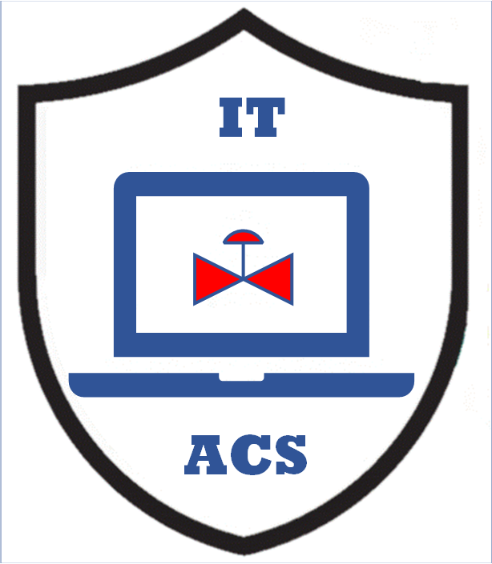


Plant AI and Human Interfaces
MLM-091-A
Industry – Generic Process Industry
Principal Role – Owner + EPC
Professional Role – Control Engineer
Enterprise Phase – Design & Operations
Turn on your audio and click start to begin video
Notes:
This MLM describes how Artificial Intelligence (AI) and Human beings may be interfaced in Process Plants. The intended audience is Engineers and Technicians who may encounter AI in their work.

Slide 2

An Enterprise Consists of 3 Major Components
These components are: People, Facilities and Systems, and each have interfaces with the other two.
Automation is the process of reducing the role of People in the Enterprise and thereby increasing the role of Control & Information Systems and Facilities equipment. However, the degree of automation that is implemented is a conscious design decision (usually based on a cost/benefit or safety analysis).
Notes:
An enterprise consists of three major components
People and Organizations People
Production Facilities and Control and Information Systems.
Each of these have interfaces with the other two, across which information must flow.
Automation is the process of reducing the role of People in the Enterprise and thereby increasing the role of Control & Information Systems and Facilities equipment. However, the degree of automation that is implemented is a conscious design decision (usually based on a cost/benefit or safety analysis).

Slide 3

Line of Automation
This requires establishing a “Line of Automation” between the maximum and minimum feasible level of automation between
People and Equipment, and
People and Control & Information Systems
There are thus two ”Lines of Automation”:
Replacing people with conveyors, robots or other equipment.
Replacing people with control and & information systems.
Notes:
This requires establishing a “Line of Automation” between the maximum and minimum feasible level of automation between
People and Equipment, and
People and Control & Information Systems
There are thus two ”Lines of Automation”:
Replacing people with conveyors, robots or other equipment.
Replacing people with control and & information systems.

Slide 4
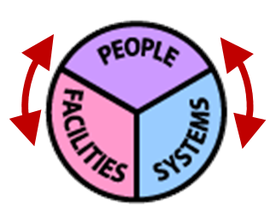
When is the Line of Automation Established?
The Line Automation is established early in the design, typically during the Preliminary Engineering Phase.
Lines of automation are important because most problems and errors occur at human interfaces with control systems and facilities.
Where the lines of automation are established is important because most problems and errors occur at human interfaces
Notes:
The Line Automation is established early in the design, typically during the Preliminary Engineering Phase.
Lines of automation are important because most problems and errors occur at human interfaces with control systems and facilities (red arrows).
It should be recognized that the introduction of AI in the human interface to control and Information systems or plant facilities may have major consequences.

Slide 5
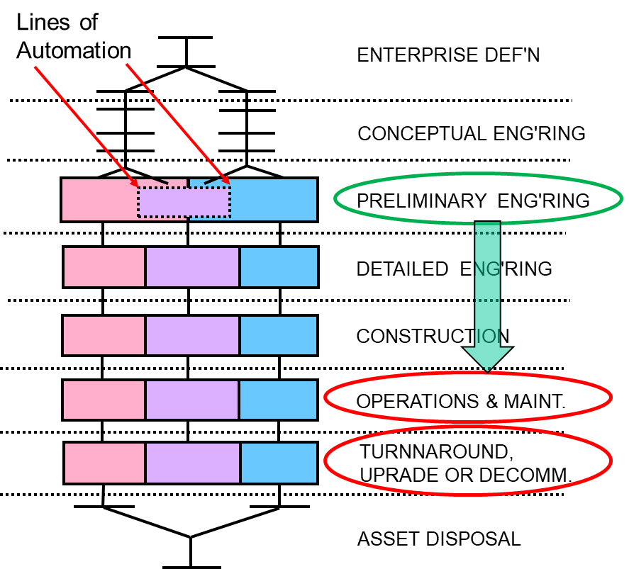
Line of Automation has a Major Effect on Design
The Line Automation is typically established during the Preliminary Engineering Phase. After this, Detail Engineering & Construction develop the facility based on this.
However, if a “simple” replacement of Human Activities by AI Agents or Humanoid Robots is introduced during Operations or Maintenance, the analysis and documentation done during Detail Engineering, Procurement, and Construction should be repeated.
Where the lines of automation are established is important because most problems and errors occur at human interfaces
Notes:
The Line Automation is typically established during the Preliminary Engineering Phase, but may be revised during Operations, Maintenance Turnaround, or Upgrades.

Slide 6
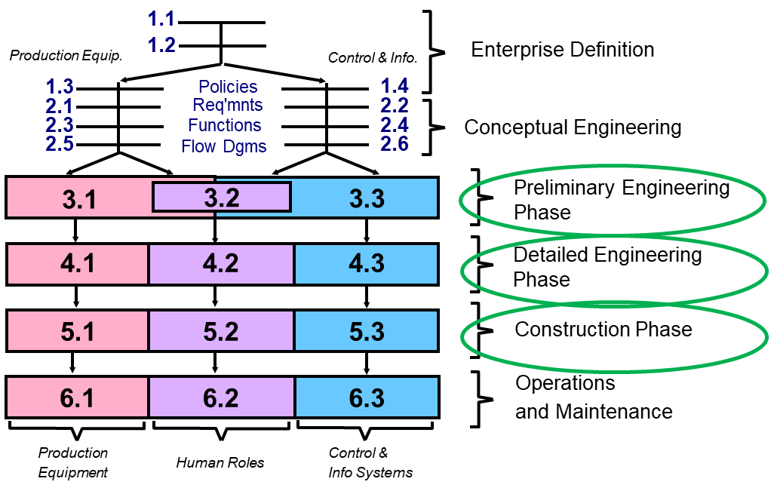
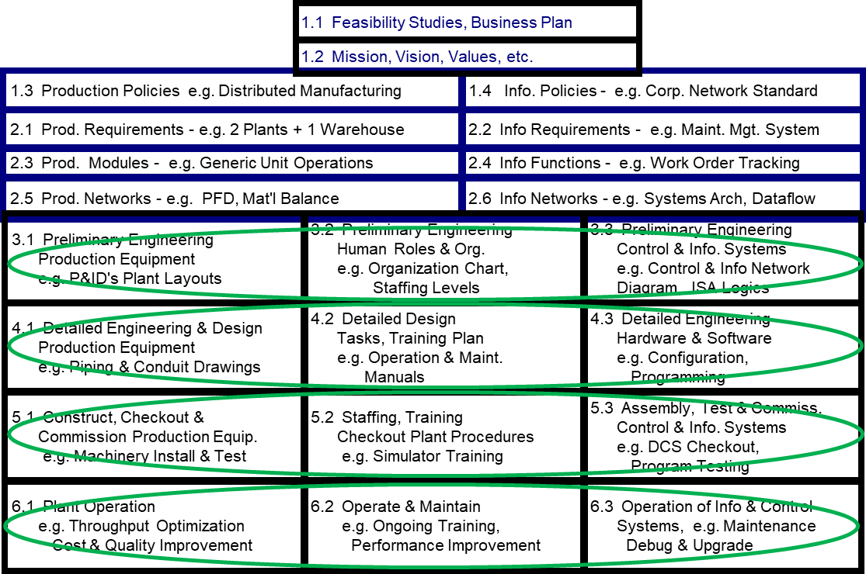
Changes in Human Roles have Major Effects on the Entire Design
The amount of effort (shown in green) involved in changing the role of humans can be very substantial!
Where the lines of automation are established is important because most problems and errors occur at human interfaces
Notes:
Hazard and risk assessment (H&RA) allows the identification of hazardous events and assessment of risk for the control of which requirements are elicited for safety-related systems. These requirements included in a specification for the safety-related systems form the baseline of the safety strategy for the identified risks.
Cybersecurity requirements, however, ensure that, when possible, the operational environment, including safety-related systems, provides suitable security countermeasures based on the known threats and vulnerabilities of the system at the time.
As a result, cybersecurity risk evolves as new threats materialize, new threat vectors and surfaces are discovered and new vulnerabilities are exploited, which may lead to the need for revised security countermeasures, whereas safety requirements remain reasonably stable between modifications to the system.

Slide 7
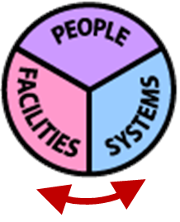
Speed of Interfaces has a Major Effect on Control
We have learned that as the Response and Resolution of the interface between facilities and control systems is improved, a dramatic improvement in the quality of control is possible.
This is related to the stability of control loops (see Bode Plots), but the same mathematics applies to the Response & Resolution of any interface.
Where the lines of automation are established is important because most problems and errors occur at human interfaces
Notes:
We have learned that as the Response and Resolution of the interface between facilities and control systems is improved, a dramatic improvement in the quality of control is possible.
This is related to the stability of control loops (see Bode Plots), but the same mathematics applies to the Response & Resolution of any interface.
Thus, if the AI response is improved (compared to humans), the whole process may run better !

Slide 8
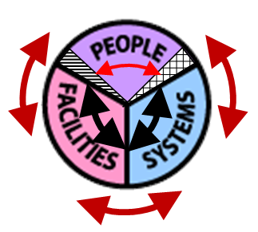
Artificial Intelligence Introduces new Human Interface Problems
The new AI interfaces (shown as black arrows) may be faster and better than a human.
For example, an AI Agent might communicate with a control system at millions of Bits Per Second (BPS); while an Operator with a screen and keyboard might manage only a few BPS.
This also changes the interface for human operators (crimson). Traditional user interfaces to Control and Information systems and to plant equipment have evolved over many years and are thoroughly understood and well-documented. However, the reliability, Response, Resolution, and Repairability of new AI interfaces may not be known, and may even be unpredictable.
Where the lines of automation are established is important because most problems and errors occur at human interfaces
Notes:
The new AI interfaces (shown as black arrows) may be faster and better than a human.
For example, an AI Agent might communicate with a control system at millions of Bits Per Second (BPS);
while an Operator with a screen and keyboard might manage only a few BPS.
Similarly, an AI agent monitoring network traffic might detect and respond to an intrusion more quickly than a human.
This changes the interface for human operators (crimson). Traditional user interfaces to Control and Information systems and to plant equipment have evolved over many years and are thoroughly understood and well-documented in plant design. However, the reliability, Response, Resolution, and Repairability of these new AI interfaces may not be known and may even be unpredictable.

Slide 9
Artificial Intelligence Introduces new Human Interface Problems
?
As the role of AI Agents and Humanoid Robots increase, humans must find a way to understand what is happening, as interfaces that are hundreds of times faster, more accurate, and eventually more intelligent, take over.
Where the lines of automation are established is important because most problems and errors occur at human interfaces
Notes:
As the role of AI Agents and Humanoid Robots increase, humans must find a way to understand what is happening, as interfaces that are hundreds of times faster, more accurate, and eventually more intelligent, take over.

Slide 10
Key Messages
The Line of Automation must be carefully considered and documented during the Preliminary Engineering Phase and later whenever human roles are changed.
Operating procedures have evolved over many years to ensure that operators can always intervene to maintain safe operations. There can be serious unintended consequences when the role of the Plant Operator is modified.
At the very least, AI agents or humanoid robots must inform the operator “after the fact” of any initiative that was taken, and the reasons for its actions.
It has been suggested that truthfulness must be the first law of AI. (Elon Musk).
Notes:
The Line of Automation must be carefully considered and documented during the Preliminary Engineering Phase and during any subsequent Phase whenever human roles are changed.
Operating procedures have evolved over many years to ensure that operators can always intervene to maintain safe operations. There can be serious unintended consequences if the role of the Plant Operator is modified
At the very least, AI agents or humanoid robots must inform the operator “after the fact” of any initiative that it has taken and the reasons for its actions.
It has been suggested that truthfulness must be the first law of AI. (Elon Musk).

Slide 11
More Reading
Related MLMs:
MLM-090-A An Engineer’s View of AI.
MLM-090-B AI Applications in Process Industry.
References
ISA TR84.00.09-2017, ‘Cybersecurity Related To The Functional Safety Lifecycle’
IEC PAS 63325 Ed1, ‘Lifecycle Requirements for Functional Safety and Security of IACS’
Notes:
:

Slide 12

Author
Gary has more than 40 years of experience with enterprise integration and optimization projects, including PERA master planning and project management.
As one of the initial authors of the PERA Handbook of Master Planning, he has used PERA Enterprise Architecture and Master Planning methodologies throughout his career including control and information systems for oil production, pipelines, refining and marine loading, petrochemicals, coal, gas, and oil-fired power plants, polyethylene, ammonia, explosives, paint, pulp and paper, food and beverage, and pharmaceuticals. LNG facilities included world-scale arctic, European, and US Gulf coast complexes.
infrastructure facilities included Fire, Police, and Emergency Response systems for major US cities, as well as emissions reporting and trading systems for more than 100 US Power Plants,
https://creativecommons.org/licenses/by-sa/4.0/
Please click here to provide feedback on this MLM.
Notes:
Gary has more than 40 years of experience with enterprise integration and optimization projects, including PERA master planning and project management.
As one of the initial authors of the PERA Handbook of Master Planning, he has used PERA Enterprise Architecture and Master Planning methodologies throughout his career including control and information systems for oil production, pipelines, refining and marine loading, petrochemicals, coal, gas, and oil-fired power plants, polyethylene, ammonia, explosives, paint, pulp and paper, food and beverage, and pharmaceuticals. LNG facilities included world-scale Arctic, European, and US Gulf coast complexes.
infrastructure facilities included Fire, Police, and Emergency Response systems for major US cities, as well as emissions reporting and trading systems for more than 100 US Power Plants,

